Slide 1
EXCHANGE STUDIES Master’s programme in Bioentrepreneurship
Giulia Grillo Mikrut
International coordinator

Slide 2
TODAY’S PROGRAM:
General presentation of exchange studies
The application process
Official nomination vs. freemovers
Q&A about exchange studies

Slide 3
EXCHANGE STUDIES
Karolinska Institutet has bilateral agreements with approximately 150 universities worldwide
Our partner universities are located within Europe and outside of Europe
The exchange period depends on where you decide to travel to but generally lasts one semester
It is a good idea to already now start reading some travel reports if interested in exchange studies later on in your studies

Slide 4
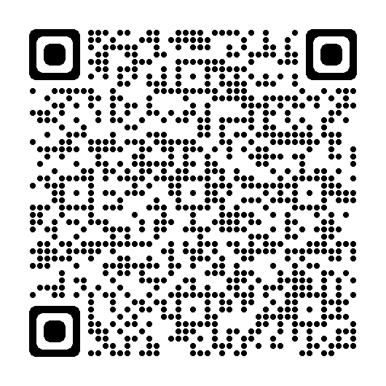
Exchange agreements at KI

Slide 5
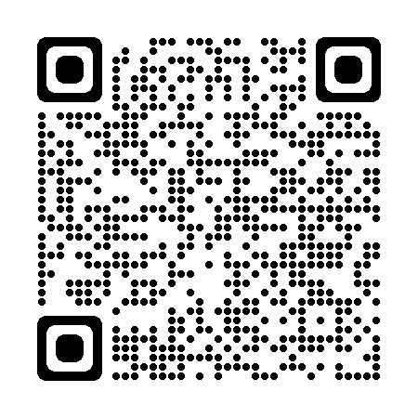
Study abroad

Slide 6
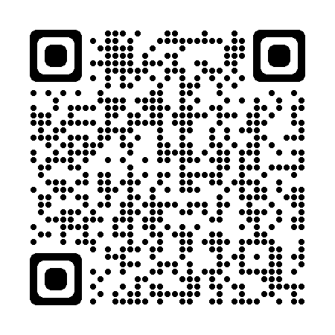
TRAVEL REPORTS

Slide 8
Where can you go?

Slide 9
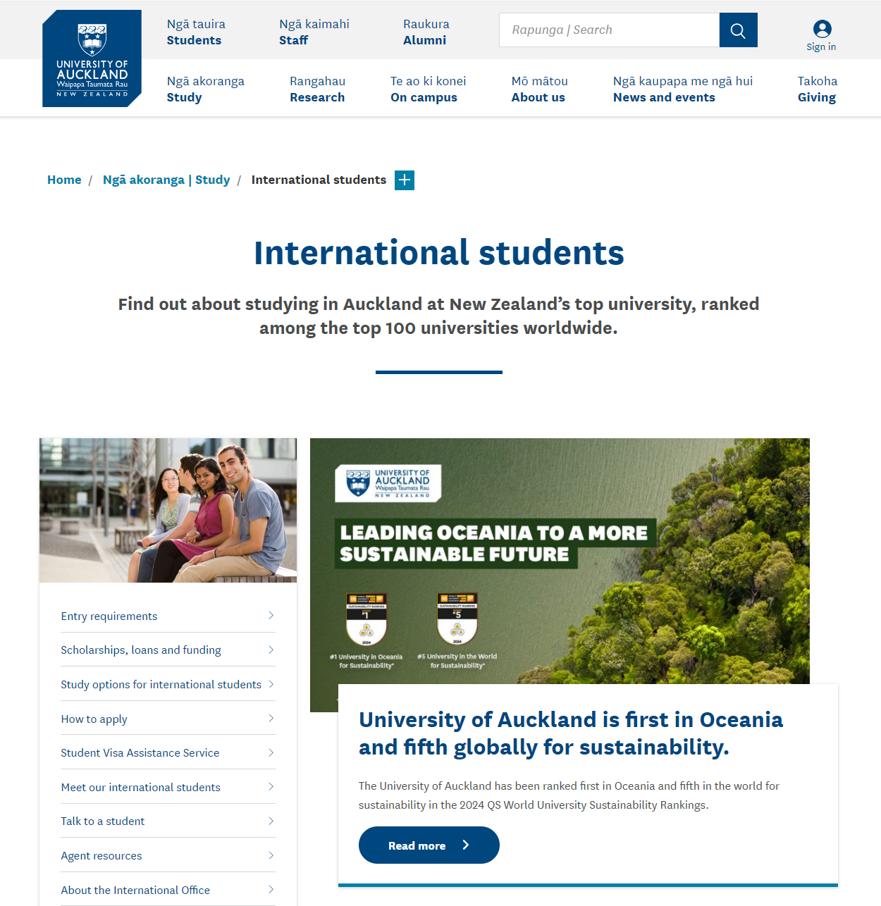
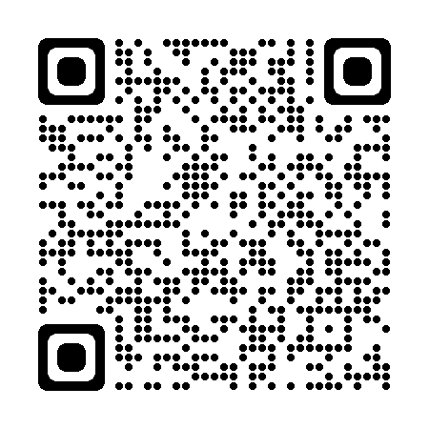

Slide 10
Eligibility
To be nominated for exchange studies in semester 4 the student must have 60 ECTS from semester 1 and 2 and be registered for semester 3 on September 15
Two students can apply to go to Auckland in semester 4, for their Master's thesis, to do their project. However, a large part of the students spend either the practical placement 2 course and/or the Master's thesis as "freemovers" in companies/organizations abroad.

Slide 11
Application process:
Application
Deadline:
Friday January 26 2024
11.00 AM
Second round of applications: 7 June 2024
Nomination mail
If nominated, accept the nomination before deadline
Application to Partner University
Please contact your international coordinator when you receive your letter of acceptance. The international coordinator will then provide the stipend application and will issue your insurance certificate and insurance card
The international coordinator will officially nominate you to our partner
You will then apply directly to our partner university.

Slide 12
Is it Difficult to be Nominated to Exchange Studies?
BASIC REQUIREMENTS
The programme has set a number of selection rules for exchange studies within the Master´s Programme in Bioentrepreneurship. You must meet a number of these basic requirements:
Study Results: your competence to continue your studies at KI at the time of your departure.
CV
Good Ambassador: you have to be a good ambassador for KI. As an exchange student from KI, you will be representing KI at the host university.
Motivation letter: your statement should demonstrate that you are motivated to study abroad, and if applicable provide evidence of interest in a particular course, university, country etc.

Slide 13
How do I apply?
(Only for exchanges to Auckland)

Slide 14
APPLICATION FORM:
Mobility Online
Entire application online
All attachments are uploaded in the system (CV, Transcript of records and motivation letter)
If you claim research experience you must submit a signed supporting document from your supervisor in order to be considered for possible extra points in your application assessment.

Slide 15
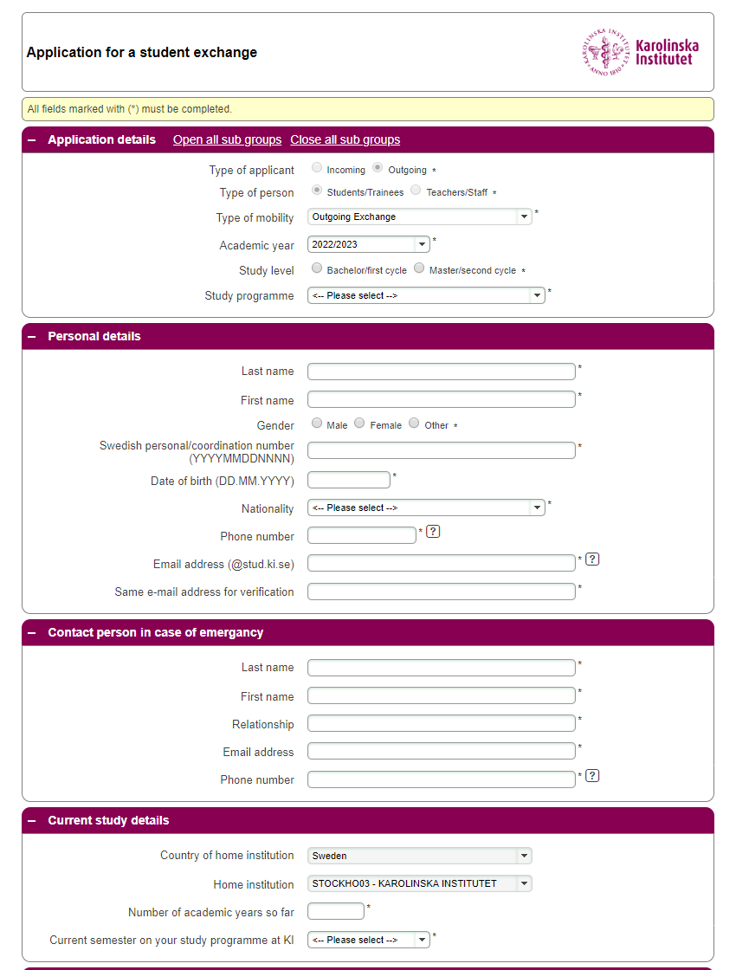

Slide 16
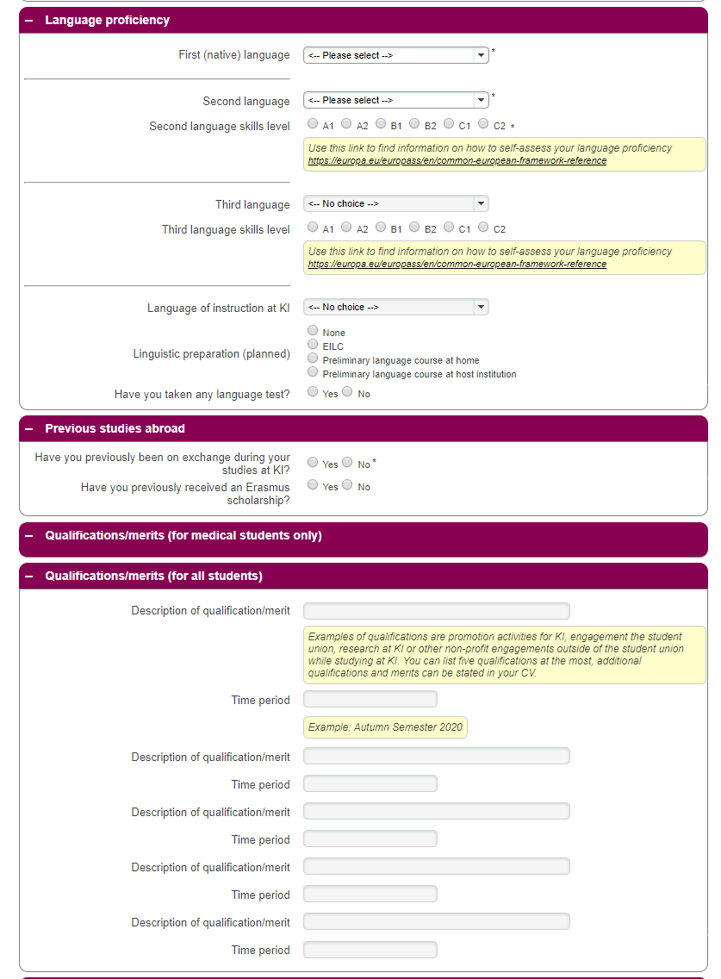

Slide 17
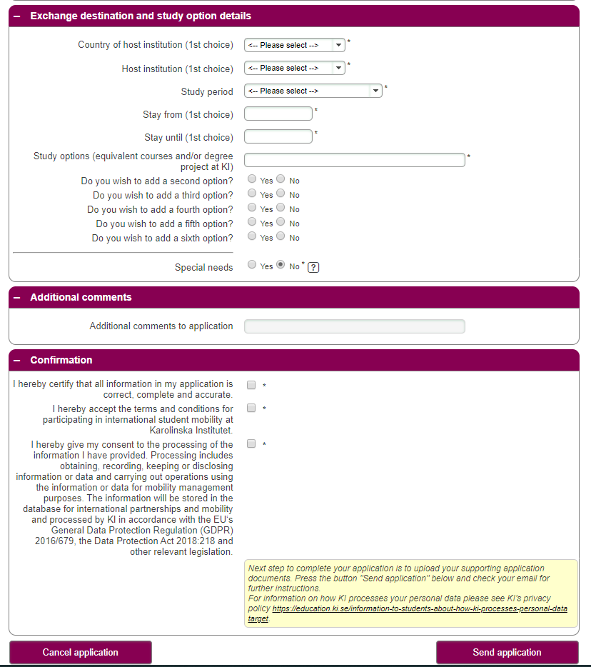

Slide 18
Submission of application
After registering your application you will receive an email from Mobility Online
Please create your account
Upload all the relevant documents
Submit the application
The application is finalized only when you have uploaded all the necessary documents and the application has been submitted

Slide 19
Selection, ranking and nomination mail
After the application deadline, the international committee will meet to assess all the incoming applications.
All students will be ranked and based on this ranking we will select the two highest ranked students to be nominated to the University of Auckland
If not nominated, you will receive confirmation in writing from the international coordinator
Please accept/reject your nomination within the deadline stated in the nomination email
If you accept your nomination, the international coordinator will nominate you to the University of Auckland and you will begin a separate correspondence with Auckland that will result in a Letter of Acceptance
If any places are available later in the Spring semester, these will be announced in our second round of applications (deadline 7 June 2024)

Slide 20
Letter of acceptance
When all the paper work is finalized, our partner will send a Letter of Acceptance to our student. In this letter our partner will state the exact dates of your exchange. Until you have this paper you shouldn’t make any travel arrangements because it means you are yet to be officially accepted at the university abroad.
When you have received the Letter of Acceptance get in contact with your international coordinator who will issue your insurance certificate and insurance card. You are insured two weeks before and after your exchange period in the country where your exchange will take place and on your way there and back.
Your international coordinator will also send you the stipend application and the Code of Conduct for exchange studies.
You will also receive an invitation to follow our mandatory preparatory online course, PREPARE (Canvas)
As officially nominated student, you will also receive an invitation to our kick-off later on in the Autumn semester together with all outbound students at KI

Slide 21
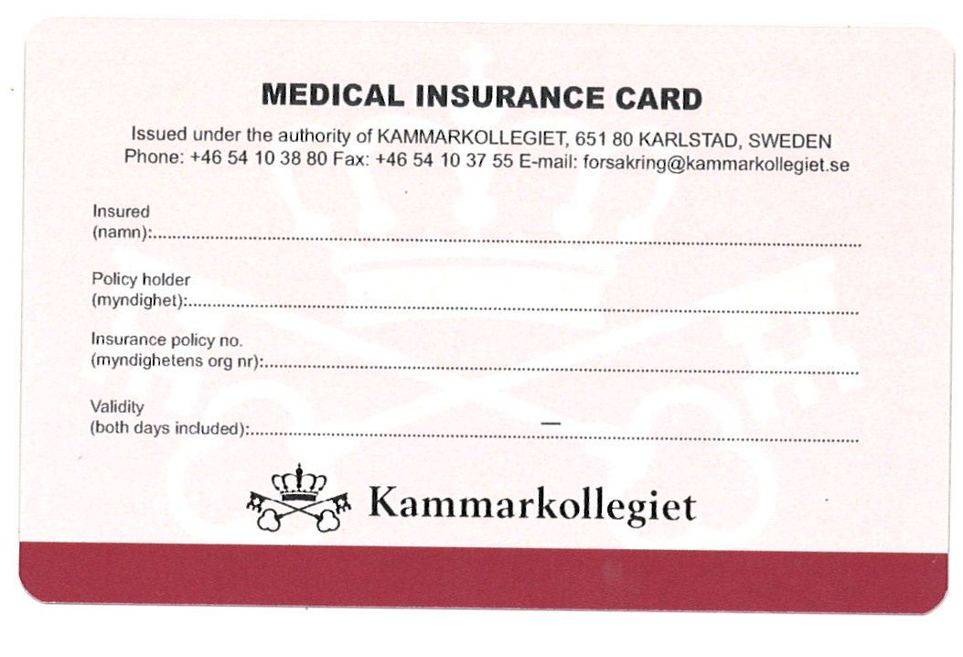
Insurance
”Student UT” (Kammarkollegiet)
Medical Insurance Card (MIC)
Download the Kammarkollegiet app
(information on app in Swedish)
2 weeks prior to and after the study period
Only valid in host country (+ direct journey)
Always save the receipts for expenses
In case of emergency – contact numbers on
the back of the MIC card
Check your home insurance + travel insurance
European Health Insurance card
Valid in 33 countries in Europe
Valid before ”Student UT” if you need health care
Order it from Försäkringskassan.se (also available as app for your smartphone!)

Slide 22
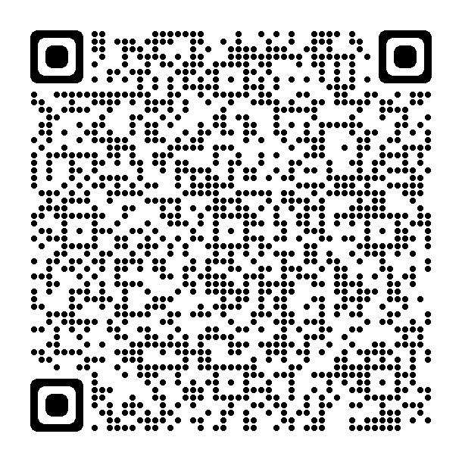
Insurance STUDENT UT

Slide 23
INK (bilateral agreements): Auckland
If you travel outside the European Community your exchange can partially be covered by an INK travel grant:
When going on exchange to the University of Auckland for your degree project the amount you will receive is 10.000 SEK.

Slide 24
EXTERNAL FUNDS
EXAMPLES OF STIPENDS’ SITES:
www.stipendier.se
www.lansstyrelsen.se
www.vardforbundet.se
https://utbildning.ki.se/stipendier-for-studenter
https://www.globalgrant.com/search
https://www.studera.nu/
Check our online pages for an updated stipend list: https://education.ki.se/scholarships

Slide 25
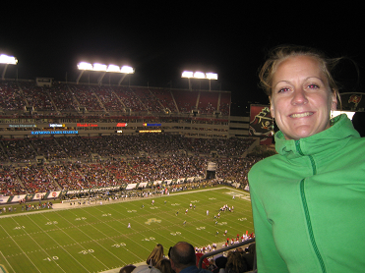
During your exchange
Address and phone number – leave with relatives and international coordinator
Download UD’s app Resklar
Register at the Swedish Embassy
Be a good KI ambassador
Should anything happen, stay in touch
Take care of yourselves and have fun
Experiencing American culture. Liselotte, Physiotherapy

Slide 26
Blog During Your Exchange Studies
Join me on my exchange studies - from Sweden! We encourage outbound exchange students to document the experience by writing a blog, sharing an Instagram, Snapchat or any other social media account, so that fellow students can follow your exchange studies abroad from home.
https://education.ki.se/blog-during-your-exchange-studies
Please consider also becoming a digital ambassador during your exchange! More information can be found on KI homepage!

Slide 27
AFTER YOUR EXCHANGE
Before traveling home, remember to ask the partner university for a Certificate of Attendance.
If you received an Erasmus+ scholarship (freemover) ask your supervisor to sign the last page of the Learning Agreement (After the Mobility)
Write and submit your travel report (deadline September 1st). Upon approval of your travel report you will receive the second and final installment of your stipend.
Best travel report competition!
Share your exchange experience with your fellow students!

Slide 28
What you need to prepare and hand in latest by Friday January 26th 2024 if you want to go on exchange to the University of Auckland:
Prepare your Letter of Motivation
Write your CV and download your Transcript of Records from Ladok
Fill in the application form online

Slide 29
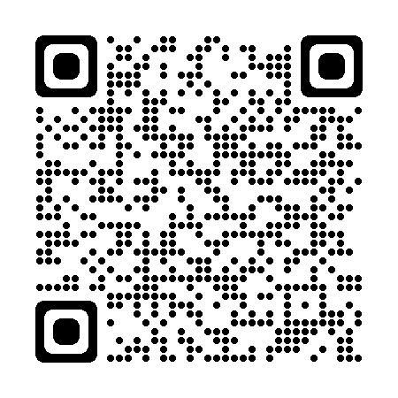
FREEMOVERS/ERAMUS+ INTERNSHIPS
Studying Abroad as a Freemover
If you choose to study abroad on your own as a so called freemover you can control much of the visit abroad yourself. This means that you prepare and arrange your studies at a foreign university on your own initiative. You are responsible for all costs such as application and tuition fees, etc. Contacts with universities and authorities are also your responsibility.
There is no deadline for going abroad as a freemover, but all paperwork has to be handed in no later than 4-6 weeks before your departure (visa included, if applicable)
You won’t be an official student while abroad, this meaning you will not be considered an official student while abroad, will not be able to apply for student housing or receive a student card.
Any tuitions or administration costs will be your responsibility
The minimum length of your mobility needs to be at least 8 weeks/60 days in order to receive an Erasmus+ scholarships for internships within the European Union

Slide 30
Writing Your Thesis Abroad
You will be insured with the Legal, Financial and Administrative Services Agency of Sweden (Kammarkollegiet), provided there is a written agreement between KI (not the student) and the institution or establishment and if you do your research project in the European Union you might be able to receive an Erasmus+ scholarship for traineeship (special conditions for the UK and Switzerland).
We have no limitations to which countries you can go to as freemover, as long as you can find a suitable project at a company/organization as well as a project specific supervisor. All the projects, however, need to be approved by the course leaders of the Clinical Placement 2 and Degree Project course here at KI before making any final arrangements with the supervisor/institution/company abroad.

Slide 31
Eligibility
PRACTICAL PLACEMENT 2
To be eligible for an internship abroad in semester 3 during the Practical Placement 2 you must have at least 30 ECTS from semester 1, as well as being registered for semester 2 on March 15
DEGREE PROJECT
To be eligible for an internship abroad in semester 4 you must have 60 ECTS from semester 1 and 2 and be registered for semester 3 on September 15

Slide 32
Freemover during summer and after graduation
It is the programme director that needs to approve your internship
Stipend only if you do the internship within the EU
Minimum 60 days
Insurance (if approved by your programme director, you can receive insurance also for internships outside the European Union)

Slide 33
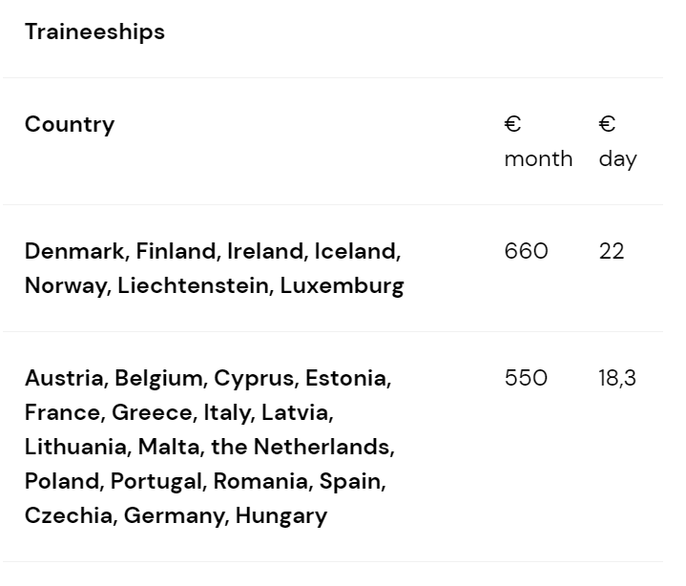
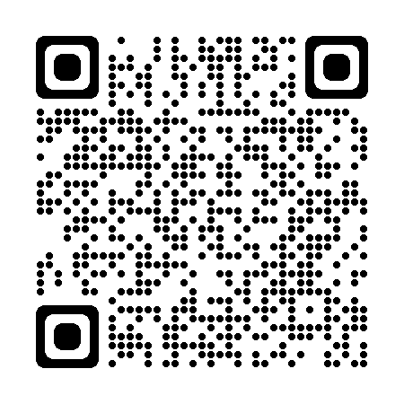
KI SCHOLARSHIPS
Within the Erasmus agreement (exchange to a European country) the amount of the scholarship varies depending on where you are traveling to and for how long (min. 60 days):

Slide 34
Erasmus+ specifics
Online Linguistic Support (OLS)
Compulsory language test before and after the exchange period
Possibility to do an online language course
Results sent to you - not the partner university
E-mail from OLS-support - noreply@erasmusplusols.eu
Certificate of Attendance signed by the partner university and after exchange language test

Slide 35
Extra inclusion support
From autumn semester 2022, extra support (currently 250 Euro per month, subject to change) can be awarded to all students in the following two groups:
Students with permanent or long-term disabilities, including disabilities caused by physical or mental illness. This must be certified by the coordinator for students with disabilities or from the municipality that currently provides support.
Students with children, regardless of whether the child accompanies the parent during mobility or not. This must be certified by the Swedish Tax Agency (“familjebevis”).
In addition, you can receive inclusion support for actual extra costs incurred by the exchange, if these costs are not covered by the extra inclusion support.

Slide 36
Coordinator for students with disabilities

Slide 37
Extra support for Green travel
If you are going on an Erasmus exchange during the academic year 2023/2024 and travel by train or bus (“Green travel”) to and/or from your Erasmus destination, you can apply for an extra travel allowance of SEK 2 000 (if the trip costs less than SEK 2 000, you will be reimbursed for the exact amount). The allowance can, for example, be used to pay part of an Interrail ticket. Up to four travel days can also be added to your regular scholarship days for studies or traineeship and reimbursed in the same way.

Slide 38
INK (bilateral agreements)
When traveling as freemover outside the European Union we do not offer any stipends/scholarships

Slide 39
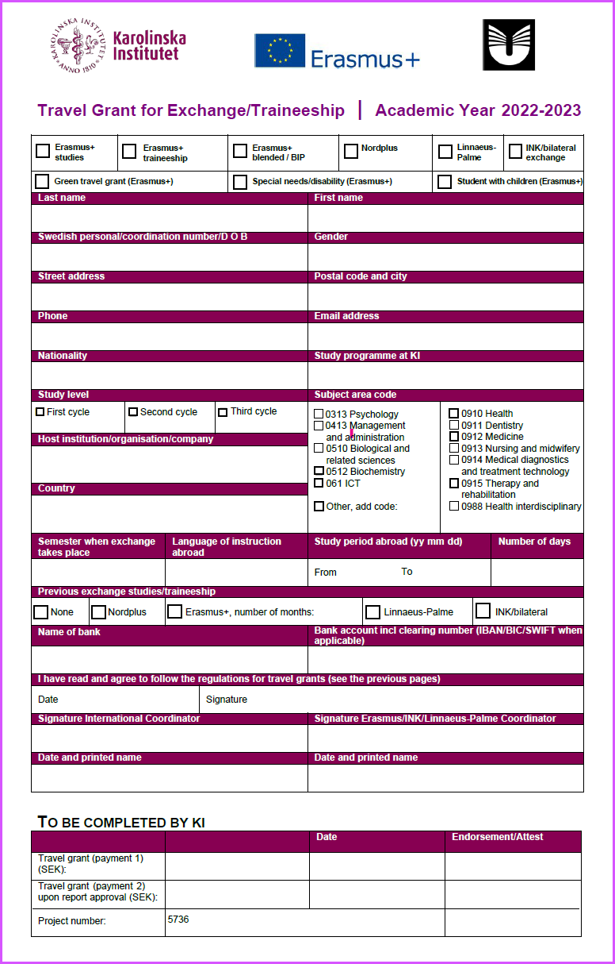

Slide 40
STIPENDS AND SCHOLARSHIPS
At KI you can apply for an Erasmus scholarship (if you go on exchange within Europe)
The INK travel stipend is granted only to students going on official exchanges during the 4th semester (Auckland); no stipends are offered to freemovers going on mobility outside the European Union.
You can apply at CSN to receive a higher study loan (not for exchange studies)
Have a look at other organization for external funds. Please make sure to read the conditions of the external scholarships
It is your responsibility to apply for external funds but the international coordinator can assist you with supporting documents

Slide 41
EXTERNAL FUNDS
EXAMPLES OF STIPENDS’ SITES:
www.stipendier.se
www.lansstyrelsen.se
www.vardforbundet.se
https://utbildning.ki.se/stipendier-for-studenter
https://www.globalgrant.com/search
https://www.studera.nu/
Check our online pages for an updated stipend list: https://education.ki.se/scholarships

Slide 42
Drop-in times
Do you have questions related to your application for exchange studies?
Come to my drop-in times or book a separate appointment with me!
Wednesday 17 January 11am-2pm
Wednesday 24 January 11am-2pm
Application deadline: Friday January 26th 11am!

Slide 43
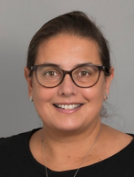
Email: giulia.grillo.mikrut@ki.se Phone: +46 (0)8 524 867 90 Visiting address: SOLNA Berzelius väg 3, 5th floor FLEMINGSBERG Alfred Nobels allè 10, 4th floor (by appointment only) Languages spoken:
INTERNATIONAL COORDINATOR

Slide 44
Thank you for your attention!

