Slide 1

Implementing at a SUD clinic
Susanna Krus - Specialist Nurse
Klara Schultz - Psychologist
Isabel Jadbäck - Specialist Psychologist
Notes:
ISABEL
Welcomen to this presentation, wewill share our work with Good Psychiatric Management (GPM) in an adult addiction treatment setting.
My name is.. and with me I have Klara .. and Susanna

Slide 2


Addiction Clinic, Malmö
~ 700 patients
Multiple sub-teams
Complex clinical presentations
Common diagnoses: BPD, ASPD, ADHD, PTSD
Notes:
ISABEL
We work at an outpatient addiction clinic in Malmö, in southern Sweden, where we treat adult patients with moderate to severe substance use disorders and psychiatric comorbidity. The clinic serves approximately 700 patients and employs around 25 staff members. The clinic is organizationally part of the psychiatry department.
The service is organized into sub-teams based on primary substance use, including one team specializing in alcohol use disorders and another focusing on illicit drug use. Common substances are cannabis, cocaine, and amphetamines.
Our patient population—particularly those within the drug treatment team—presents with highly complex clinical profiles. Many individuals have experienced adverse childhood conditions, including family dysfunction, early onset of substance use, and incomplete education. In adulthood, many face significant challenges in entering or maintaining participation in the labor market.
Common diagnoses at our clinic include:

Slide 3
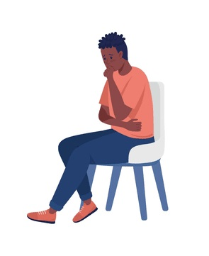
Comorbidity SUD - BPD
Important to recognize!
More severe symptoms Reduced quality of life Increased risk of death
Notes:
ISABEL
We know that comorbidity is important to recognize. It is generally associated with more severe symptoms, reduced quality of life, and an increased risk of premature mortality. The presence of a substance use disorder complicates the treatment of personality disorders, and conversely, personality pathology makes substance use disorders more difficult to treat. Relapses are often particularly destructive and are not infrequently a response to interpersonal stress.

Slide 4

Why GPM?
Structured framework is necessary.
Multiprofessional collaboration.
Local guidelines – offer GPM as a first-line intervention following diagnosis.
An intervention that all staff at the clinic can provide.
There are knowledge gaps regarding effective treatment for BPD and SUD.
SBU. Treatment and social support interventions for co-occurring substance use and other psychiatric disorders: A systematic review of interventions, health economics and ethics. Stockholm: Swedish Agency for Health Technology Assessment and Assessment of Social Services (SBU); 2025. Available from: https://www.sbu.se/372
Notes:
ISABEL
It has long been recognized that certain patients with personality disorders can be challenging to manage in individual treatment. These contacts may easily become long-term and, over time, risk losing clear direction and therapeutic purpose. We therefore identified a need to work more systematically and collaboratively with this patient group.
In recent years, GPM has been recommended within our region as a first-line intervention following a diagnosis of personality disorder, and the majority of staff have received basic training in the method.
A recent report from the Swedish Agency for Health Technology Assessment and Assessment of Social Services (SBU) reviewed the evidence for psychological treatments in substance use disorders and found no randomized controlled trials specifically targeting patients with comorbid personality disorders and substance use disorders.
This, in turn, provided us with the mandate to explore and implement a treatment approach that appeared clinically appropriate for this population.

Slide 5
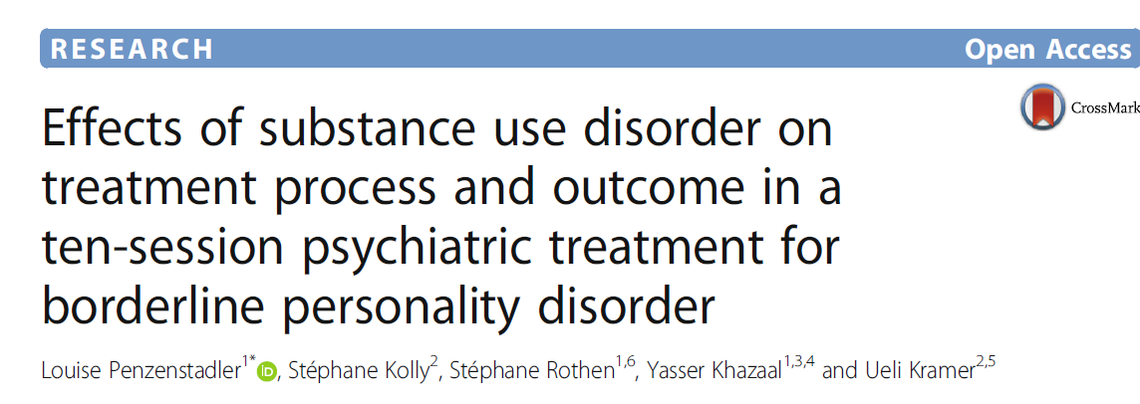
Why GPM?
GPM had been evaluated on a small scale in patients with BPD and SUD.
Notes:
ISABEL
GPM has previously been evaluated on a smaller scale in patients with borderline personality disorder (EIPS) and substance use disorders, with promising clinical experiences.
A total of 99 patients with borderline personality disorder (EIPS), including 51 with comorbid substance use disorder (SUD), completed 10 sessions of GPM.
Results: No significant difference was found between the groups in terms of reduction in EIPS symptoms. The authors concluded that GPM appears to be effective for patients with EIPS and comorbid SUD.
​
There were a number of limitations for this study. We​
do not have any long-term outcome measures to prove​
that the effect of the treatment stays the same for both​
groups. These are secondary analysis, so we have fewer​
details on the evaluation of co-morbid SUD, such as severity​
of SUD. The number of patients for each group​
was limited. Furthermore, between substance use disorder​
analyses were not carried out due to the limited​
number of patients. Our outcome measures were selfreported​
which is subject to responder bias. Although​
the drop-out rate was moderate in our patient groups, it​
has to be considered as a possible limitation.

Slide 6

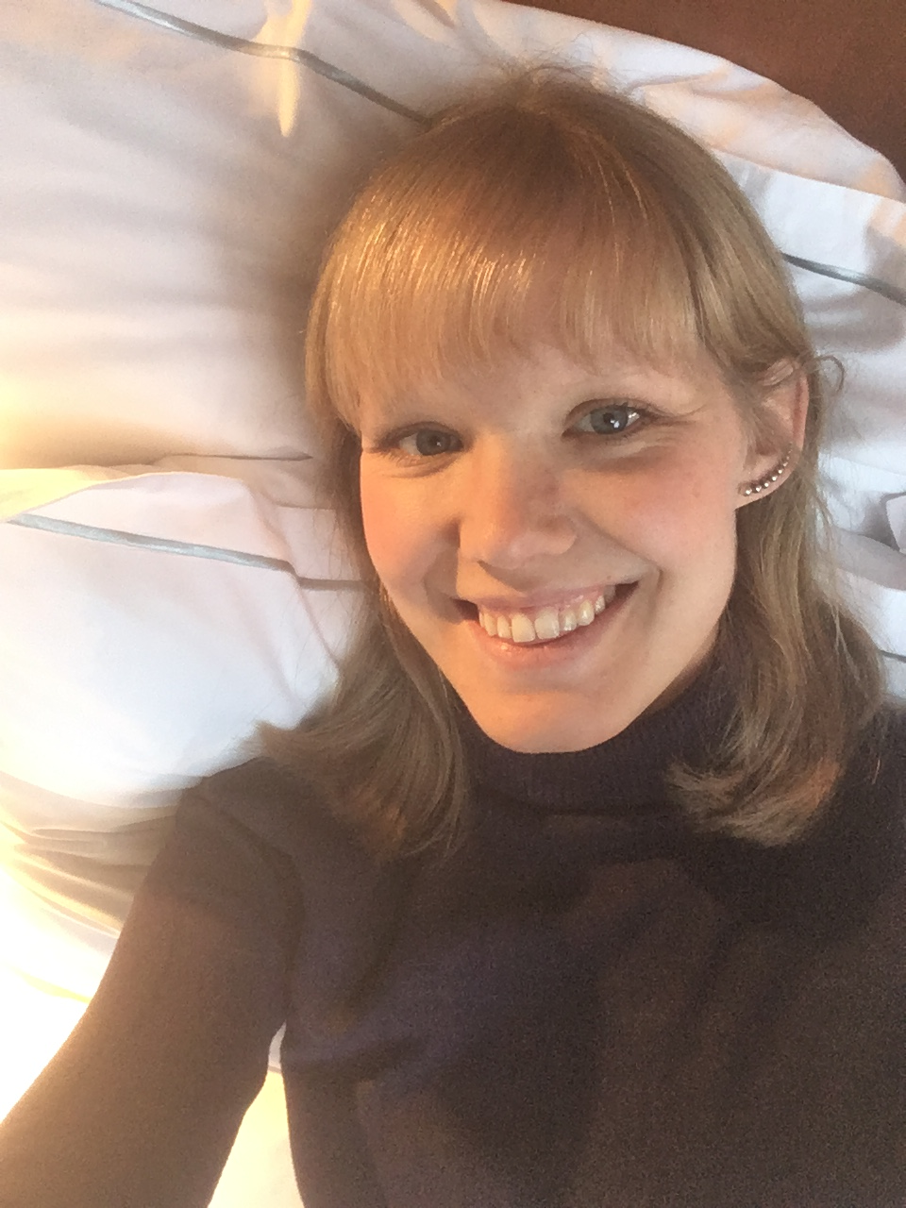
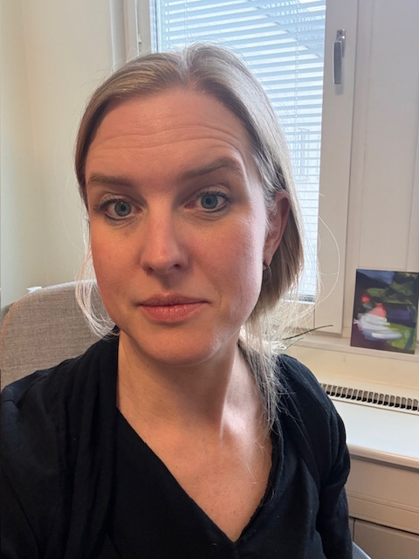


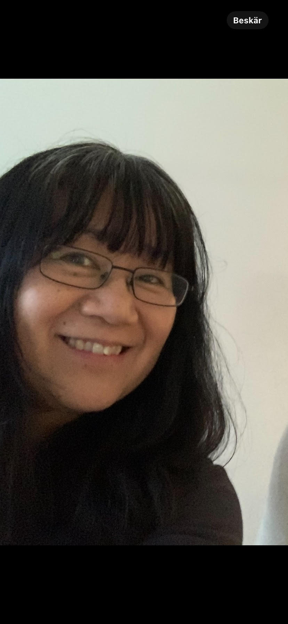
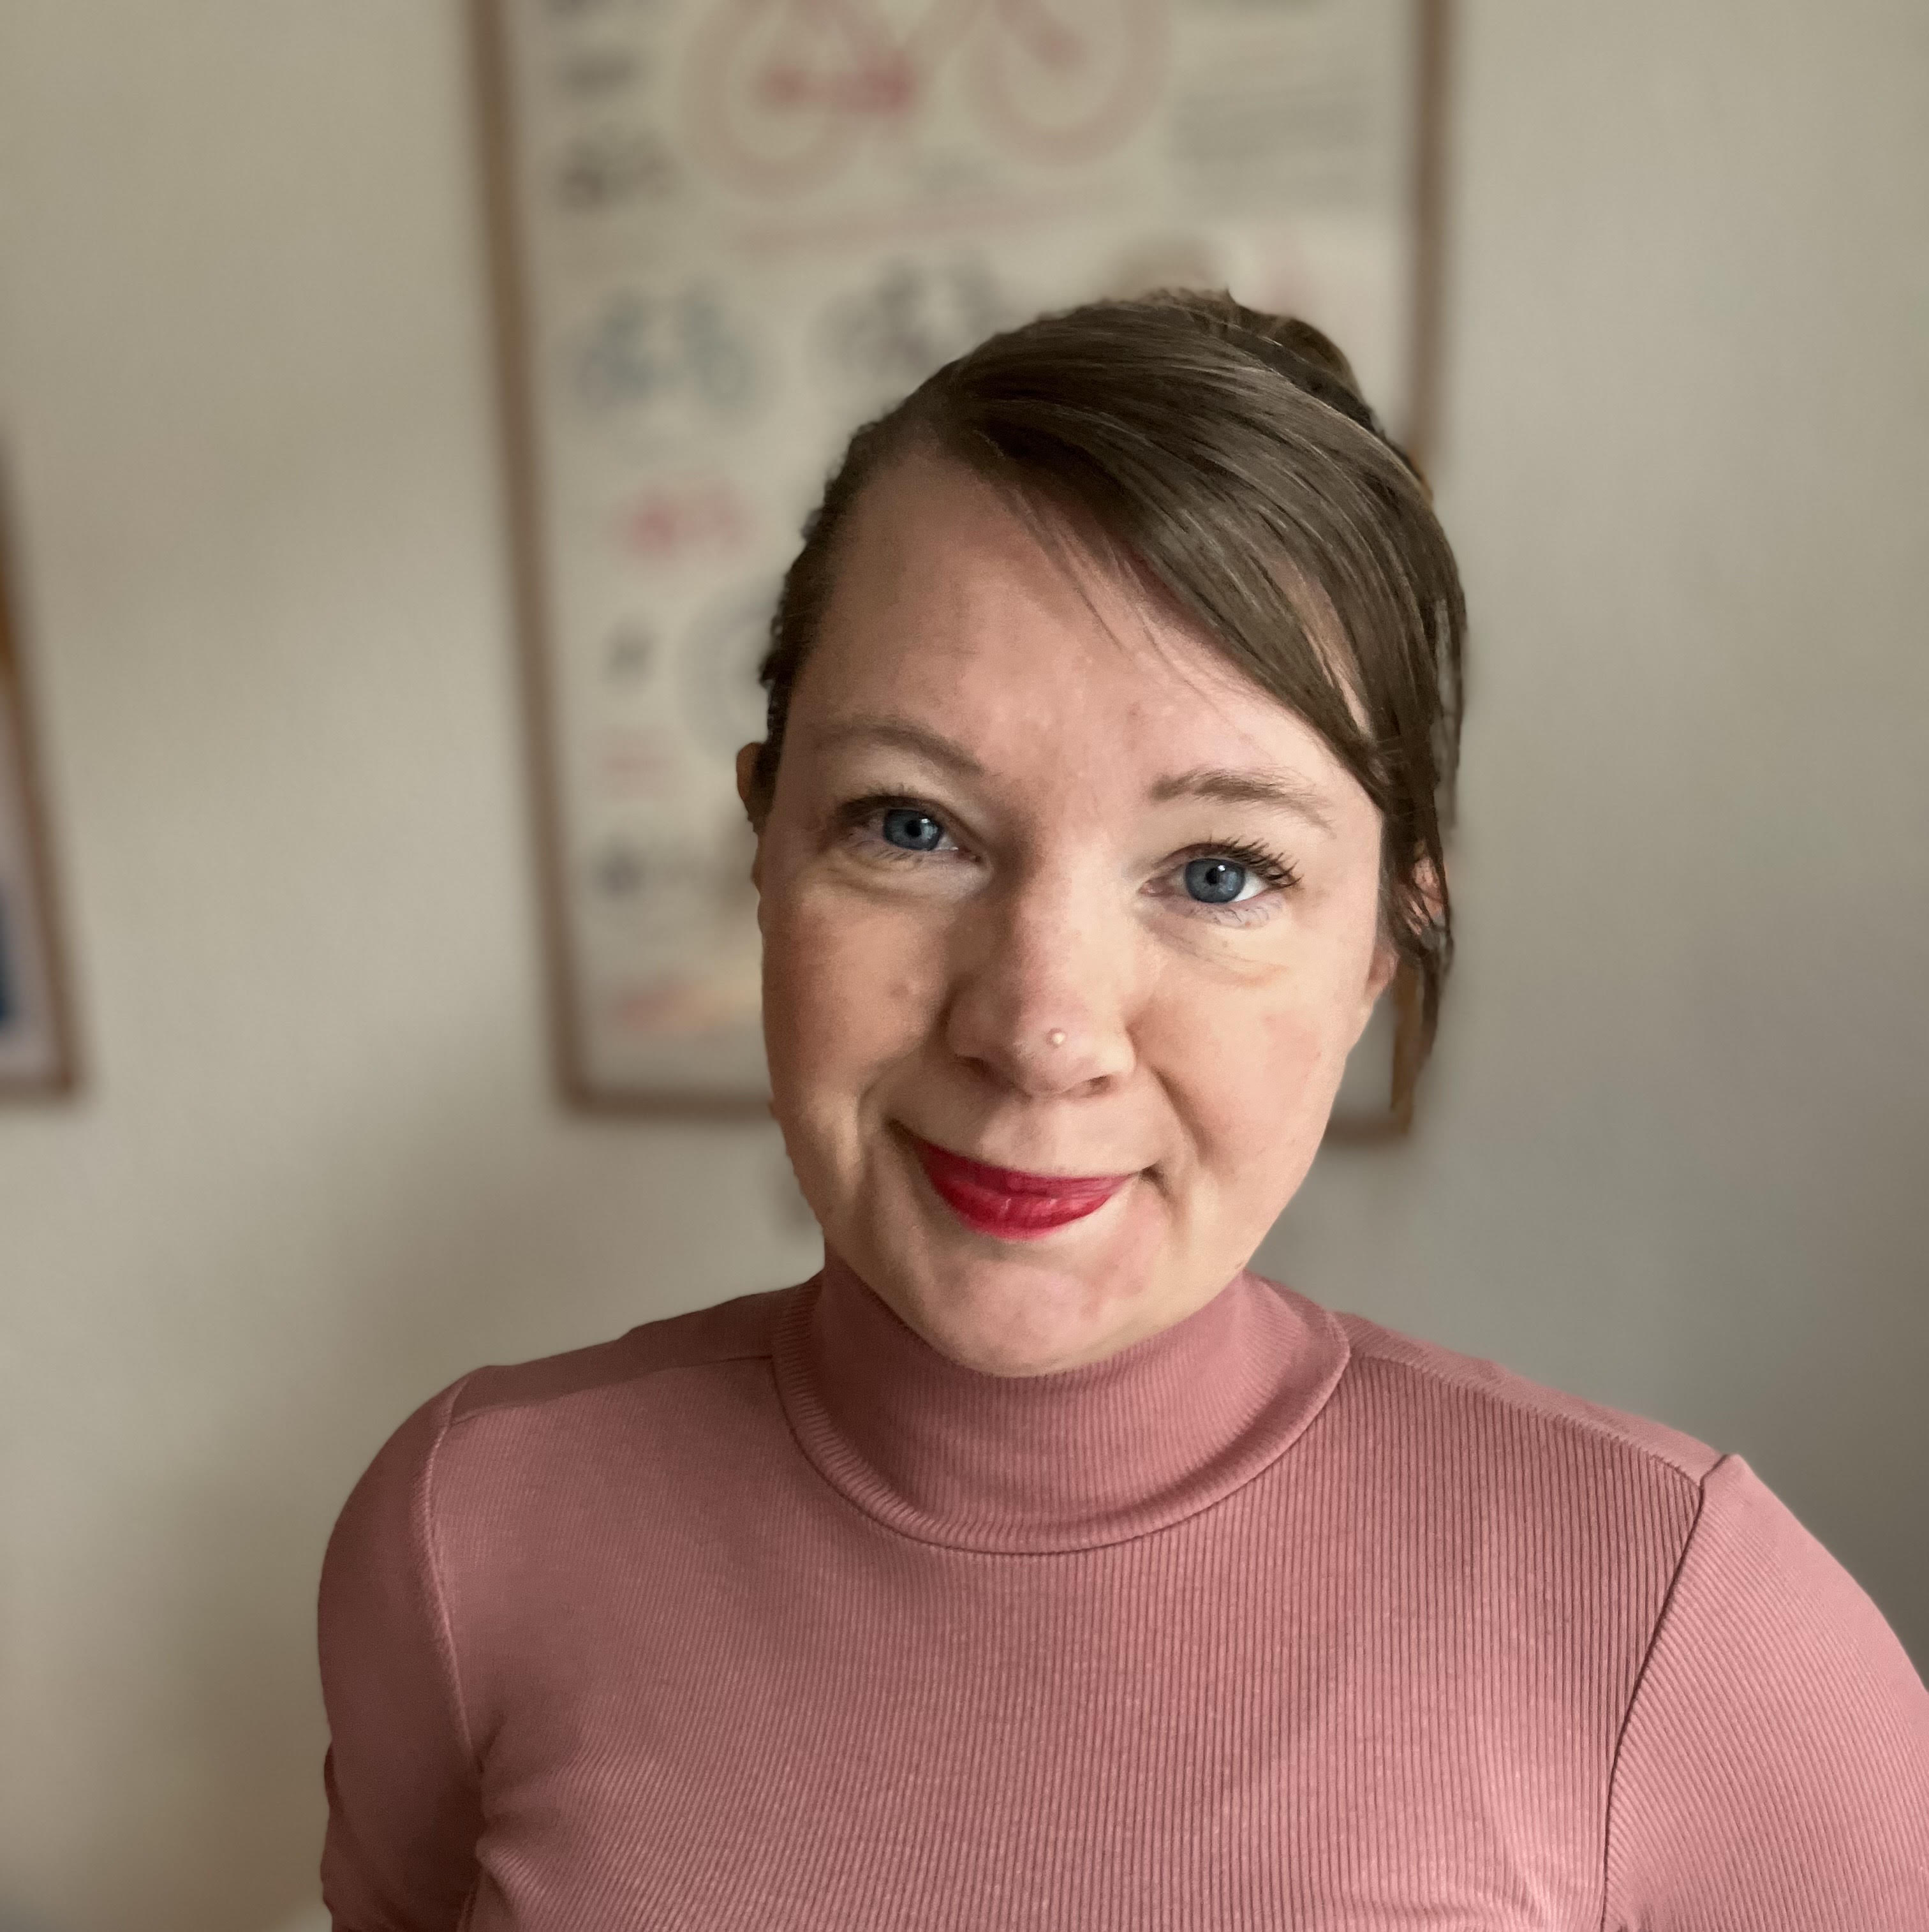
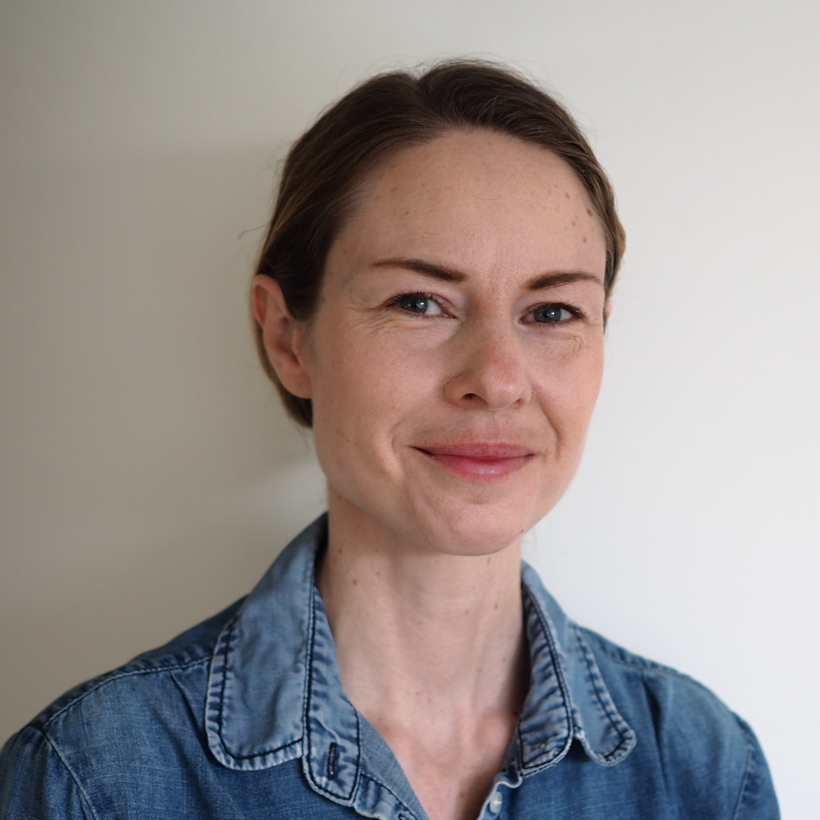

GPM-team
Education
Team
External supervision
Jonas Berge
Senior Consultant, Associate Professor
Klara Schultz
Psychologist
Susanna Krus
Specialist Nurse
Stina Ingves
Specialist Nurse
Emma Larsson
Social Worker
Isabel Jadbäck
Specialist Psychologist
Notes:
SUSANNA
This is our GPM team, which was established in 2023. The team consists of two specialist psychiatric nurses—one with Step 1 training in CBT and one currently undergoing Step 1 training in psychodynamic therapy (PDT)—one social worker, two psychologists, and one senior consultant psychiatrist.
All team members have completed basic training in GPM and some of us completed ab basic course in MBT at the Anna Freud Centre.
The team meets for one hour each week to review current patients. Meetings typically begin with discussions of acute crises, followed by updates on patients’ overall progress.
If a patient has relapsed and is unable to stabilize with outpatient interventions alone, collaboration with social services may be initiated to provide more intensive treatment, such as residential care.
Approximately every six weeks, the team receives external clinical supervision.

Slide 7
Treatment Process
Diagnostic assessment
Introduction
Individual treatment
Evaluation
Terminate?
Refer? (DBT,MBT)
Group therapy
(maximum 18 months)
Notes:
SUSANNA
This outlines our general treatment process. Patients considered for the GPM team are required to have a diagnosis of borderline personality disorder (EIPS). If the diagnosis has not been previously established, a diagnostic assessment is conducted.
Following this, patients participate in an introductory phase, where they receive psychoeducation about the diagnosis and an overview of GPM.
Patients then engage in individual treatment in parallel with group-based GPM. The group intervention is time-limited to a maximum of 18 months.
The intervention is continuously evaluated using both self-report measures and regular case discussions within the GPM team.
Upon completion of treatment, patients are either discharged or, if further intervention is required, referred to other specialized treatments, such as Dialectical Behavior Therapy (DBT) or Mentalization-Based Therapy (MBT).

Slide 8
Treatment Process
Diagnostic assessment
Stability
Joint assessment
Cognitive ability
Notes:
KLARAn(tid utredning + psykiatriker)
We aim for patients to have maintained abstinence from alcohol and drugs for at least a short period, ideally one motnh, prior to the initiation of the assessment. However, we strive to remain flexible and may conduct assessments while patients are in residential treatment. In some cases, patients are admitted to an addiction treatment unit to facilitate the assessment process.
The assessment begins with a so-called joint evaluation, during which the patient and a significant other meet with both a physiatrist and a psychologist. This session focuses on obtaining a developmental history and an overview of the current clinical presentation.
We generally aim to keep the assessment process relatively brief; however, differential diagnostic considerations are often present, particularly regarding conditions such as ADHD and PTSD, which also require evaluation.
A cognitive assessment is frequently conducted, particularly when evaluating possible comorbid ADHD. This provides a valuable basis for identifying necessary adaptations during treatment, as well as for making recommendations regarding accommodations in educational and occupational settings.

Slide 9
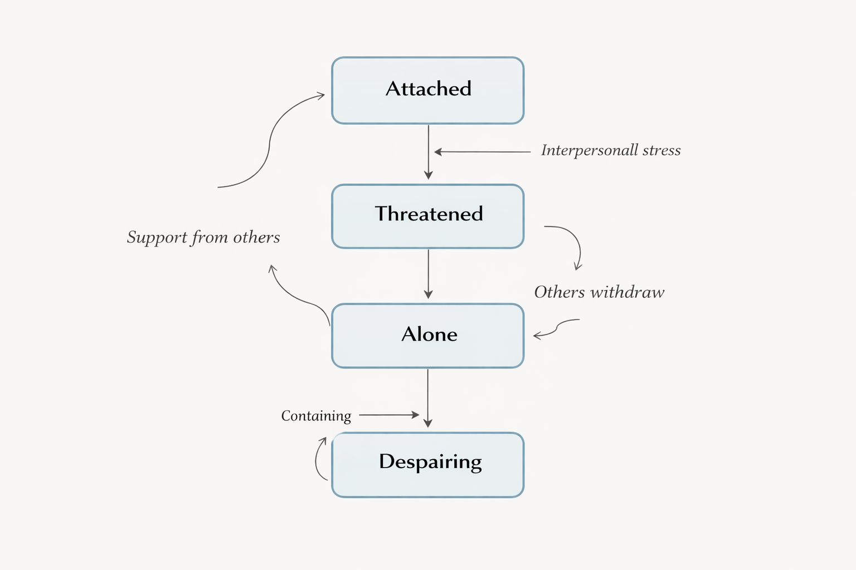


Treatment Process
Introduction
Notes:
KLARA
Following the establishment of a diagnosis, patients receive psychoeducation. This includes information about borderline personality disorder and the rationale and principles of GPM.
Particular emphasis is placed on understanding the relationship between interpersonal stress and maladaptive behaviors, including relapse. Relapses and episodes of intoxication are often preceded by relational crises, which is an important focus within the treatment framework.

Slide 10
Treatment Process
Individual treatment
Goal
Crisis plan
Individual Placement and Support (IPS)
Brief admission
Treatment of comorbid conditions (PTSD)
Notes:
KLARA
Individual treatment begins with the establishment of treatment goals, which are formulated in an individualized care plan. Each patient is also expected to have a crisis plan, including early warning signs of deterioration, personal coping strategies, and contact information for relevant support persons who can be reached during periods of increased distress. Each patient regularly provides screening samples in order to monitor alcohol and drug use.
At our clinic, an Individual Placement and Support (IPS) specialist is available to assist patients in accessing employment or other meaningful daily activities.
Some of our patients have access to patient-controlled admissions, a preventive intervention that allows for brief inpatient care within psychiatric services when needed.
In some cases, comorbid conditions are also treated within the framework of individual therapy, for example post-traumatic stress disorder (PTSD) using Prolonged Exposure (PE).

Slide 11
Treatment Process
Group therapy
Group rules
Composition
Theme
Notes:
SUSANNA (Susanna lägger till?)
Prior to the start of group treatment, all patients are introduced to the group rules. One key rule is that patients may acknowledge having relapsed, but are asked not to describe the sequence of events in detail, as this may trigger cravings in other group members.
Composition???
Theme????

Slide 12
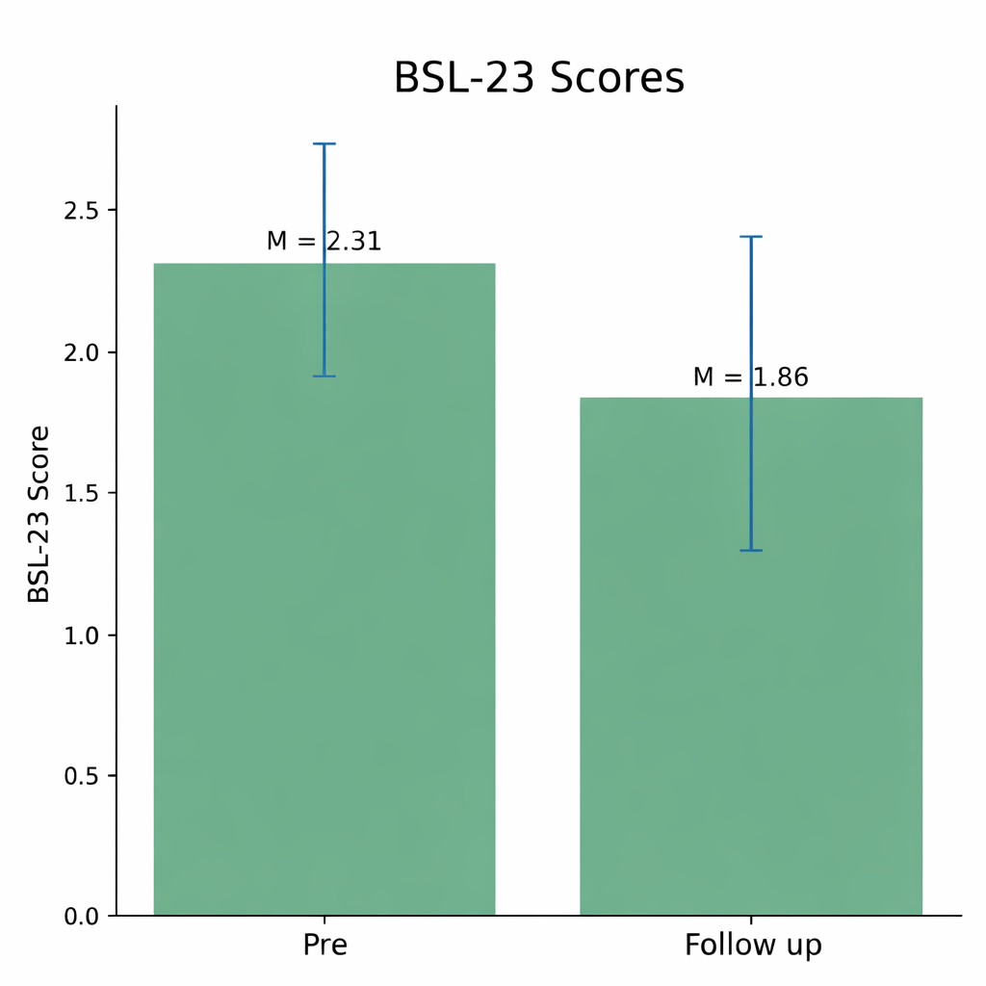
Results
Change in BSL-23 scores from pre- to follow-up (n = 11)
Mean duration of treatment at follow-up = 12 months.
Significant reduction in symptoms (p = .041)
Medium-to-large effect size (d ≈ 0.71)
Most participants improve but have significant symptoms at follow up
Notes:
ISABEL
Here are the results of differences in BSL-23 scores between baseline and follow-up. However, there is considerable variation in how long patients remained in treatment, although the mean treatment duration was one year. This is only a small sample of 11 patients, which limits the conclusions that can be drawn. Nevertheless, we observed a significant reduction in symptom severity, although many patients still reported high levels of symptoms at follow-up.
Resultatet visade en signifikant minskning i BSL-23-poäng från före (M = 2.31) till efter (M = 1.86), t(10) = −2.35, p = .041. Effektstorleken var medelstor till stor (Cohen’s d = 0.71).
Kleindienst och kollegor (2020) föreslår svårighetsgrader för BSL-23 enligt: none or low: 0–0.3; mild: 0.3–0.7; moderate: 0.7–1.7; high: 1.7–2.7; very high: 2.7–3.5; and extremely high: 3.5–4. BSL-23 poäng på 1.50 särskiljde bäst BPD/EIPS patienter från en klinisk kontrollgrupp (psykiatriskt sample), medan tydligast diskriminering av från en frisk kontrollgrupp (utan psykiatriskt tillstånd under livstiden) var en poäng på 0.64.

Slide 13

Interview
What is GPM?
“GPM is for people with similar difficulties, and the idea is to help each other by sharing experiences.”
“It’s hard to describe, but you should feel less alone. You get support from others with the same diagnosis and from facilitators.”
Notes:
KLARA

Slide 14
Interview
What symptoms troubled you before starting treatment?
“My separation anxiety was the worst; I almost became obsessed with others.”
“Problems in relationships, unstable emotions and mood swings…”
“I had a lot of problems with anger directed outward. Strong emotions that were hard to control. I couldn’t put words to my feelings or connect them to my reactions.”
Notes:
KLARA

Slide 15
Interview
Is there anything you can do today that you couldn’t before treatment?
“I can communicate better with people around me about how I am feeling.”
“Setting boundaries – standing up for myself.”
“I have become better at avoiding situations that can easily lead to relapse.”
Notes:
SUSANNA

Slide 16
Interview
How much has the treatment helped you overall?
“Very much. I am a completely different person today. GPM motivates me to stay sober.”
“Hard to see change during treatment, but I can see it now in hindsight. I’m more tolerant toward myself… something has changed, even if I can’t say exactly what.”
“My friends have noticed a positive difference—not just that I stopped using drugs.”
Notes:
SUSANNA

Slide 17
Interview
Did you experience any disadvantages of the treatment?
“It didn’t feel like it was for me and it was hard to catch up on everything I missed at work”
“It’s a bit difficult that the group meetings are in the afternoon—I end up waiting all morning.”
Notes:
SUSANNA

Slide 18

Key Lessons
Challenges
Intake to the GPM team has been adjusted over time - patients need to be relatively stable and motivated.
Difficult to evaluate the intervention as a whole and to discharge patients considered fully treated.
Notes:
ISABEL
At first, we were fairly generous in terms of which patients we accepted into treatment, but over time we realized that patients need to be reasonably stable and sufficiently motivated for the intervention.
We still find it difficult to assess when a treatment is successful or not. This is partly because the patients’ condition often fluctuates very dramatically, and it is not always easy for the patients themselves to recognize the progress they are making in everyday life. It is also not entirely easy to discharge patients who have completed their treatment but still wish to receive some support in order to avoid deteriorating again. In many cases, the patients’—and perhaps also our own—separation anxiety may play a role in the difficulties involved in ending a patient’s treatment.

Slide 19

Key Lessons
Advantages
Team-based work with a challenging patient group.
The method has a name and is time-limited.
Patients feel validated when difficulties beyond substance use are acknowledged.
susanna.krus@skane.se klara.schultz@skane.se
isabel.jadback@skane.se
Notes:
ISABEL
The greatest advantage of this treatment intervention is that we work as a team around a challenging patient group, which makes you feel less alone and allows you to support one another.
We also believe it is an advantage that we can give the intervention a name and that it has a clear beginning and end.
Patients often feel acknowledged when their co-occurring conditions are recognized. The strength lies in the fact that we focus on both their emotional instability and their addiction.
Thank you for listening. You are very welcome to contact us if you have any questions.

