Slide 1
Implementing Good Psychiatric Management : Early Experiences from a Qualitative Study
Dr Sonja Quan
Consultant Psychiatrist

Slide 2
Collaborators
Sika Javaid, BHSc (Hons) student, University of Auckland
Dr Lilian Ng, Forensic Psychiatrist and Senior Lecturer, University of Auckland
Dr Rodrigo Ramalho, Psychiatrist and Population Health Scientist, University of Auckland
Dr Sonja Quan, Psychiatrist
Notes:
This study was inspired by collaboration between the work of two of the clinical psychiatrists:
Dr Quan’s experience in a semi-rural District Health Board (pop of 110 000 where resources were limited led her to explore using GPM in the clinical setting. Her experience in working according to the principles of Good Psychiatric Management allowed her socialise this way of working with the community, crisis and inpatient teams and in the primary care setting
Dr Ng’s expertise in qualitative methodology helped shape the research questions and effort to measure the clinical impact of on aspect of GPM, training staff to work according to these principles. Dr Ng was able to provide additional insight about linking a theoretical and evidence based model into clinical practice, due to her experience of working with ACOS.
Sikva was a bachelor of health sciences honours student at the University of Auckland
Rodrigo is a psychiatrist and population health scientist and the Academic Director of the Postgraduate Certificate in Health Sciences in Alcohol and Drug Studies and a Senior Lecturer in the Department of Social and Community Health, Faculty of Medical and Health Sciences

Slide 3
Te Toka Tumai (Auckland District Health Board)
Covers a population of approximately 498 000 residents
Approximately 3.6% of the total ADHB population access mental health services
Māori are most likely to access services (19.6 % of the general population)
Access to a 58 bedded inpatient unit
Notes:
Population of Auckland is 1.8 million

Slide 4
Assertive Community Outreach Service
Provides assertive treatment and support to service users with psychotic and mood disorders who have a pattern of problematic engagement with services and/or treatment recommendations and a history of high-risk behavior during periods of relapse
Caseload of about 100 patients
Staff consisted of 1 psychiatrist, 1 psychologist, 5 nurses, 3 social workers, 1 occupational therapist and 3 community support workers and team leader (social work background)
Notes:
ACOS provided a real‑world test of GPM in a complex, high‑risk service setting.

Slide 5
Healthcare Improvement : Quadruple Aim
Improve patient experiences
Improve population health
Reduce cost
Improve staff experiences
Bodenheimer, T., & Sinsky, C. (2014). From triple to quadruple aim: care of the patient requires care of the provider. Annals of family medicine, 12(6), 573–576
Notes:
The Institute for Healthcare Improvement (IHI) is a leading non-profit organization dedicated to improving health and healthcare worldwide. Founded in 1991, IHI has been at the forefront of healthcare innovation for over 25 years, focusing on enhancing patient safety, healthcare outcomes, and system efficiency
The Triple Aim in healthcare is a framework developed by the Institute for Healthcare Improvement (IHI) to optimize health system performance by simultaneously pursuing three key objectives:
Improving the experience of care: This includes enhancing the quality, accessibility, and reliability of care, as well as improving patient satisfaction
Improving population health: This involves addressing the overall health outcomes of a defined population, including prevention, chronic disease management, and promoting healthy lifestyles
Reducing per capita costs of care: The goal is to lower healthcare costs or reduce the rate of cost increases while maintaining or improving care quality
The Triple Aim-enhancing patient experience, improving population health, and reducing costs-is widely accepted as a compass to optimize health system performance. Yet physicians and other members of the health care workforce report widespread burnout and dissatisfaction. Burnout is associated with lower patient satisfaction, reduced health outcomes, and it may increase costs. Burnout thus imperils the Triple Aim.
Quintuple aim: addressing health inequities
All clinical staff were eligible for this study, including nurses, allied health and CSWs

Slide 6
Methodology and Methods
Data collection:
Semi-structured interviews (about 45 minutes)
Data analysis:
Reflexive thematic analysis informed by interpretative phenomenological analysis

Slide 7
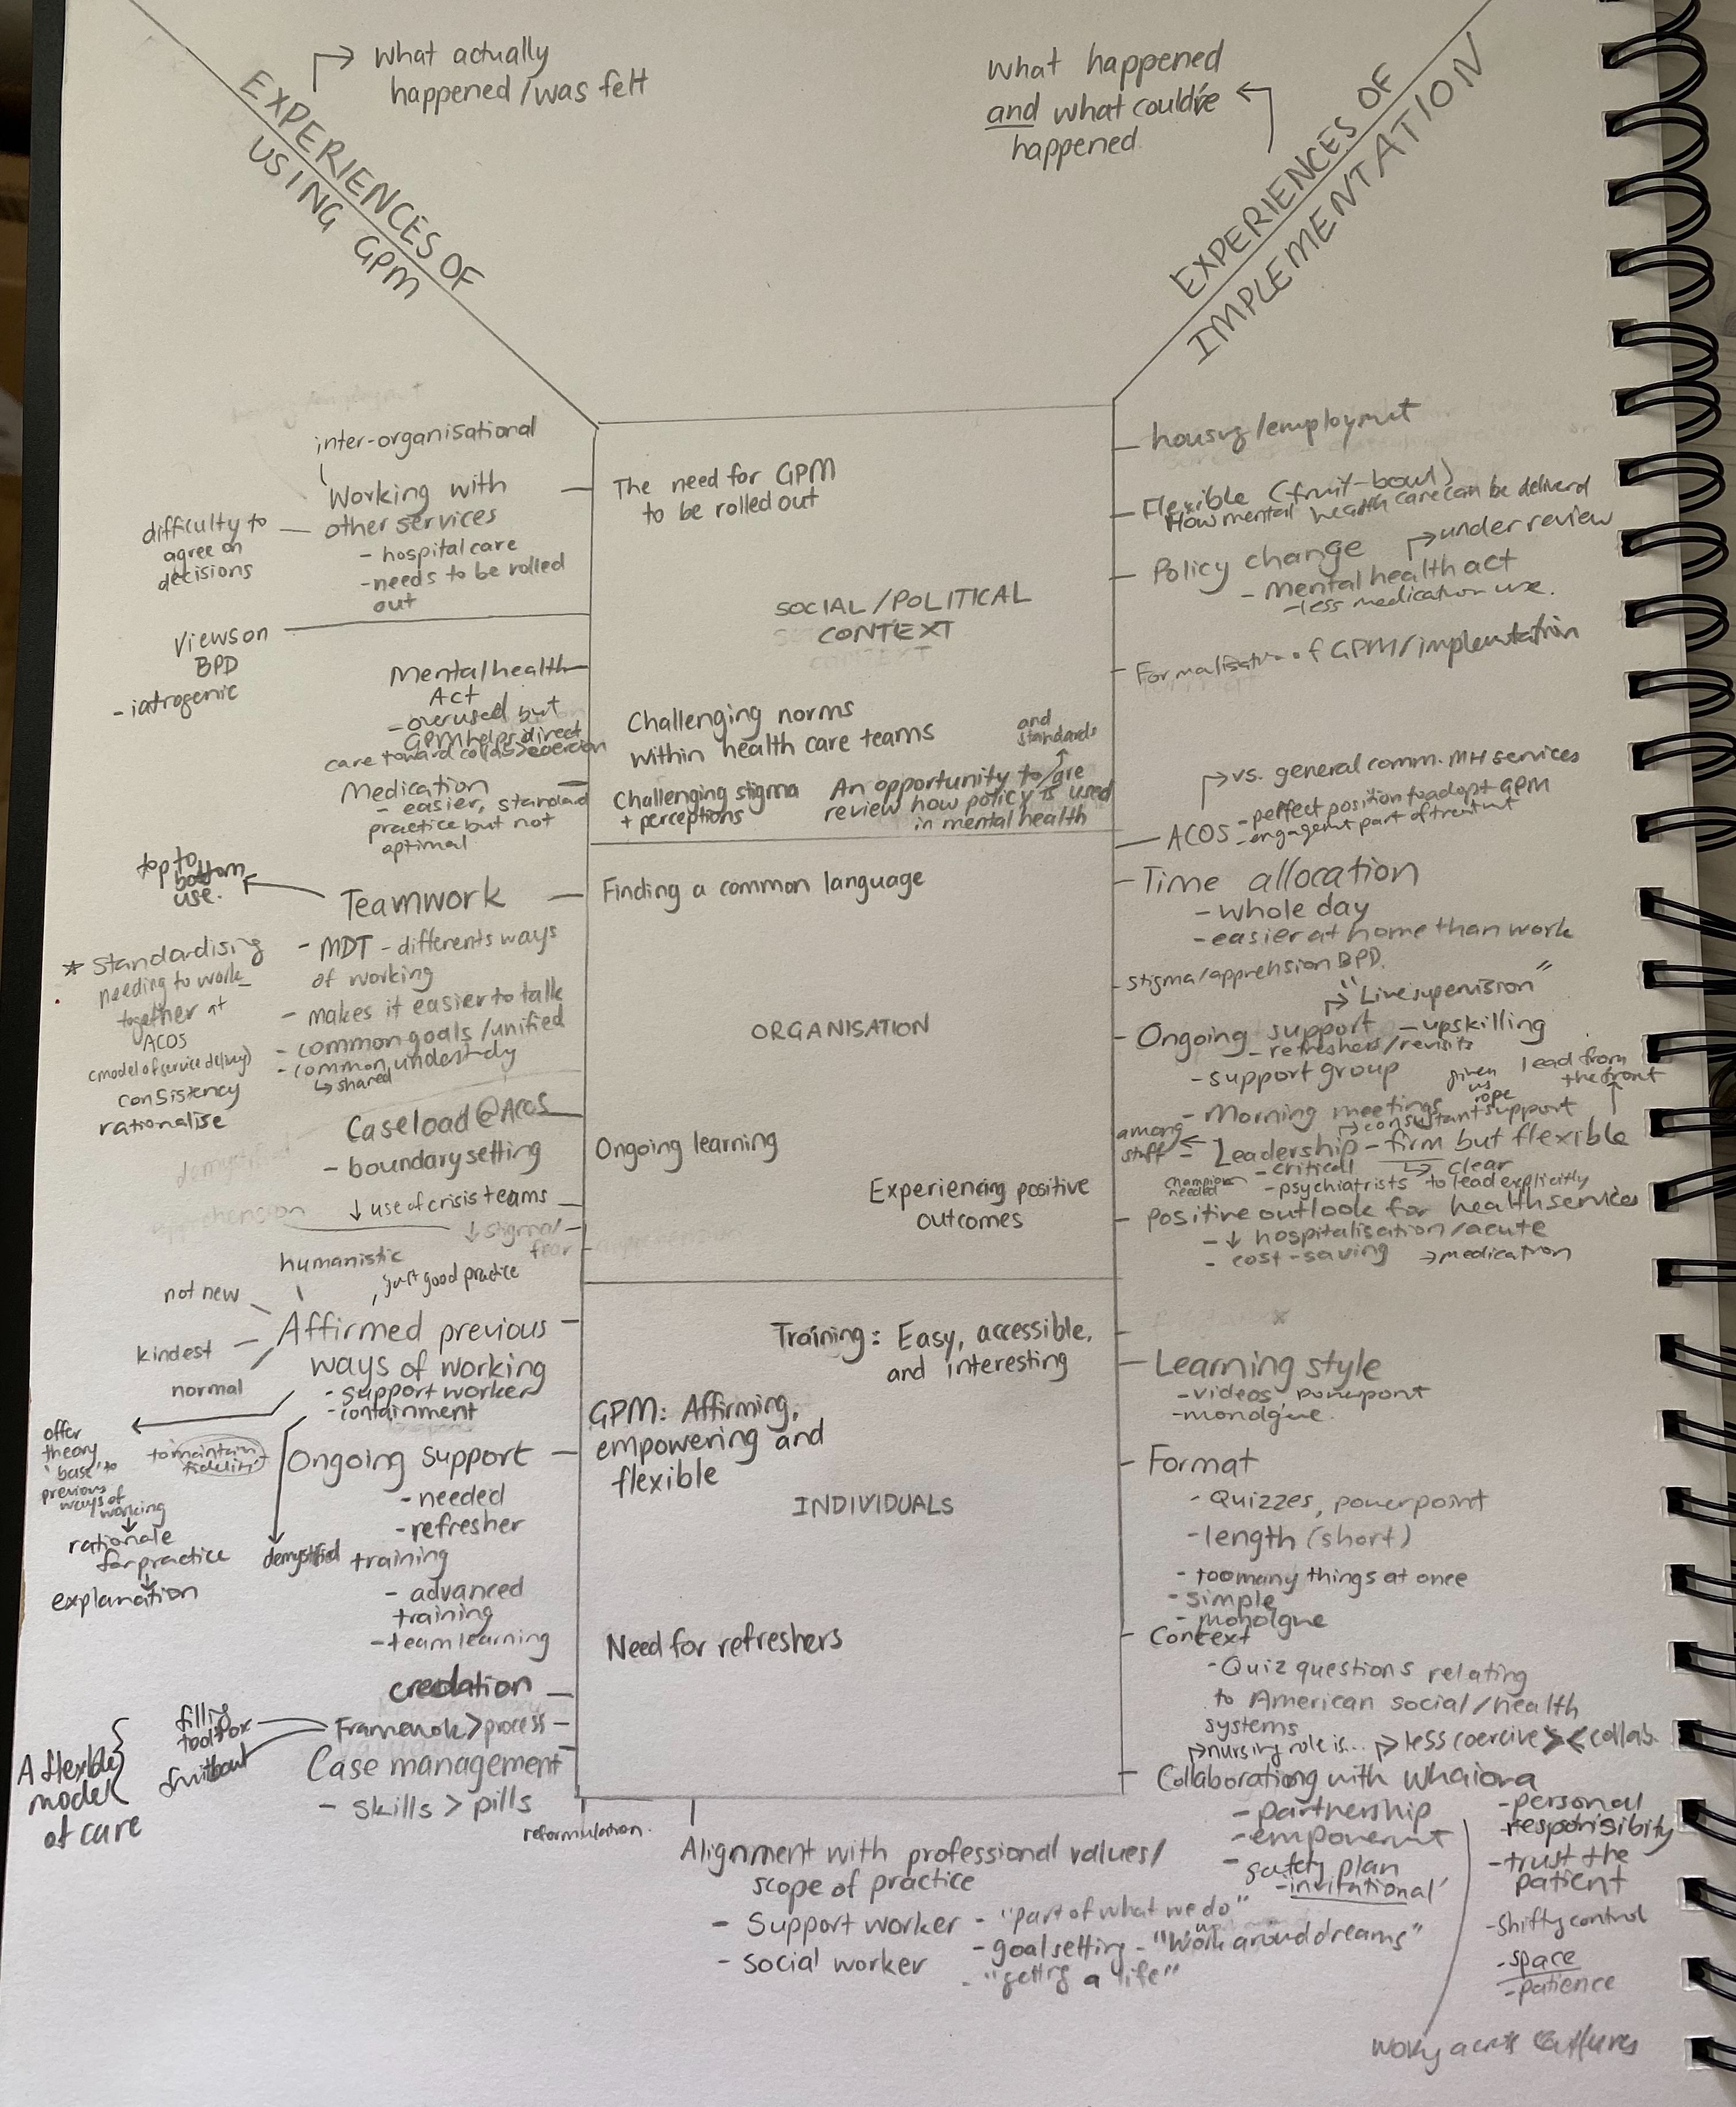
Sociopolitical context
Experiences of using GPM
Organization
Experiences of implementation
Individuals
Notes:
Context → Implementation → Use of GPM → Staff and Patient Experience

Slide 8
Findings
GPM is a pragmatic, structured and flexible model of care
GPM empowers practitioners and patients
Leadership is instrumental for implementation

Slide 9
1. A Pragmatic, Structured and Flexible Model of Care
GPM is complementary to practitioners' values
An intuitive model that affirms understanding of good practice
Increased compassion towards patients
Notes:
An intuitive model - many people said GPM was familiar to them. One person said GPM “consolidated and affirmed the way I do practice”. GPM was described as a simple model that tightened up clinical treatment. It was a model that made sense to many staff, and although it did not dramatically change the way people practiced, it did provide staff with the skills to practice more confidently, in a way they felt they should be. It affirms good practice.
The interpersonal hypersensitivity model that explains borderline personality disorder seemed to help some people practice with more compassion and understanding towards patients. One person said ... now I hold them with a little bit more empathy and my awareness of what’s going on for them informs how I approach that time... I’m softer and I’m just more compassionate… (AS)

Slide 10
Provides structure and a common language for staff
Flexibility that supports culturally safe and person-centered care
Notes:
GPM provides structure to treatment:
Helps with clinical decision making
Provides structure/consistency by providing a consistent platform to work from
Puts theory into practice
GPM provides a common language
Helps clinicians rationalize their decisions and communicate this to other team members
Different disciplines who have a shared understanding
Improved team communication and functioning
Flexibility that supports culturally safe practice
GPM can be culturally adapted, but does not necessarily need adapting
GPM is holistic and person centered
GPM can be used by all professionals
Some people shared how they had integrated GPM with their own faith-based or cultural values. One person described how they communicate goal setting incorporated with a spiritual dimension… "allowing that person to take responsibility for upcoming vocational training or something, just moving forward... I let them know that it’s God’s plan, you know, that we finally get our potential realized because that’s human growth” another person said "You can put a bit of yourself in there,... the cultural stuff." Most people said GPM could be easily used without adapting it to NZ's context, however two suggestions were made. Firstly, adding an aspect of spirituality to the model and secondly, making connections to Māori models of health, which was seen as something that could be easily done.

Slide 11
2. Practice that Empowers Practitioners and Patients
Enhances individual and collective confidence
Restoring patient’s agency in the therapeutic relationship
Notes:
Increased individual confidence to use skills and take risk
Increased team confidence when seeing positive outcomes
Positive impact on staff’s experience of providing care
Collaboration
Shifting control to patients and increasing independence
Many people commented on the confidence that GPM gave them and helped them practice with more conviction. It suggests GPM has a positive impact on staff's experiences of providing care. One person said, ...it is empowering for me as a practitioner to feel that I can implement psychological treatment on a daily basis with those of my clients who have been judged to be the most difficult of patients... I feel more confident and more empowered to do that. (C) Another person said /"we’re a little bit more, like emancipated by the fact that we can still do our job"
Empowerment was also a collective outcome that infiltrated into the way the team functioned, one person said the team was GPM-ed. From the analysis, it seemed like the leadership that ACOS had, had contributed to staff empowerment, through constant encouragement and 1:1 supervision.
GPM was particularly helpful for addressing high risk situations. Some non-clinical staff said before training in GPM, they would have needed assistance to manage some situations, but now they were confident with their skills to manage the situation themselves.
When practitioners felt more confident in treatment, they also seemed more willing to empower patients by taking a more collaborative approach to treatment.
GPM gave practitioners a more realistic and optimistic perspective of their role as clinicians, and the responsibility that patients have in making their own life decisions. This is described quite well by someone who said, “it really gives us back that emphasis that they are the key to their own… so let’s not try and control or dictate where their lives go because that’s sometimes the safe place... it’s quite oppressive and quite punitive"/"we’ve given back control and then let the cards fall where they do, because that’s life and we’ve got to sort of remember that and just put a perspective that we’re in it for a short window of their lives but their lives are their lives”

Slide 12
3. Leadership is Instrumental in Implementation
Contextual fit of GPM
Complex patients
Assertive outreach model
Wider health care contexts
System push back
Notes:
Enablers vs system challenges
Participants were asked what made GPM a good fit for ACOS and their experiences of implementation and whether GPM should be used in other services and the challenges of doing so.
There were several features that made GPM a good model for ACOS. Firstly, being a multidisciplinary team, GPM seemed to improve team cohesion by giving everyone the same basic knowledge about providing good clinical care, especially in more difficult situations. Also, compared to other community mental health services, ACOS had a smaller caseload which meant staff could have more frequent contact with patients. GPM was useful for working with patients with complex histories and backgrounds and working in a high-risk environment.
A crucial element during the implementation of GPM was leadership. Participants described this as an active but not forceful encouragement, daily reminders during morning meetings, one on one support, live supervision, leading by example and leading with courage and confidence. Although GPM did not challenge the general understanding that professionals had about clinical care, the focus on therapy and solving life problems instead of hospitalization and medication did require professionals to push back on what was common practice for some services.
Most people agreed that GPM should be used by other services, especially in inpatient services. However, this could be challenging if other services suggested treatment that was not aligned with the principles of GPM, there could be some inconsistency. NZ’s lack of standard treatment for borderline personality disorder seems problematic because it can make it difficult to ensure patients care plans are coordinated and understood by all those involved in the wellbeing of a person. Participants often mentioned they believed the Mental Health Act was sometimes misused and patients were overmedicated in order to treat symptoms, as opposed to looking at achieving recovery through case management and therapy.

Slide 13
Moving Forward
GPM as baseline standard of care
Integration with the DBT programme
Integration with Māori cultural practice

Slide 14
GPM offers a shared language and ethical stance that supports both staff wellbeing and patient agency Thank you

