Slide 1


GPM as a framework for a dimensional, trigger-based approach to emotion dysregulation in borderline personality disorder
Martin Blay, MD, MSc Psychiatrist-psychotherapist Head of the Personality Disorder Unit EPSYLIA, Lyon, France PhD candidate in clinical research at Paris Saclay University
2nd International conference on GPM– Karolinska Institute, Stockholm, Sweden – May 4-5Th 2026

Slide 2
Conflit of interest
None

Slide 3
It always starts with patients…

Slide 4
Mister X, 26
Referred for diagnostic evaluation for BPD
Medical history:
BPD(reason for referral)
ADHD (diagnosed at a specialized center)
Adult ASD without ID (diagnosed at a specialized center)
BD(diagnosed at a specialized center)
Cannabis and alcohol use disorder
Bulimia nervosa
Complex PTSD (severe childhood trauma)
Intimate partner violence
DID (recently diagnosed in a private clinic)
Living situation: In an open relationship, no children. Lives with his girlfriend and another boyfriend in an apartment. Not working. Dropped out of high school due to mental health issues
Medication: XEROQUEL 600mg, TERCIAN 100mg, TEMESTA 2.5mg

Slide 5
Clinical picture
Multiple emotional outbursts throughout the day
Self-harming and, at times, aggressive behaviors
Multiple substance and food-related issues (substances and food)
Anger outbursts
Recurrent dissociative and paranoid symptoms
Major interpersonal difficulties
Hypersensitivity to rejection and fear of abandonment
Difficulties with social cognition
Post-traumatic symptoms, including hypervigilance and, at times, significant flashbacks

Slide 6
How to treat ?
ASD Specialist: “ASD must be first”
BD Specialist: “BD must be stabilized first”
EMDR Therapist: “We must start by stabilizing the flashbacks”
Referring Physician: “Above all, BPD must be treated first”…
…
Patient: “I don’t understand any of this”

Slide 7
Let’s slow down a bit…

Slide 8
Personality disorders
Personality disorders (PDs) are among the most frequent and disabling psychiatric disorders.
Among these disorders, the most studied is borderline personality disorder (BPD), which affects approximately 1.6% of the general population
Treatment is psychotherapeutic (GPM!)
New development in PD research emphasize that PD should be considered dimensionally
Level of Personality Functioning (~BPD) : identity, self-determination, empathy, intimacy
Pathological personality traits
Blay et al., 2026 ; Gunderson et al., 2018 ; Sharp & Wall, 2021

Slide 9
Emotion dysregulation
Among the core psychopathological dimensions of BPD, emotion dysregulation (ED) constitutes a key mechanism.
In classification, ED has long been mostly accounted in the BPD criteria, and thus mostly viewed through this lense
At least 4/9 criteria: self-harm & suicide, affective lability, impulsive behaviors, anger…
… Even though we now know that it is a transdiagnostic construct, also found
Other PDs: NPD, OCPD, ASPD
NDDs : ADHD, ASD
(c)PTSD
BD
Glenn & Klonsky, 2009 ; Blay et al., 2024, 2026 ; Carmassi et al., 2022 ; Sloan et al., 2017

Slide 10
The problem
Consequently, the presence of ED frequently leads to the attribution of a BPD diagnosis, even when the clinical profile is rooted in other psychopathological dynamics.
Hard to distinguish between BPD, other disorders, and true comorbid pictures...
Potential important consequences
Impaired therapeutic relationship due to lack of epistemic epistemic correspondence
Missing key issues may lead to treatment drop-out/resistance (e.g., ASD, PN)
Delays in prescribing medication and/or failure to prescribe medication (e.g., ADHD, BD)
Blay et al., 2023; Blay et al., 2024; Campbell et al., 2009; Richter et al., 2023; Bemmouna et al., 2022

Slide 11
The need for a dimensional approach
New dimensional approaches
HiTOP (and its super-spectrum of emotional dysfunction)
ICD-11 & AMPD
Great models… but with little implementation in clinical practice
The categorical approach remains the most widely used
In this context, there is a need for a simple, accessible, trans-diagnostic and dimensional approach of ED for patients fulfilling BPD criteria, to pragmatically solve this important question
Blay et al., 2024, 2026

Slide 12
The place of GPM
Initially developed for BPD, GPM conceptualizes personality disorders and its comorbidities as characterized by typical emotional and interpersonal triggers/dilemmas
Loss of relational dependance and fear of abandonment (for BPD)
Loss of ideal self-image and threat to self-esteem (for NPD)
Loss of control (for OCPD)
Loss of ideal body image and weight (for comorbid ED)
Loss of control over trauma cues (for comorbid PTSD)
Such approach, if adapted to the more specific dimension of ED and extended to other disorders, would provide a clinical framework directly compatible with a transdiagnostic understanding of this complex psychopathological dimension

Slide 13
The last three years in a nutshell
Development of a dimensional, trans-diagnostic trigger-based approach of ED
Development of a a GPM adaptation directly integrating this trigger-based approach, to treat patients fulfilling the criteria for BPD.
Naturalistic evaluation of the usefulness of this adaptation in real-world outpatients

Slide 14
Our model (further described on Wednesday!)

Slide 15
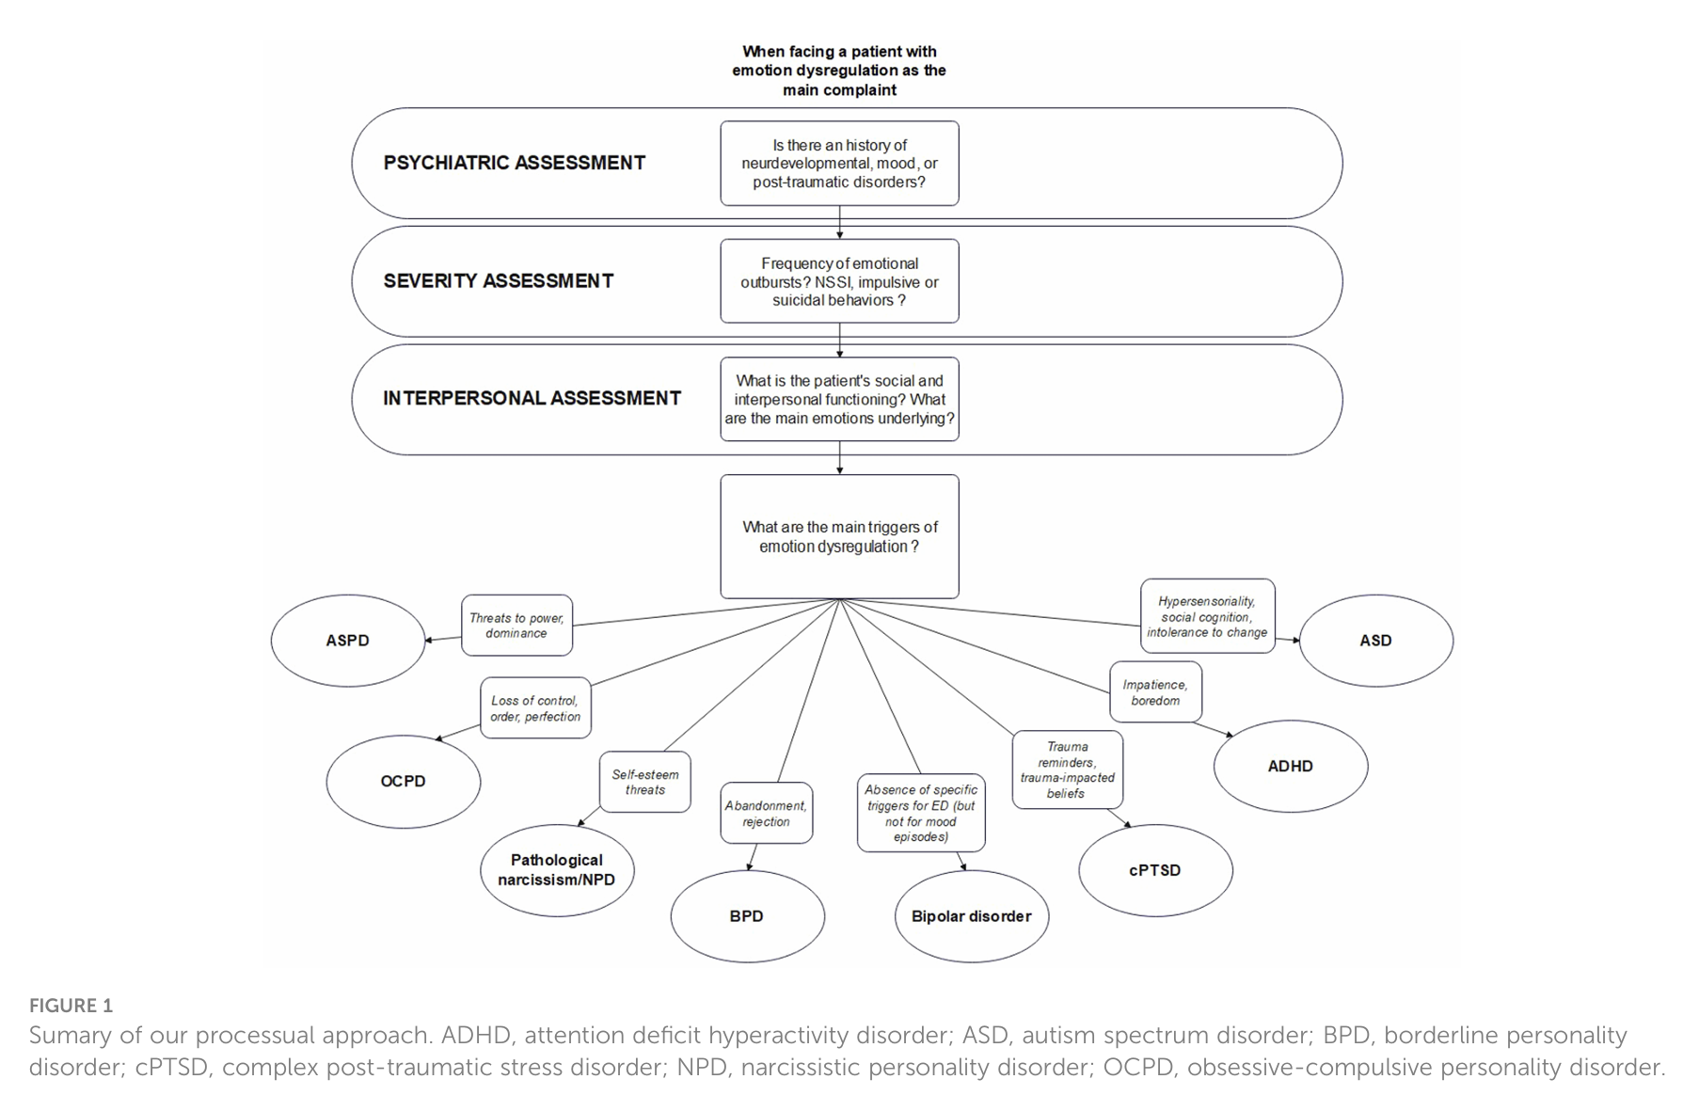
Evaluation (1)

Slide 16
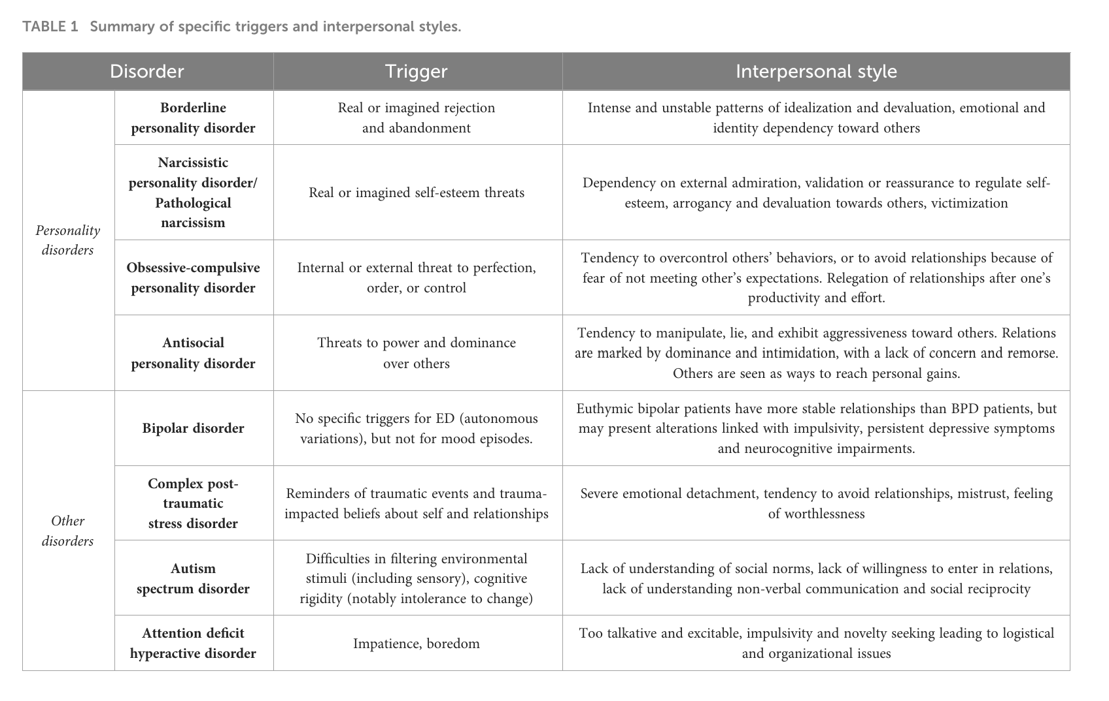
Evaluation (2)

Slide 17
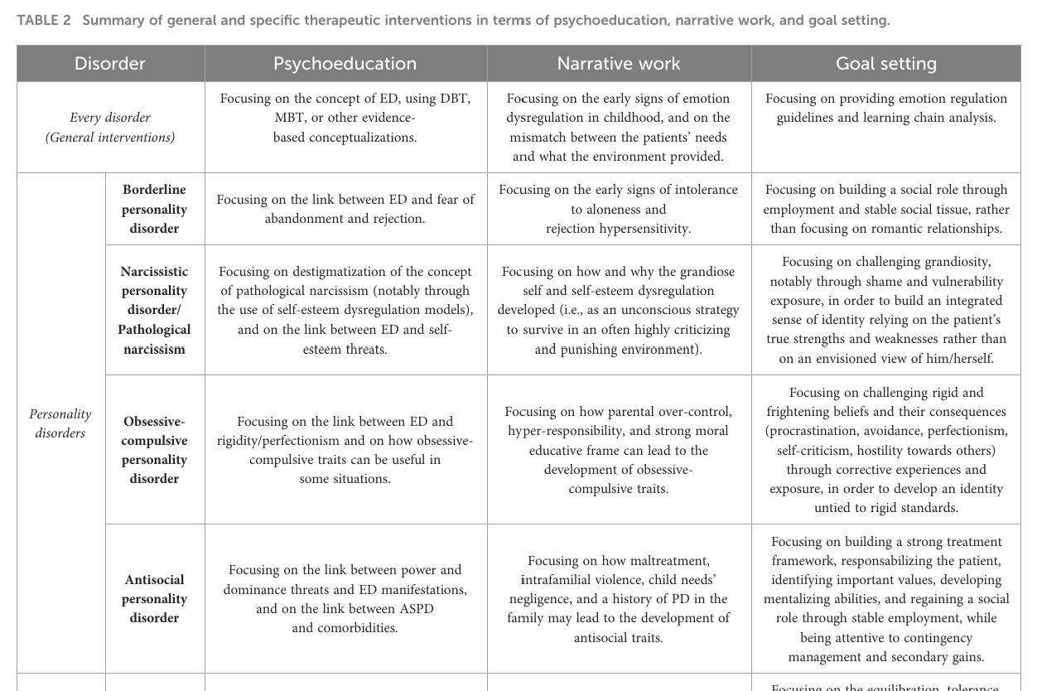
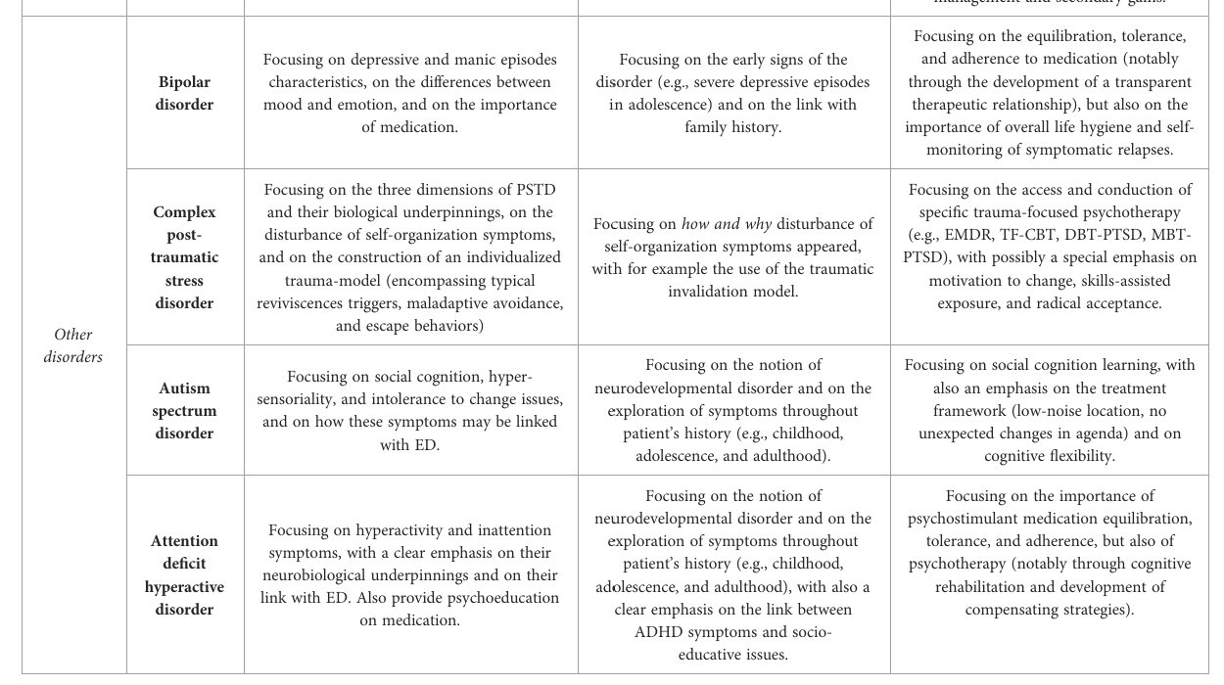
Treatment

Slide 18
GPM-extended

Slide 19
General presentation
GPM-extended builds on the foundational principles of GPM for BPD
Diagnostic process focuses on BPD criteria and integrates dimensional AMPD tools (for personality functioning)
This process is enhanced using the three main GPM dilemmas developed at that time to assess how one’s personality may dysfunction.
The assessment of the presence/absence and relevance of each dilemma for each patient relies on both clinical and psychometric investigation
Once the main dilemmas are identified, both the clinician and the patient work on a clear prioritization of the treatment targets, with the most impacting dilemmas being the first one to focus on.

Slide 20
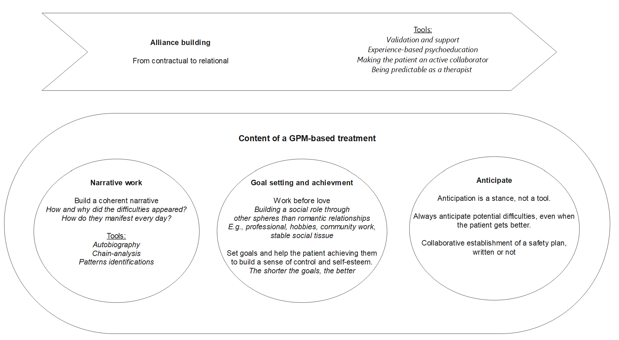
Treatment content
The content remains the same… but GPM-extended tailors psychoeducation and case management to each patient’s specificities.

Slide 21
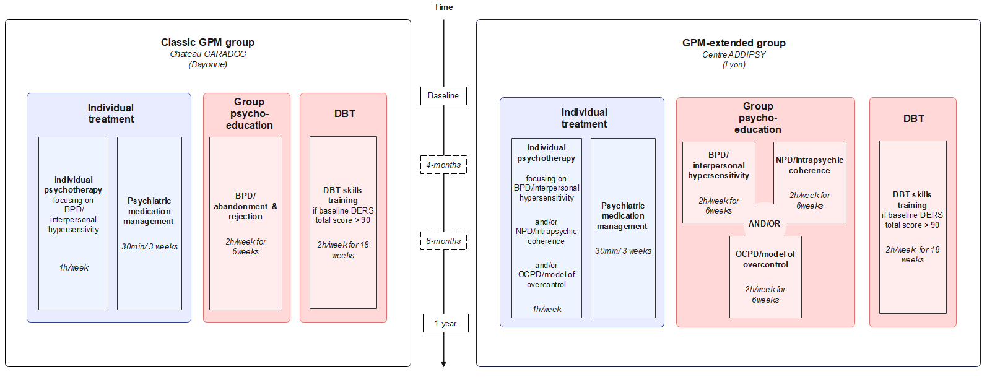
The EPSYLIA study

Slide 22
Outcomes
Primary : change in overall intensity of ED, as assessed by the DERS total score, between before and after 1 year of treatment.
Secondary : change between before and after 1 year of treatment on
Emotion dysregulation subdimensions severity, using DERS sub-scores
Interviewer-rated BPD symptoms, using the ZAN-BPD total score
Self-rated BPD symptoms, using the BSL-23 mean score
Emotion dysregulation related behaviors, including anger outbursts, affective dysregulation, self-harming/suicidal behaviors, and self-damaging impulsive behaviors, using ZAN-BPD’s items 1, 2, 7 and 8 scores.

Slide 23
Methods
Data from the larger EPSYLIA study (NCT06913738) were used for the present analyses.
Inclusion criteria :
1°) being >18 years old
2°) having a diagnosis of BPD made using the SCID-II
3°) having signed an informed consent
4°) being affiliated with or beneficiary of the French social security system.
Scale used in the present analyses
SCID-II, ZAN-BPD, BSL-23, DERS
Analyses:
On complete cases only.
Paired Student t tests (or Wilcoxon tests), effect sizes.

Slide 24
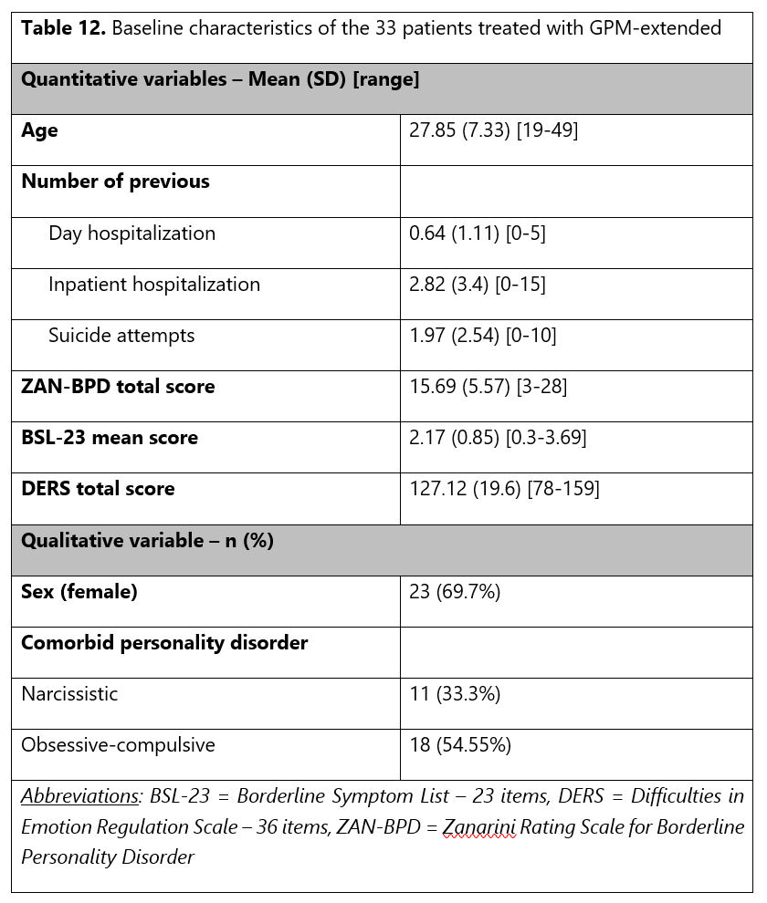
Results (1)
33 patients diagnosed with BPD were included in the study (mean age = 27.85 (SD = 7.33) years, 69.7% female).
2 drop out, 5 finishers that did not undergo the final evaluation
26 patients underwent final psychometric evaluation, with only 25 fulfilling DERS and BSL
With 25 pairs, we had 80% statistical power to detect a medium-sized effect (d = 0.58) on the total DERS score in a two-tailed paired t-test at a significance level of 5%,
Notes:
In summary, patients had moderate (according to the ZAN-BPD) to high (according to the BSL-23) intensity of borderline symptoms, and severe ED symptoms according the DERS (Burton et al., 2022). The comorbidity rates for NPD and OCPD were high, with a third of patients (for the first) and more than half of the patients (for the second) rating positive.

Slide 25
Results (2)
Regarding treatment delivered, 3 therapists were involved
Therapist 1 = 21, 63.84%
Therapist 2 = 9 (27.27%)
Therapist 3 = 3 (9.09%)).
Alongside individual therapy
31 patients underwent the BPD-focused psychoeducation group (93.94%)
14 underwent the narcissism-focused psychoeducation group (42.42%)
Only one 1 underwent the OCPD-focused psychoeducation group (3.03%), the lack of participation was mostly due to organizational reasons
26 patients underwent the DBT-skills training group (78.79%).

Slide 26
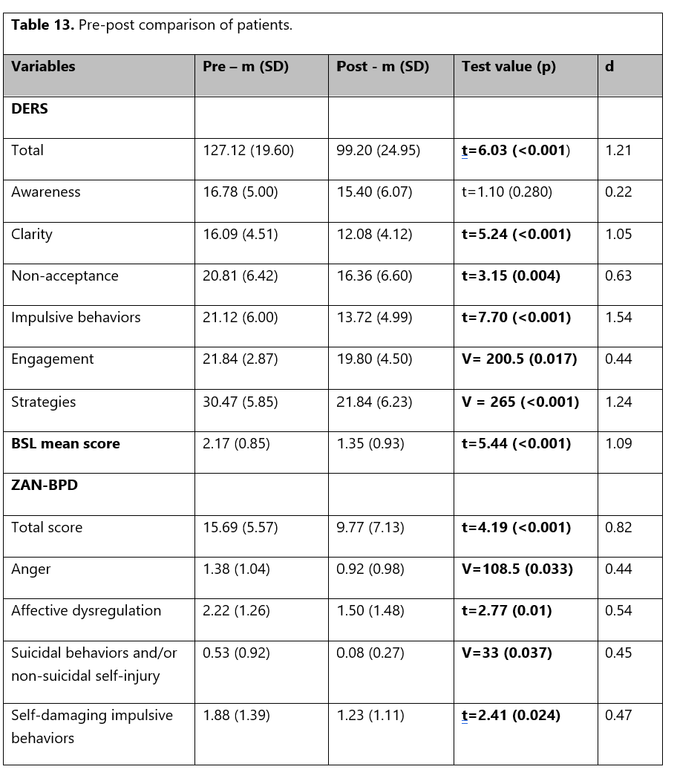
Results (3)
Significant decrease in overall ED severity with a strong effect size, and with an intensity going from severe to mild
At the subscale level, only lack of emotional awareness did not decrease significantly
Regarding borderline symptom severity, we observed a significant decrease in the BSL mean score and ZAN-BPD total score, with strong effect sizes, going from high to moderate intensity (BSL) and from moderate to mild intensity (ZAN-BPD).
At the item level, significant decreases were observed for anger, affective dysregulation, suicidal behaviors and/or non-suicidal self-injury and self-damaging impulsive behaviors, with small-to-medium effect sizes.
Finally, at the diagnostic level, 10/26 patients did not fulfill the BPD diagnosis anymore after treatment (38.46%).
Notes:
Significant decrease in overall ED severity (127.12 to 99.20, p < 0.001, d = 1.21), with a strong effect size, and an intensity going from severe to mild (Burton et al., 2022).
At the subscale level, only lack of emotional awareness did not decrease significantly (16.78 to 15.40, p = 0.280, d = 0.22). Lack of emotional clarity significantly decreased (16.09 to 12.08, p < 0.001, d = 1.05), with a strong effect size, as did difficulties in controlling impulsive behaviors (21.12 to 13.72, p < 0.001, d = 1.54) and lack of access to emotion regulation strategies (30.47 to 21.84, p < 0.001, d = 1.24). Non-acceptance of emotional responses also significantly decreased (20.81 to 16.36, p = 0.004, d = 0.63), with a moderate effect size. Difficulties in engaging in goal-directed behaviors also significantly decreased (21.84 to 19.80, p = 0.017, d = 0.44), with a small-to-medium effect size.
Regarding borderline symptom severity, we observed a significant decrease in the BSL mean score (2.17 to 1.35, p < 0.001, d = 1.09), with a strong effect size, going from high to moderate intensity (Kleindienst et al., 2020). A similar observation was found with the ZAN-BPD total score (15.69 to 9.77, p < 0.001, d = 0.82), going from moderate to mild intensity. At the item level, significant decreases were observed for anger (1.38 to 0.92, p = 0.033, d = 0.44), affective dysregulation (2.22 to 1.50, p = 0.010, d = 0.54), suicidal behaviors and/or non-suicidal self-injury (0.53 to 0.08, p = 0.037, d = 0.45), and self-damaging impulsive behaviors (1.88 to 1.23, p = 0.024, d = 0.47), corresponding to small-to-medium effect sizes. Finally, at the diagnostic level, 10/26 patients did not fulfill the BPD diagnosis anymore after treatment (38.46%).

Slide 27
What can we say?

Slide 28
Summary of results
These preliminary results suggested that, despite important methodological limitations, a dimensional trigger-based of GPM (GPM-extended) was feasible in routine outpatient care and can lead to clinically meaningful improvements of ED and BPD symptoms
Furthermore, they offer preliminary support for the use of GPM as a foundational framework for a modular approach to the treatment of personality disorders.
GPM was not only used as a generalist treatment but also as an overarching clinical framework that structures the integration of additional therapeutic components according to patients’ predominant personality profile.
But many, many limitations to take into account…

Slide 29
Towards a stress-sensitive GPM general conceptualization?
While the notion of triggers provides a descriptive and clinically useful framework for ED conceptualization and treatment, we believe that it can also be used more broadly in the specific context of PDs.
In these disorders, triggers can be understood as situations in which the mechanisms that ordinarily support self-regulation are compromised or temporarily lost.
This interpretation introduces a stress-sensitive dimension to the trigger-based model, not as an initial assumption, but as a second-order explanatory framework.
Put in other words, in PD patients, triggers do not actually provoke emotional reactions. Rather, they signal a loss or threat to the structures that ordinarily support self-regulation.
ED may thus emerge when these individuals are no longer able to rely on their usual strategies to regulate their identity, emotions, and sense of agency.

Slide 30
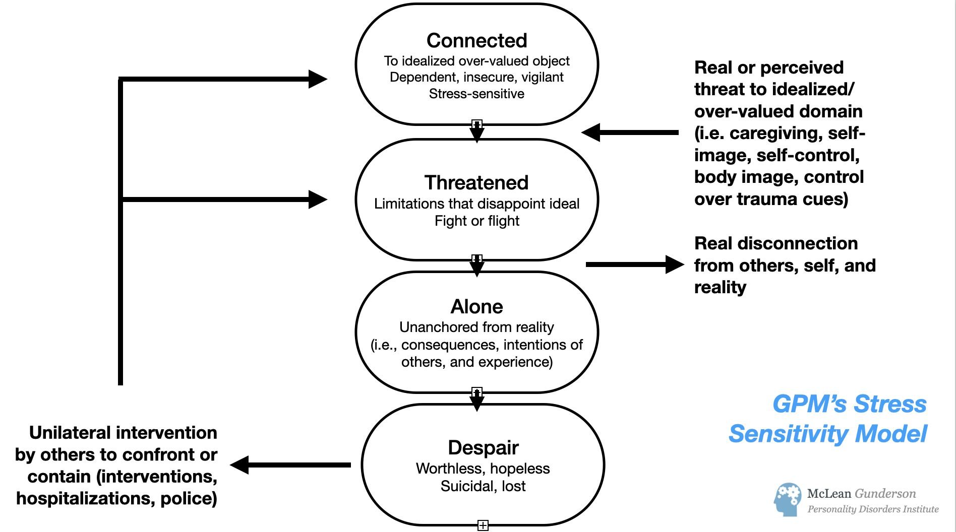
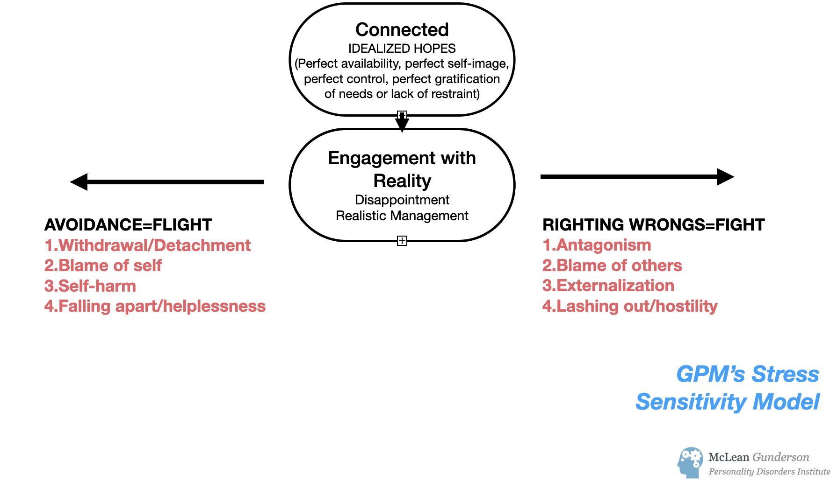

Slide 31
Thank you for your attention. Martin.blay5@gmail.com
Martin Blay, MD, MSc
Psychiatrist-psychotherapist
Head of the Personality Disorder Unit EPSYLIA, Lyon, France
PhD candidate in clinical research at Paris Saclay University

