Slide 1
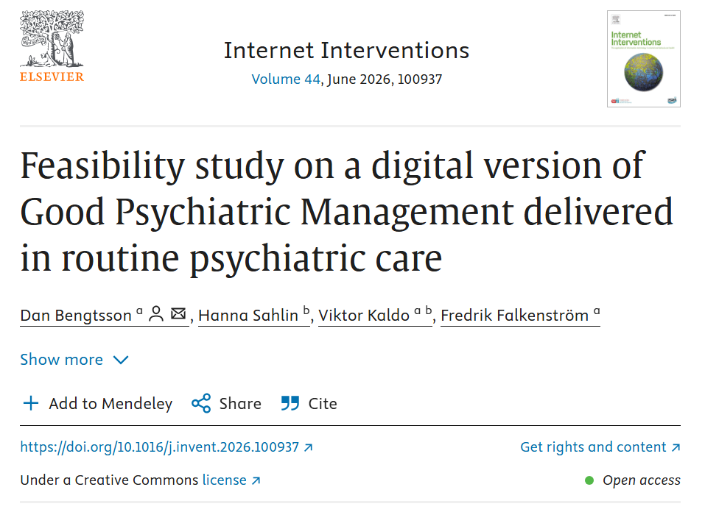
A Pilot Study of GPM-I in Routine Care
Feasibility, refinement, and the clinical logic of GPM-I, phase II
Dan Bengtsson, Licensed Psychologist, PhD Candidate
Linnaeus University · Personality Disorders Unit, Huddinge University Hospital · Region Stockholm
GPM International Conference Stockholm · May 2026
Linnaeus University

Slide 2
02 GPM-I: What & why
GPM was working – but the same three gaps kept showing up. We built GPM-I to close them.
STARTING POINT
No low-threshold option for patients outside specialist programs
GPM thinking doesn’t travel beyond personality specialists
Yet the psychoeducational core is transmissible – shouldn’t need a specialist slot
Assessment
Diagnosis confirmed
Low-threshold intervention missing
Specialist treatment
MBT / DBT
OUR RESPONSE · GPM-I AT A GLANCE
FORMAT
Digital guided self-help
8 weeks · weekly written feedback
STRUCTURE
Core modules + optional modules
Psychoeducation on personality mechanisms
PLATFORM
Stöd och Behandling
Sweden’s national digital care platform
TARGET
Personality disorders
& related problems · ICD-11
Linnaeus University
Based on GPM principles, adapted for digital delivery in routine care

Slide 3
03 Pilot study: Design & sample
Study design
Outcomes & pathways
Design
Naturalistic open feasibility study
Clinical pathways
Setting
Outpatient psychiatry, Psykiatri Sydväst
Assessment Unit
ADHD / Neuropsychiatry Units
Personality Disorders Unit
Recruitment
Aug 2023 – Dec 2024
Primary feasibility outcomes
N
131 offered → 78 initiated
Uptake and completion
Acceptability (CSQ-8)
Negative effects (NEQ)
Secondary outcomes
Weekly CORE-10 (mixed-effects model)
Pre–post symptom measures (DERS, PHQ-9, GAD-7, WHODAS)
DIAGNOSTIC GROUPS
Personality syndrome
ICD-11 personality disorder
Personality difficulties
Sub-threshold / co-occurring
Related problems
Emotion dysregulation, ADHD overlap
Naturalistic open feasibility study · Psykiatri Sydväst · N = 78 initiated
Linnaeus University

Slide 4
04 Key findings
Feasibility indicators · Table 1. Acceptability & completion
Exploratory outcomes · Table 2. Pre-post by diagnostic group
Measure | n | %
Program initiated (≥1 module) | 78 | 59.5
Standard completion (M 1–2) | 40 | 51.3
All modules completed (1–6) | 13 | 16.7
CSQ-8 satisfaction | 28 | 85.7
Willingness to return | 28 | 78.6
Helped deal more effectively | 28 | 67.9
≥1 negative effect (NEQ) | 25 | 32.1
Measure | PD Pre | PD Post | PSP Pre | PSP Post | MDG Pre | MDG Post
DERS-16 | 53.67 | 47.67 | 56.53 | 52.33 | 52.86 | 50.86
BSL-23 | 1.43 | 1.27 | 1.46 | 1.25 | 1.46 | 1.50
Note. Values shown as means. PD = personality disorder, PSP = personality problems, MDG = mixed diagnostic group. Exploratory outcomes; descriptive group comparisons.
Note. Initiation row: 78/131 offered. CSQ-8: n = 28 respondents. NEQ: n = 27 respondents; 25 endorsed ≥1 negative effect. Other percentages are based on N = 78 initiators.
Feasibility results with exploratory pre-post outcomes · N = 78
Linnaeus University

Slide 5
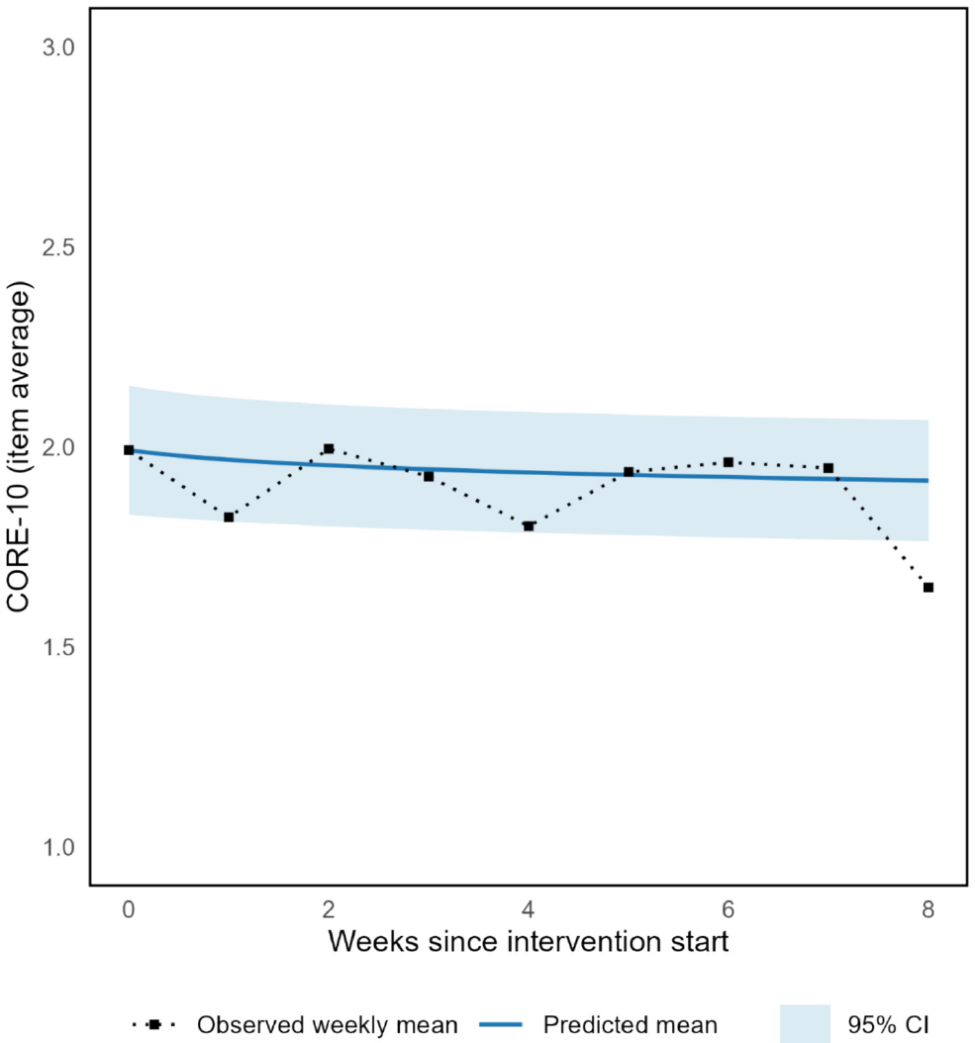
05 Weekly CORE-10 trajectory
CORE-10 trajectory · Linear mixed-effects model
Parameter | Estimate | SE | p
Intercept | 1.52 | 0.08 | < .001
log(week+1) | −0.074 | 0.033 | .031
Note. Random intercept by initiator; fixed effect of log(week+1). N = 581 observations. Satterthwaite df. AIC = 692.4 (log-time) vs 693.5 (session).
Interpretation. Over 8 weeks, the estimated reduction was small: ≈0.15 points on the 0–4 mean scale (≈1.5 points on 0–40 total). This suggests modest group-level change and considerable between-participant variability.
Feasibility results · N = 78 · CORE-10 weekly self-report
Linnaeus University

Slide 6
06 What the pilot taught us
INSIGHT 1 · REBALANCING
The program was structurally overloaded
2 core modules: concepts stacked without space to process
4 optional modules: deeper content reached too few
INSIGHT 2 · THEORETICAL SPINE
The program lacked a theoretical anchor
GPM-informed ≠ GPM-anchored
Psychoeducation present but loosely connected
INSIGHT 3 · FEASIBILITY
Delivery worked in routine care
Implementable by regular clinical staff
Results imperfect, but feasibility was demonstrated
Restructure: 4 modules as the full program
Every participant receives the complete intervention
Elective deep-dive modules extend – not supplement – the four
Anchor in hypersensitivity model
Already central to GPM – becomes the organizing principle
Transforms disparate content into coherent intervention
Refine and scale
Update program with feedback & lessons learned
Move toward larger, powered study
This led to → GPM-I 5.0
The pilot gave us three lessons: the program had to become lighter, more coherent, and more scalable.
Linnaeus University

Slide 7
07 The logic of GPM-I 5.0
Four modules, one clinical logic: understanding and working with the hypersensitivity cycle
4 MODULES — 100% GPM-I
1
Diagnosis & insight
2
Emotions
3
Life domains
4
Change
What is the pattern?
personality dynamics
What drives the cycle?
emotional sensitivity and consequences
Where does it play out?
“work before love”
Why is change hard?
stress, action and resistance
+ OPTIONAL ADVANCED DEEPENING · adds depth to the core modules, not new content
Emotions deep-dive
Emotion regulation
Self-image
Models & tools
Build your change plan
Hypersensitivity not only explains the problems. It also explains why change is hard.
Linnaeus University

Slide 8
08 When change activates the hypersensitivity cycle
Connection
idealises, dependent, rejection-sensitive
WHEN A PATIENT TRIES TO CHANGE
Change activates the same cycle
Trying something new activates interpersonal stress and pulls the patient into the cycle.
Threatened
anxiety/anger, protest, self-harm
THE CORE INSIGHT
Resistance reflects the hypersensitivity dynamic
The same pattern is identified in M1, explored in M2, mapped in M3, and activated in M4.
re-activated by interpersonal stress
THE PROGRAM LOGIC
Aloneness
withdrawal, mistrust, dissociation,
impulsivity
One cycle, four modules
The same cycle underlies each module – here seen through the lens of change.
Despair
hopelessness, suicidal risk, emptiness
Linnaeus University

Slide 9
09 From feasibility to powered evaluation
Testing GPM-I 5.0 as a scalable routine-care intervention
CURRENT IMPLEMENTATION
EARLY ROUTINE-CARE SIGNALS
NEXT STUDY
Delivered in routine care today
Encouraging early indications
Toward a powered evaluation
Delivered in routine care by a small clinical team.
Weekly written feedback is the main care contact.
Open to national self-referral across Sweden since November.
225 self-referrals received in the last 6 months.
Early signals suggest higher completion of the revised program.
Patients report high satisfaction.
The refined format appears easier to deliver.
Focus on outcomes, engagement, and scalability.
Test whether the refined version can produce meaningful change at scale.
Linnaeus University

Slide 10
Early participant feedback
Illustrative comments from routine-care use, translated from Swedish
Recognising patterns
Using emotions differently
Small sustainable changes
“I notice when my system is challenged, and can ask whether I want to act from an old pattern.”
“I listen more to the information my emotions give me.”
“I have started to see that change can be small and sustainable.”
“I focus more on myself than on others.”
“I feel less afraid of going into challenging situations.”
“I have started saying no without first building up irritation.”
Illustrative feedback, not formal qualitative analysis.
Linnaeus University

Slide 11

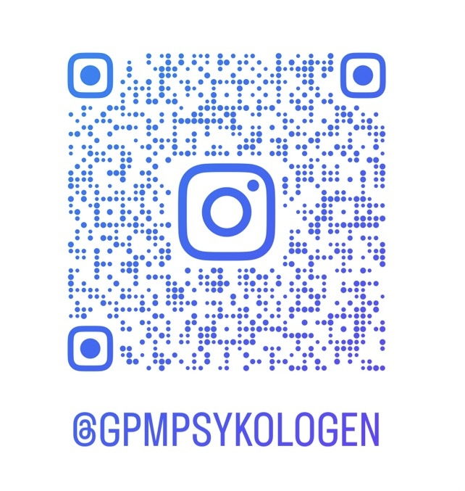
Thank you!
The Team
Feel free to reach out for questions, collaboration, or any professional exchange
To read more about GPM-I (in Swedish):
internetpsykiatri.se/behandling/personlighetsproblem
dan.bengtsson@lnu.se
Dan Bengtsson · Linnaeus University
Linnaeus University

