Slide 1



Borderline Personality Disorder Collaborative
GPM Complex: implementation of a systems approach to the treatment of BPD
Laura Cooke-O’connor | Advanced Clinician Coordinator
Cathy McLeod Everitt | Service Development Manager

Slide 2
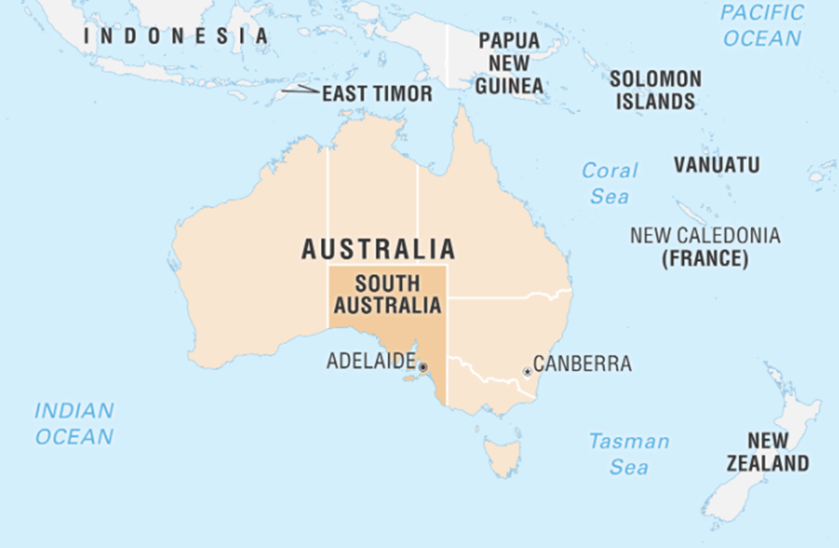
South Australia
Subtitle
Heading
  Population: 2m
  Area 983, 482km²
  BPD pop est:
  17,700 – 70,800
  BPD Co: 12.5
  Clinical FTE
  dot points
  dot points
Notes:
Kaurna Country – Adelaide – acknowledging the Kaurna people as the traditional owners of the land which is commonly referred to as Adelaide and is where BPD Co is located.
As a statewide service we service the entire state.
For context size wise – Sweden would fit into SA 2.2times
Population - SA 2m and Sweden 10.7m, 5.5 times larger population
Of the 2m of the 1.5m live in Adelaide - population spread across our regional and remote area is very small – this presents a challenge when trying to deliver mental health services and particularly evidence-based services for people living with BPD across the state
Our presentation today outline how as a service we have adapted GPM for complexity, we will outline our services foundation which has facilitated the implementation of GPM-Complex across the state and we will share a case study which provides an example of a systems approach to complex care utilising the GPM-complex framework.
Our service, a government funded specialist MHS was initially conceptualised as a centre of excellence; however, this model risks undermining our core philosophy of strengthening the entire system— leading instead to the development of a Collaborative, a systems approach that invests in local excellence, supports clinicians to build confidence and capability to deliver care within their own settings, increasing access to tx care where people live.
Given the high prevalence of the disorder between 17,000 and 72,000 – and in acknowledgement of resource constrained public mental health service our MoC it to implement a…

Slide 3
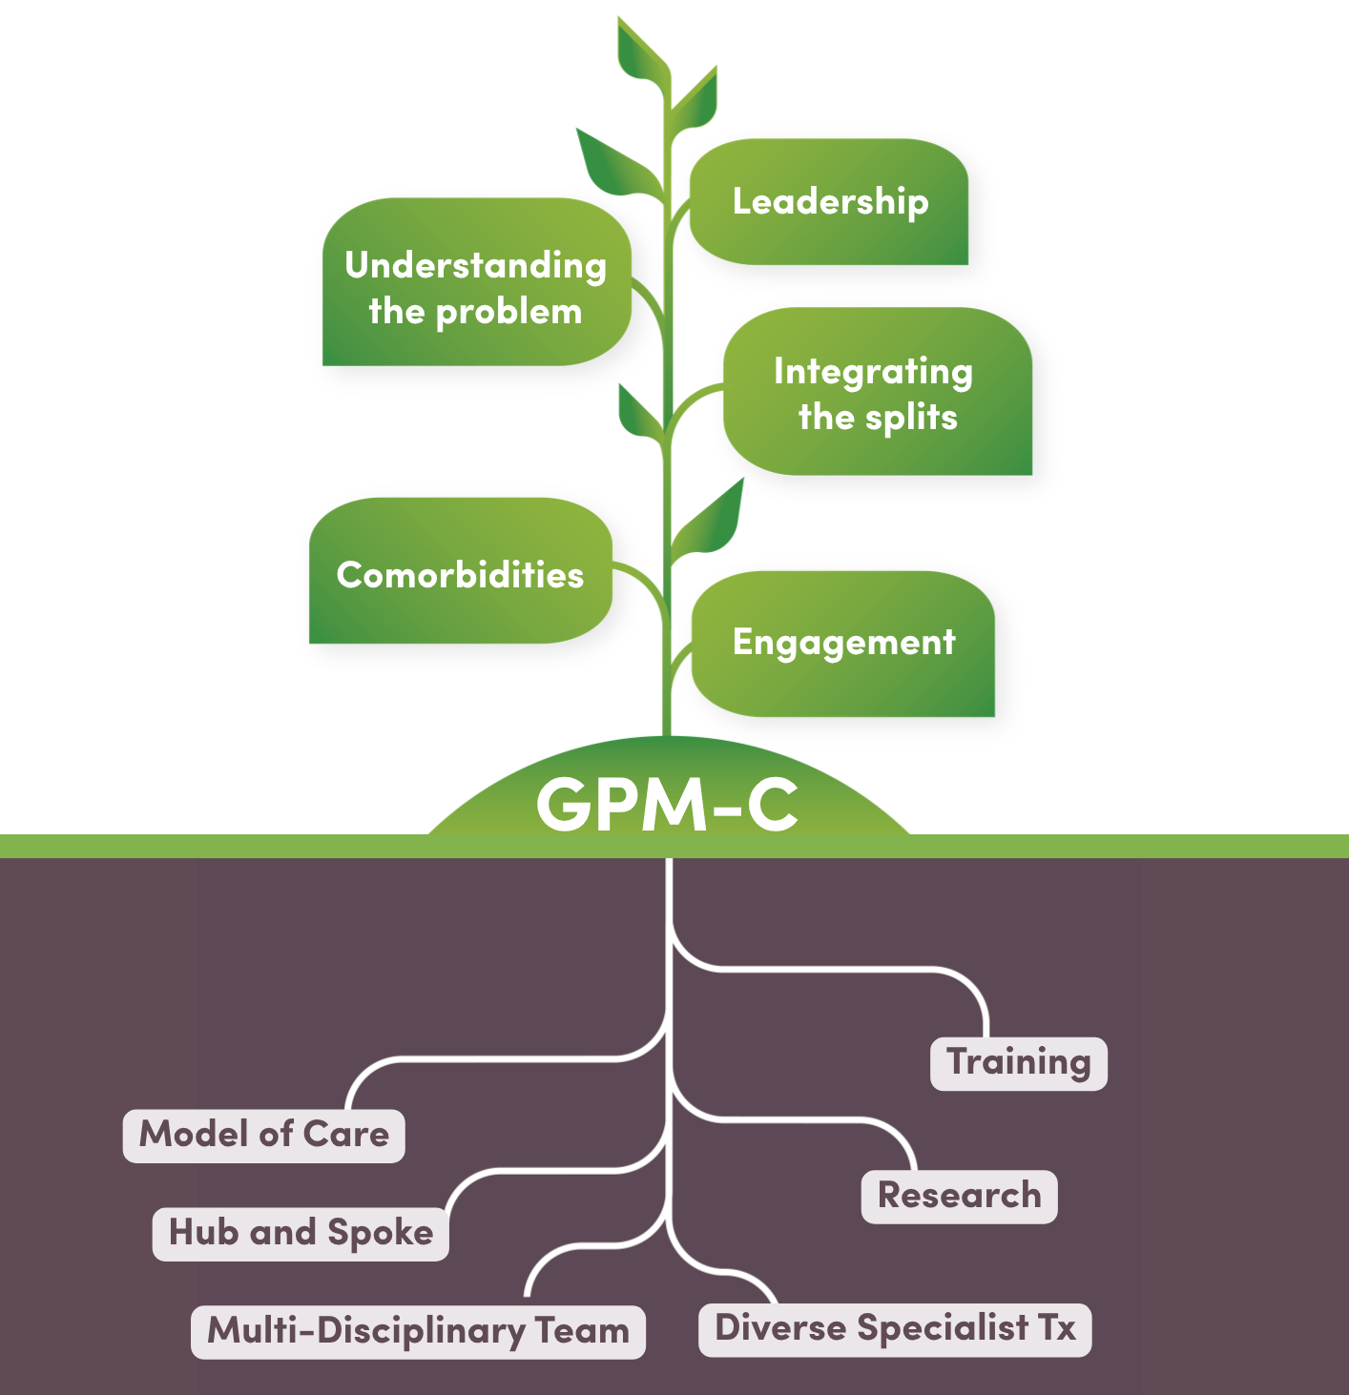
Stepped Care Model
Stepped Model of Care
Subtitle
Heading
Brief intervention
Intermediate interventions
Intensive Interventions
  dot points
  dot points
Notes:
Brief interventions a 4 session post crisis intervention – developed by PA.
And a 6 session GPM intervention for young people is being implemented in a regional location, using the Interpersonal Coherence Model as a hypothesis generator.
Intermediate interventions – consisting of short-term (10-12week) individual or group interventions have been developed and delivered
- Implementation of 10 session GPM Clinic at BPD Co.
Provides an opportunity for our team of clinicians, Psychiatry Registrars and students to develop experiencing in delivering GPM
Intensive Inventions – this includes the specialist EB tx (you are all familiar with)
- more specifically what we are here to talk about today is GPM for complexity where people are presenting with a level of complexity that prohibits engagement with the specialist EB tx.

Slide 4
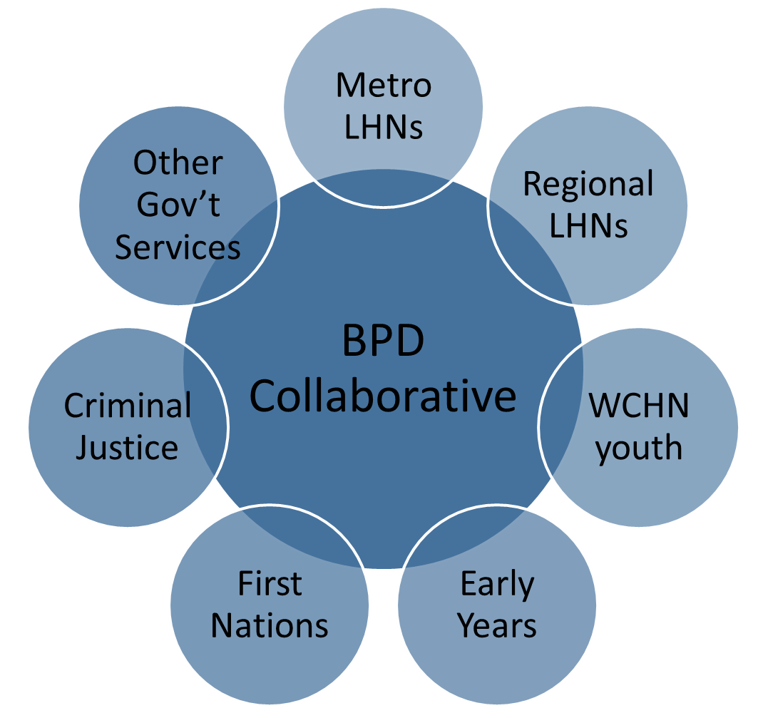
Hub and Spoke
Subtitle
Heading
  dot points
  dot points
Notes:
Our service model is facilitated by a hub and spoke model
Hub - BPD Co is situated as the hub our team of clinician and project workers are based and outreach to the
Spokes – the services across the state, including local MHS based in the communities across the state.

Slide 5
Implementation Process
Subtitle
Leadership
Tailored to the environment
Team Engagement
Training
Supervision & mentoring
Evaluation
Heading
  dot points
  dot points
Notes:
Guided by implementation science BPD Co have utilised a structure process to support system wide engagement and implementation of the model of care.
- Leadership – engagement with Exec and then local leadership in the health networks
Understanding the local environment – through regular meetings and having our hub clinicians on the ground in the local teams, their role is to get to know the local environment
Clinician establish relationships with the teams, these connections have facilitated opportunities to promote the GPM framework
With exec/leadership endorsement and willingness from the team clinicians
GPM and GPM-A training has been provided across the state, accompanied by
Post training support – supervision and mentoring has been key to supporting integration to practice.
Having a dedicated Research team has helped embed evaluation mechanisms into all elements of our service
Which is fed back in partnership meetings to support continuous quality improvements

Slide 6
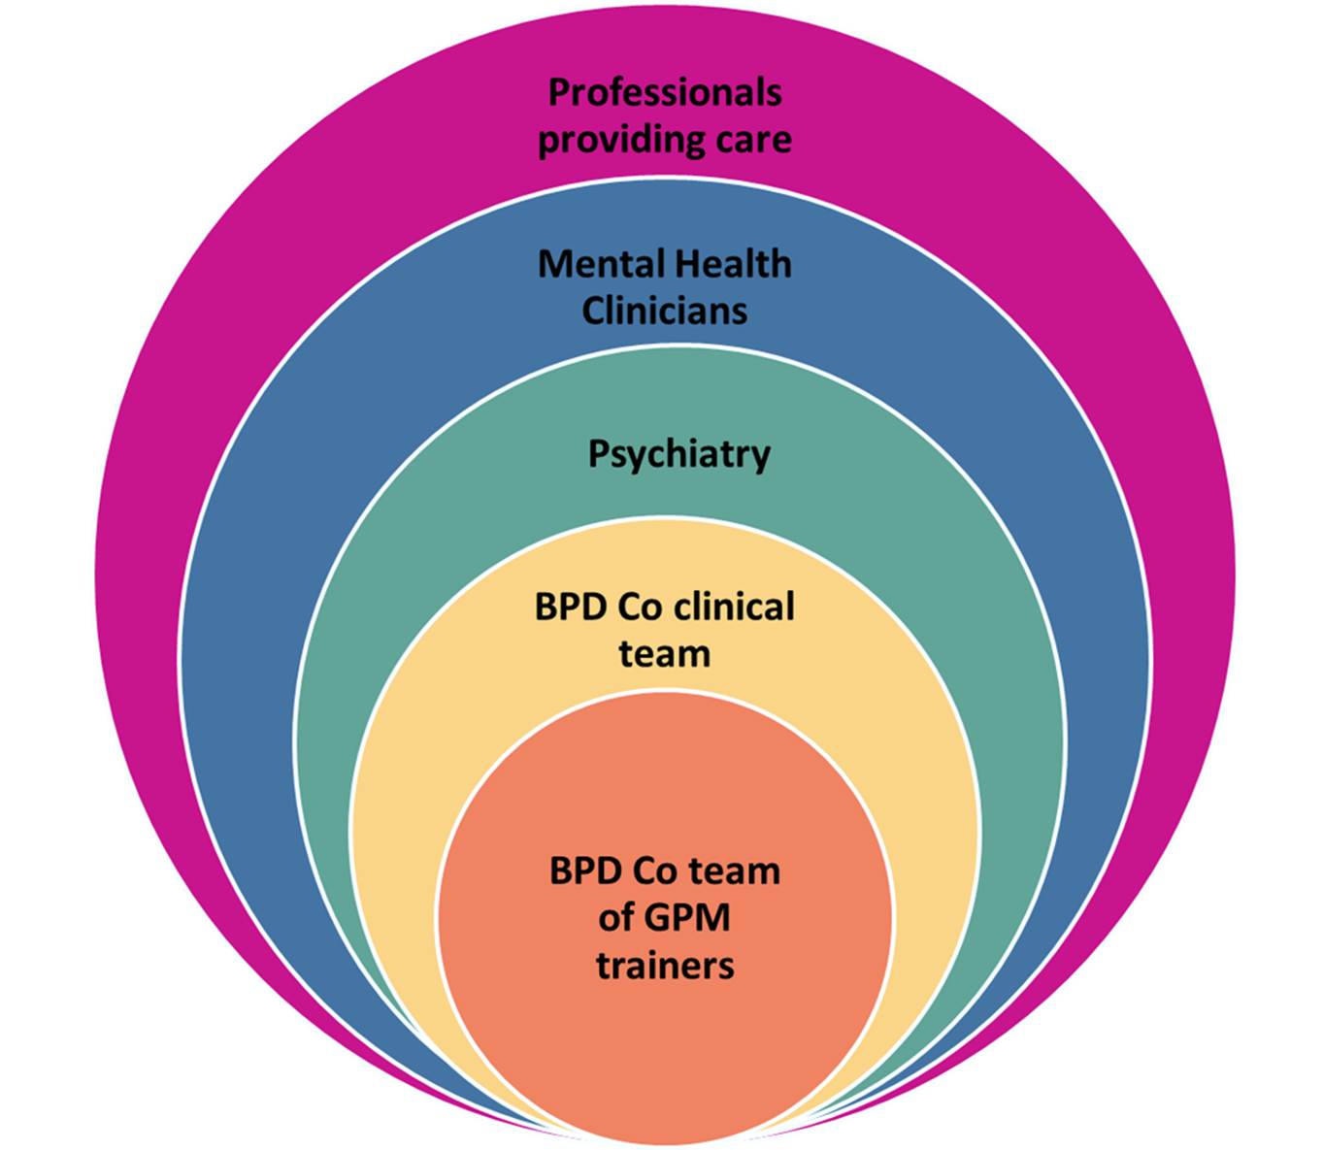
GPM training
Subtitle
Heading
  dot points
  dot points
Notes:
In 2020 we were fortunate to engage LCK
In early 2021 LCK provided a TtT program to 7 members of our team which facilitated the development of a GPM training team.
Our GPM trainers first tasks was to train the broader BPD Co team in GPM – this has been scaffolded with post training GPM group supervision delivered by LCK and also a regular peer group supervision at BPD Co.
Our GPM training program then expanded initially targeting Psychiatry and then broadening out to train MH clinicians across the state.
It became apparent in our work with people experiencing the highest levels of complexity, that they were often in receipt of care from multiple service systems (not only MH), often institutional care – Residential Care for young people under the guardianship of the minister and prison for people in contact with the justice system. Training staff providing care in GPM has been key in supporting a systems approach to responding to complexity.

Slide 7
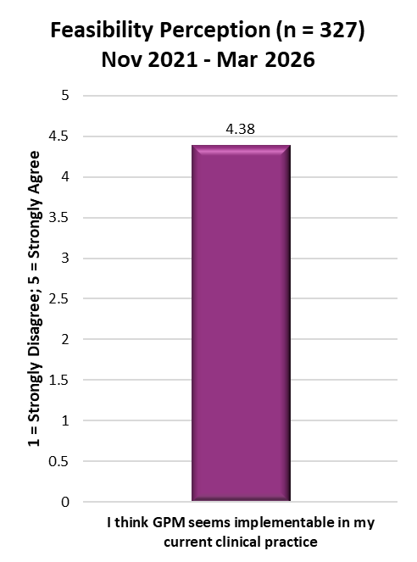
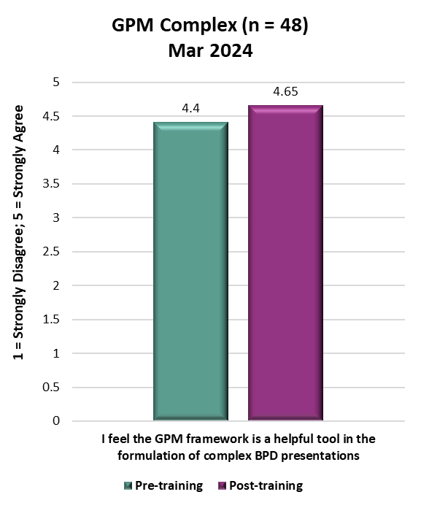
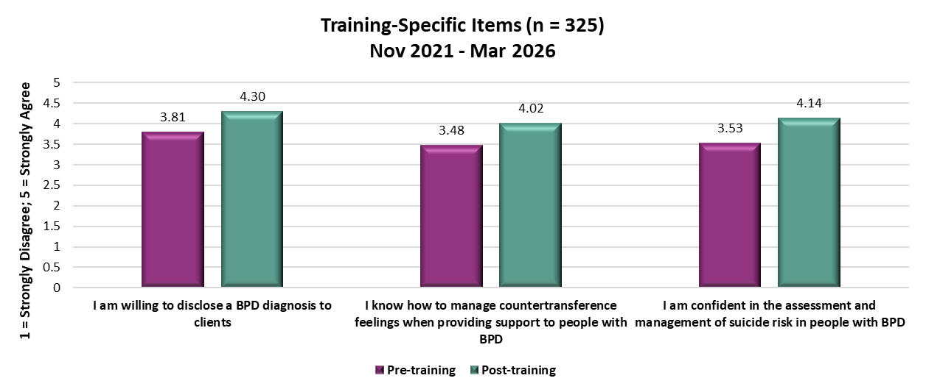
GPM Training Evaluation
  GPM and GPM-A training 2021-2026: 461 participants
  GPM Complex training 2024: 74 participants
Notes:
To date we have trained 461 participant in either GPM or GPM-A training and a further 74 people attended GPM-Complex training LCK and BPD Co facilitate 2024
With the aim of the training to help increase clinician confidence and capability to provide good enough care to people living with BPD. Training participants are routinely asked to complete a pre/post self-assessment of attitudes & skills:
Attitudes & Skills (ASQ; Krawitz, 2004)
Willingness
Enthusiasm
Confidence
Skills & Knowledge
Clinician Empathy (Bodner et al., 2011)
Treatment Optimism (Black et al., 2011)
With now over 300 matched pre/post training responses – we are confident the training is seeing positive impacts on clinician attitudes and skills
In particular we see improvements in self-reported confidence , empathy and treatment optimism
The 3 GPM specific qus saw increases in clinician reported
Willingness to disclose the diagnose BPD,
Knowledge of managing countertransference feeling, and
Confidence in assessment and management of suicide risk in people with BPD
Staff routinely complete implementation measures post training:
Acceptability
Appropriateness
Feasibility
In response to the question I think GPM is implementable in my current clinical practice 90% of all respondents indicated they either agreed or strongly agreed with this statement.
When looking specifically at GPM complex training – we see a positive increase pre/post training in response to question ‘I feel the GPM framework is a helpful tool in the formulation of complex presentations’.

Slide 8
Complexity
  3 or more comorbid psychiatric diagnoses
  Frequent acute service utilisation
  Presenting with high risk
  Requiring support from multiple systems (Mental Health, Acute hospital/ED, First Responders, NDIS)
Notes:
So what do we mean when we say complex presentations?
People presenting with BPD and 3 or more comorbid psychiatric diagnoses
Frequent acute service utilisation
Presenting with very high risk
And requiring support from multiple service systems – mental health, acute hospital and ED services, first responders, NDIS – national disability insurance service – regularly providing paid carer support packages, or other institutional care services.
Our consultation and complex care service embeds a systems approach with a GPM formulation, identifying 5 key principles GPM - Complex

Slide 9
GPM – COMPLEX CARE PRINCIPLES
Notes:
Leadership – building a strong structure
Understand the problem
Integrate the splits
Adress Comorbidities
Enlist Engagement
Leadership: is key with multiple teams/organisations involved. Important to focus on building alliances and a strong structure around the client. A responsive, predictable structure can provide containment of the client.
Understand the problem: when there are more than 3 comorbid diagnoses and BPD, it is important to define the problem that will be the focus of treatment. This needs to be decided upon collaboratively with the client.
Identify splits when they occur and focus on integrating the different experiences and views. There is no magic bullet ie no easy treatment path. Idealised solutions vs disappointing reality.
Identify comorbidities and address eg ID, ASD. They are likely to influence treatment plan.
Important to enlist engagement – of services and the patient’s involvement. This in itself will assist in building consistency and supporting patient agency.

Slide 10


Connected
Controlling-caregiving
Safety-seeking
Real or perceived threat to self or relationship with other
Threatened
Controlling-punitive
Stress- Fight or flight
Withdrawal of others
Alone
Unanchored from reality
GPM’s Interpersonal Hypersensitivity
(IHS) Model
Unilateral intervention by others to rescue, confront, or contain (interventions, hospitalizations, police)
Despair
Worthless, hopeless
Suicidal, lost
McLean Gunderson
Personality Disorders Institute
Notes:
Core Formulation – HIS
When utilsing a systems approach this is also useful to formulate the systems response to the patient and other services involved in the patients care.

Slide 11

GPM: Therapeutic approach
Education is essential – especially for the social safety network
Non-specific factors are central – reliability, listening, concern
Relational issues are central – attachment, trust
Situational changes can be essential – advise, assist
Pragmatism – every patient is different; forego theory if it isn’t working; if not now, wait

Slide 12

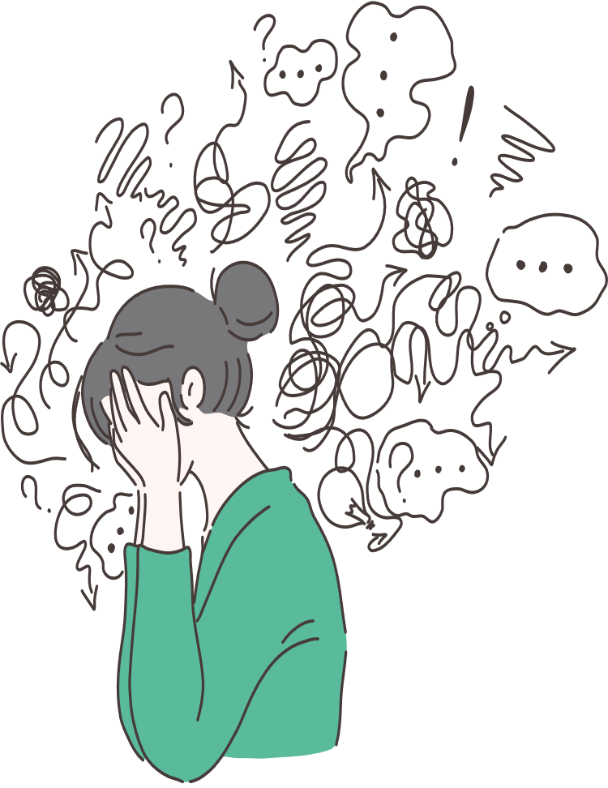
Case Study

Slide 13
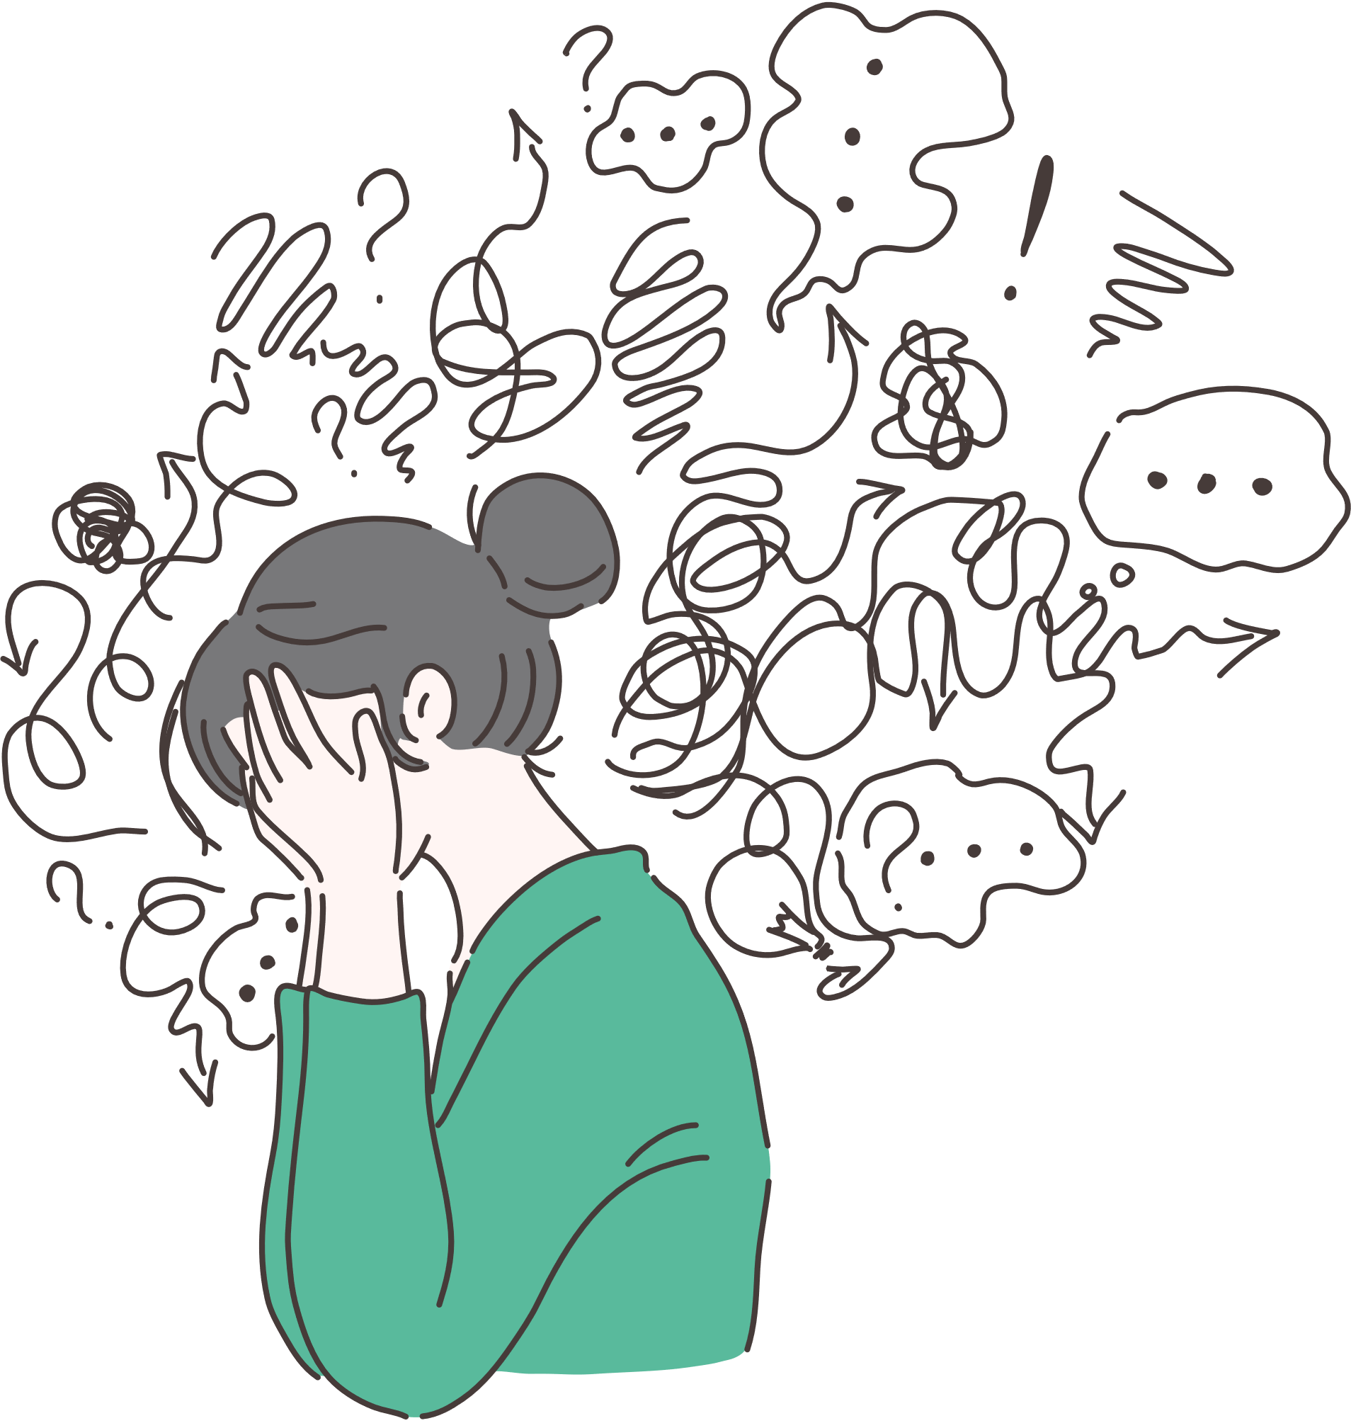
Background
Name: Lenora
Details: 16 yo female
Background: Complex developmental trauma, disrupted attachment. Removed from parents as a child, placed in care with grandparents, then returned to live with mother age 14yo. Removed from mother’s care by Child Protection Services, placed in residential care with multiple placement changes and breakdowns.
Maladaptive care seeking behaviour, frequent presentations to Hospital following self harm and presenting with physical issues to elicit admission, some complaints fictitious.

Slide 14
Symptoms: emotional dysregulation, auditory/visual hallucinations, suicidal/homicidal ideation, severe self-harm ingestion of glass, razor blades, self starvation.
Diagnosis : BPD, C-PTSD, FND, ADHD, ID.
Services involved: Department of Child Protection, Residential Care, CAMHS Guardianship team, Children's Hospital ED, Adolescent inpatient ward, RAH surgical team, RAH consultation/liaison team, SAAS, SAPOL, Education, NDIS

Slide 15
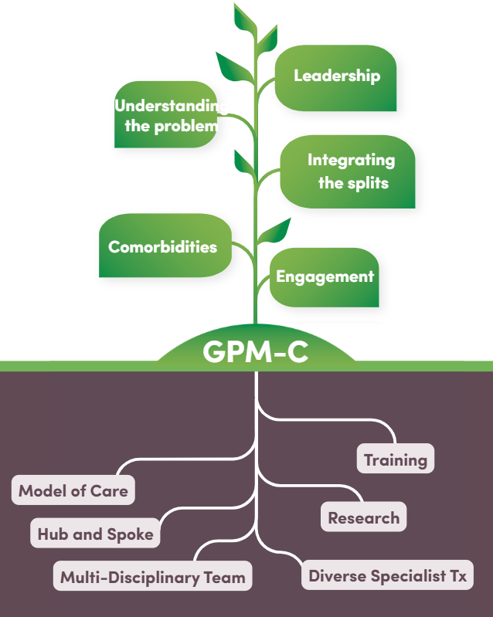
BPD Co receive referral from DCP for Clinical Lead to review current management of patient due to high risk and systems overload
Initial meeting with DCP Executive and CAMHS Psychiatrist followed by meeting with Residential Care and staff management
Development of training to be provided to DCP staff and residential care incorporating GPM-A framework /family Guidelines.
Meeting with Minister for Child Protection and Chief Executive of Child Protection.
Meeting with Director of Residential Care to understand problems staff are facing.
Delivery of training and reflective practice sessions post training to DCP/Residential care staff.
Notes:
LEADERSHIP
BPD Co meeting with the care teams – engaging their leadership – listening
UNDERSTANDING THE PROBLEM
There is conflict between treaters (mental health services) and carers (DCP/resi care)
Staff are overwhelmed and scared of Lenora dying, they have been told they need to keep Lenora alive
Staff have put in complaints about the children’s hospital as they believe Lenora should be admitted long term to keep her safe
Hospital staff tell Lenora she needs to go back home where they can keep her safe
Staff feel criticised by SAPOL and SAAS who tell them they need to keep her safe
The treating team is getting bigger and bigger, more services involved
INTEGRATING THE SPLITS
Acknowledge the commitment from the treatment team and carer team with providing opportunities to improve Lenora’s mental health. Validating their ability to maintain understanding and compassion under such anxiety provoking situations. You are pragmatic in stating that the mental health difficulties are severe and complex and there is high risk of death by suicide or misadventure.
COMORBIDITIES
You provide a clear outline of how she meets criteria for BPD and discuss the co-occurring co morbidities, acknowledging the symptomatic overlap of BPD and C-PTSD and high burden of symptoms. You also outline the role of EBT for BPD.
LEADERSHIP
Collaboratively you engage key stakeholders with understanding the problem, identify the splits, define roles and enlist engagement at a systems level to embrace a GPM-A framework to assist in managing the difficulties and offer support needed to do this, including training and reflective practice to residential care staff.
ENGAGEMENT

Slide 16
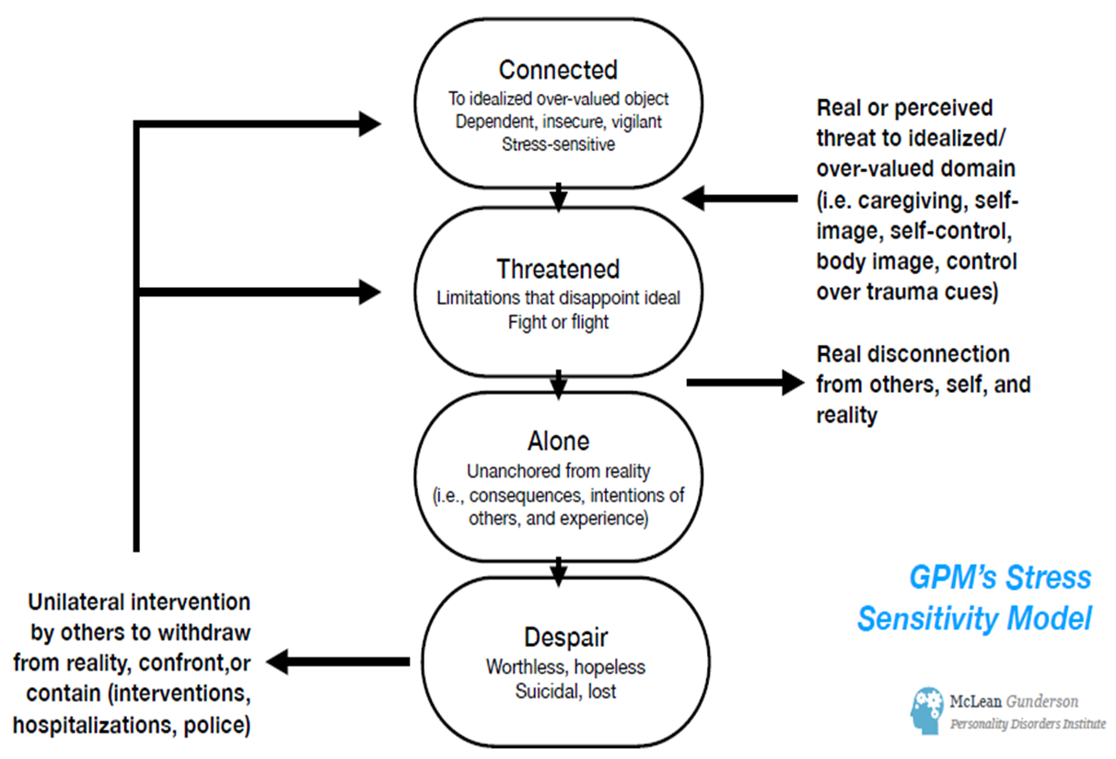
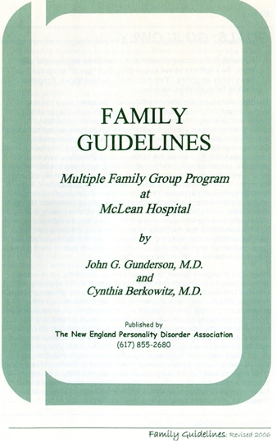
Training the residential care team
Introducing the ICM as a framework to help increase understanding
Exploring how to lean in, to be active and not reactive, to get them more organised, responsive, predictable, consistent and reliable
Using the principles in the family guidelines to:
    Providing care not treatment
    Keeping things cool and calm
    Change is difficult and fraught with fears – go slowly with setting goals
    Being realistic about expectations
    Not getting defensive in the face of accusations and criticisms
    Listening to negative feelings
    Paying attention to self destructive acts
    Acting in concert with one another
Notes:
You develop a workshop on caring for young people with personality difficulties in residential care settings.
Starting with basic information about personality development, how difficulties develop and the stress this causes.
Using the ICM as a framework to help them understand common personality vulnerabilities, to better understand what might be going on for the young people they are working with.
Get them thinking about how to lean in, to be active and not reactive, to keep things cool and calm, to get them more organised in a responsive, predictable, consistent and reliable way.

Slide 17
Feedback from staff after training and reflective practice sessions introducing GPM framework;
They acknowledge they were not responding to Lenora but to the system needs/demands. That the high number of staff/services involved was more about how many people it takes for staff to feel safe.
They tell you they have reduced the care team and have noticed there is less interpersonal noise in the house.
They are focusing on spending time with Lenora, instead of filling in forms about her, taking the time to lean in and have noticed their tolerance for risk has increased. That there is a focus on consistent behaviour from staff.

Slide 18

You meet with the CAMHS clinician to provide GPM-A coaching until they can attend training and supervision:
They let you know the GPM-A approach is helping them manage their own anxiety from the daily emails coming in from multiple services, which cause them to step out of their lane.
They are focusing on their job of maintaining a therapeutic alliance with Lenora and instilling hope and encouraging agency

Slide 19
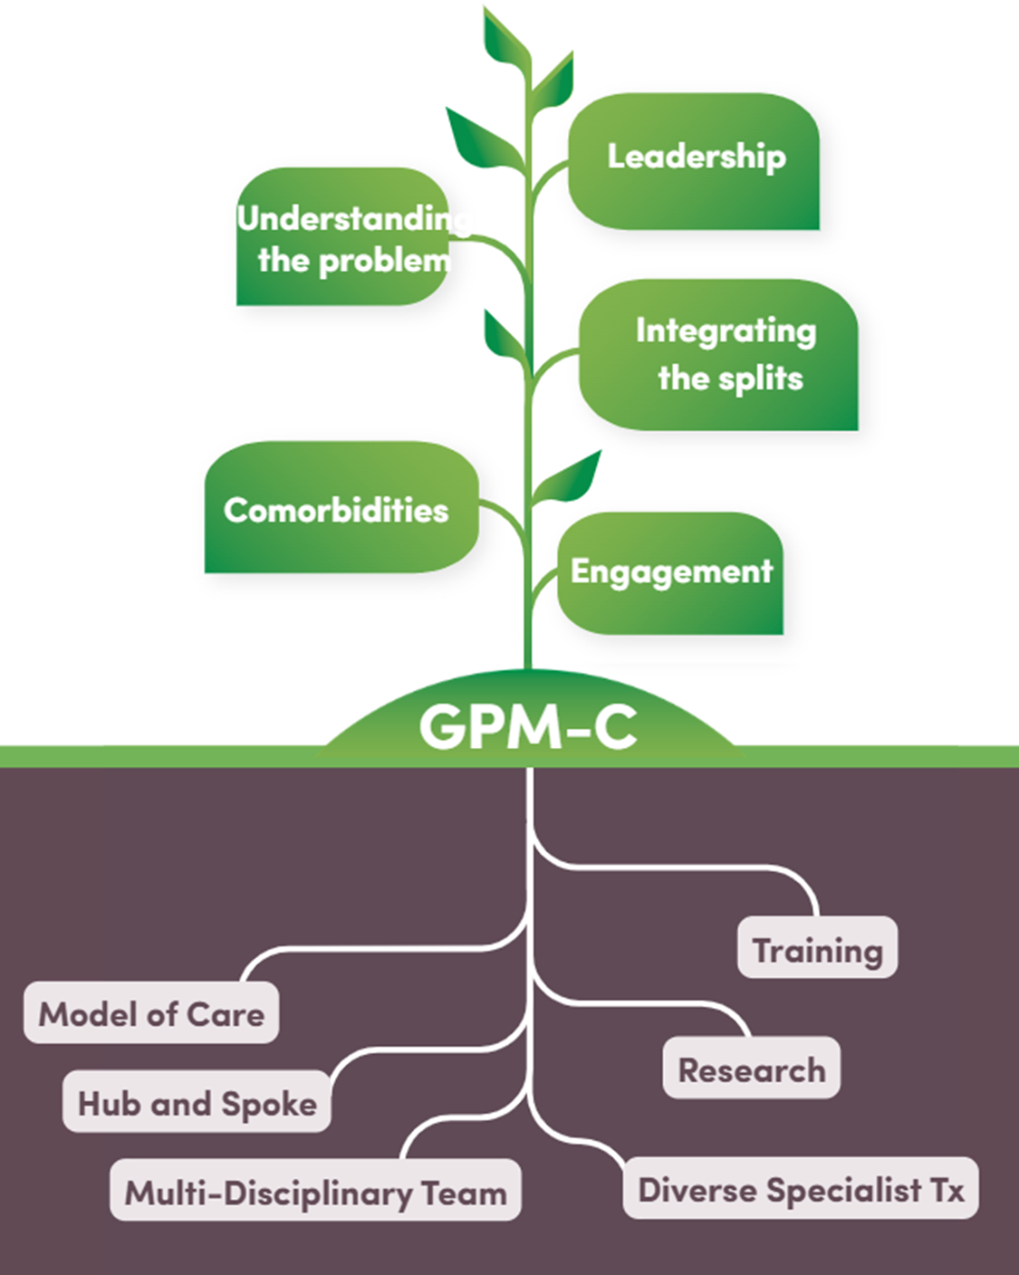
Meet with CAMHS Exec promote value of GPM -A. Approval for clinicians to attend training and GPM-A supervision
Build relationships with clinicians working in metro/regional youth mental health services
Promotion of GPM-A Handbook and Training.
Adolescent clinicians working in metro/regional MHS attend GPM-A Complex Workshop with Lois Choi-Kain 2024.
Delivery of GPM-A training to CAMHS clinicians.
Delivery of supervision/coaching sessions post training.
Development of GPM-A Network, meets monthly.
GPM-A Supervision with Lois Choi Kain 2025 with clinicians working with diversity of presentations.
Notes:
Impact for CAMHS of training and

Slide 20

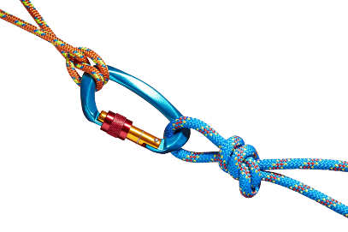
BPD Co receive referral from DCP for Clinical Lead to review current management of patient due to high risk and systems overload
Initial meeting with DCP Executive and CAMHS Psychiatrist followed by meeting with Residential Care and staff management
Meet with CAMHS Exec promote value of GPM -A. Approval for clinicians to attend training and GPM-A supervision
Build relationships with clinicians working in metro/regional youth mental health services
Promotion of GPM-A Handbook and Training.
Development of training to be provided to DCP staff and residential care incorporating GPM-A framework /family Guidelines.
Meeting with Minister for Child Protection and Chief Executive of Child Protection.
Meeting with Director of Residential Care to understand problems staff are facing.
Adolescent clinicians working in metro/regional MHS attend GPM-A Complex Workshop with Lois Choi-Kain 2024.
Delivery of GPM-A training to CAMHS clinicians.
Delivery of supervision/coaching sessions post training.
Delivery of training and reflective practice sessions post training to DCP/Residential care staff.
Development of GPM-A Network, meets monthly.
GPM-A Supervision with Lois Choi Kain 2025 with clinicians working with diversity of presentations.

Slide 21




Reflective practice session to the residential care team and supervision to CAMHS clinicians.
Feedback from staff attending the reflective practice highlights how they feel:
They have been on a BPD learning journey together
They are being more of a detective about what is going on for the young person
They have a greater understanding of connection rather than attention
Senior staff have been modelling leaning in to new staff
They are staying in their lane
Getting back to basics and keeping it simple
Communication is improving, providing consistent messaging as a team and initiating restorative conversations when things have cooled down
Less punitive in approach
Learning how to hold risk that it is all helping with the next young person they will be working with

Slide 22
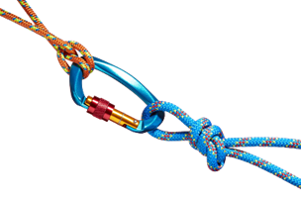

GPM framework for BPD Co Team
Organising framework
    Shared language
    Scaffolding and integration of diverse specialist therapies
    Clarity of roles and responsibilities
    Realistic expectations
    Helps manage countertransference
    Maintaining limits

Slide 23
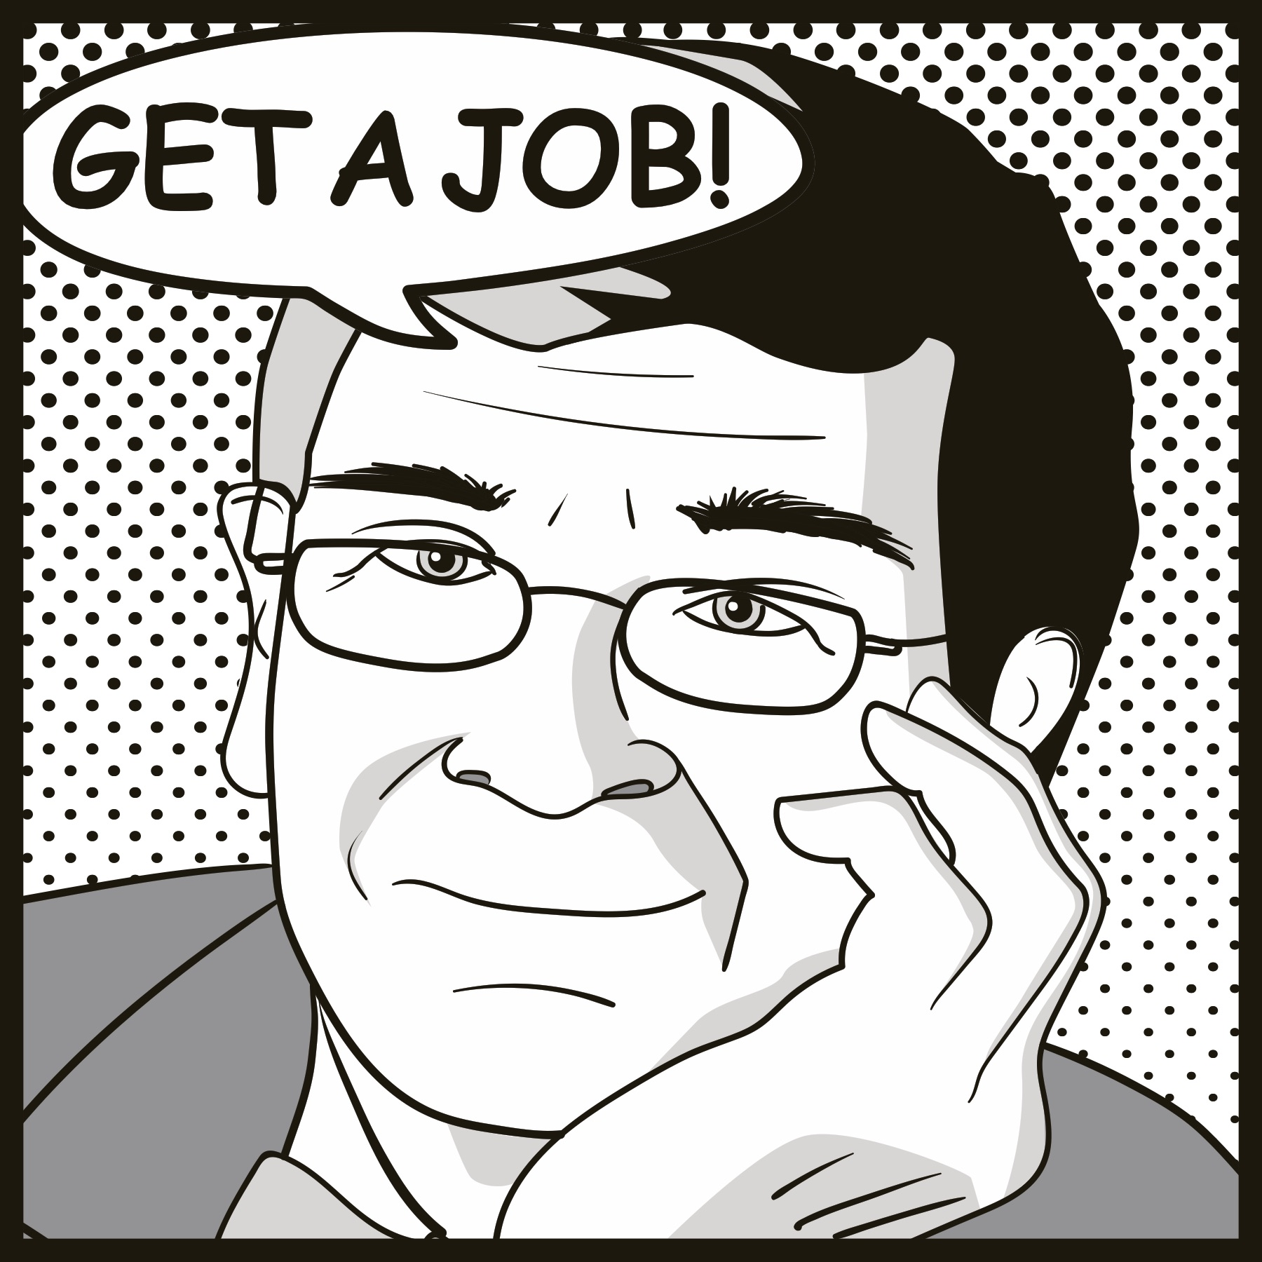

thank you
HEALTH.BPDSERVICE@SA.GOV.AU
GUNDERSONPDI@partners.org
McLean Gunderson
Personality Disorders Institute

Slide 24
END of presentation

