Slide 1


Personality disorders in primary care
What do we know?
What can we do?
Agenda
Mats Adler
Medicine doktor, specialist i psykiatri och allmänmedicin, affilierad forskare Klinisk neurovetenskap, Karolinska Institutet
Psykiatriutveckling.se
© Mats Adler, 2026, Illustrations from Shutterstock unless otherwise stated

Slide 2
Disclaimer
Mats Adler has received speaker fees from Janssen-Cilag AB and Frost Pharma AB.
© Mats Adler, 2023
© Mats Adler, 2026

Slide 3
Prevalence
Prevalence estimates in the general population range from 4% to 14.7% across studies^{1,6}
Primary care – very few studies
  London primary care study: ~24% prevalence²
  Swedish RCT in common mental disorders: 29.9% met criteria for personality disorder; most common were obsessive–compulsive (13.7%) and avoidant (12%)³
  Borderline personality disorder: estimated at ~6% in primary care⁷
In psychiatric outpatient settings, the prevalence is approximately 50%.^{4,5}
Prevalence of personality disorder (%)
Population Primary care Psychiatry
Torgersen S. Scandinavian journal of psychology 2009; 50(6): 624-32.
Moran P et al. Acta Psychiatr Scand 2000; 102(1): 52-7.
Ejeby, K. (2017). Doctoral thesis, Karolinska Institutet, Stockholm.
Beckwith et al. (2014). Personal Ment Health, 8(2), 91-101. doi:10.1002/pmh.1252
Ekselius L. Personlighetssyndrom - kliniska riktlinjer för utredning och behandling. Svenska Psykatriska föreningen, 2017.
Shadid J et al. The lancet Psychiatry 2025; 12(12): 932-46.
Dubovsky et al. The Medical clinics of North America 2014; 98(5): 1049-64.
© Mats Adler, 2026

Slide 4
Diagnos Prevalens i befolkningen över 18¹
Personality disorder 5-10,5%^{1,3}
Specific phobia 6-9 %
Alcohol use disorders² (Sweden) 8 %
Depression 5-7 %
Social anxiety disorder 2-7%
Panic disorder 2-3%
Generalized anxiety disorder 3 %
ADHD 2,5 %
Bipolar disorder 1,8 %
PTSD (Europe) 1%
Autism specrum disorder 1 %
Disorders of intellectual development 1%
Tic disorders (in school age) 0,3-0,8 %
Schizofrenia 0,3-0,7 %
Delusional disorder 0,2 %
Kupfer DJ, Regier DA. Diagnostic and statistical manual of mental disorders: DSM-5. –
5th ed. Arlington, VA, USA.: American Psychiatric Association; 2013.
Larsson G. Bättre insatser vid missbruk och beroende - Individen, kunskapen
och ansvaret. Stockholm: Regeringskansliet, 2011
Shadid J et al. The lancet Psychiatry 2025; 12(12): 932-46.
© Mats Adler, 2023
© Mats Adler, 2023

Slide 5
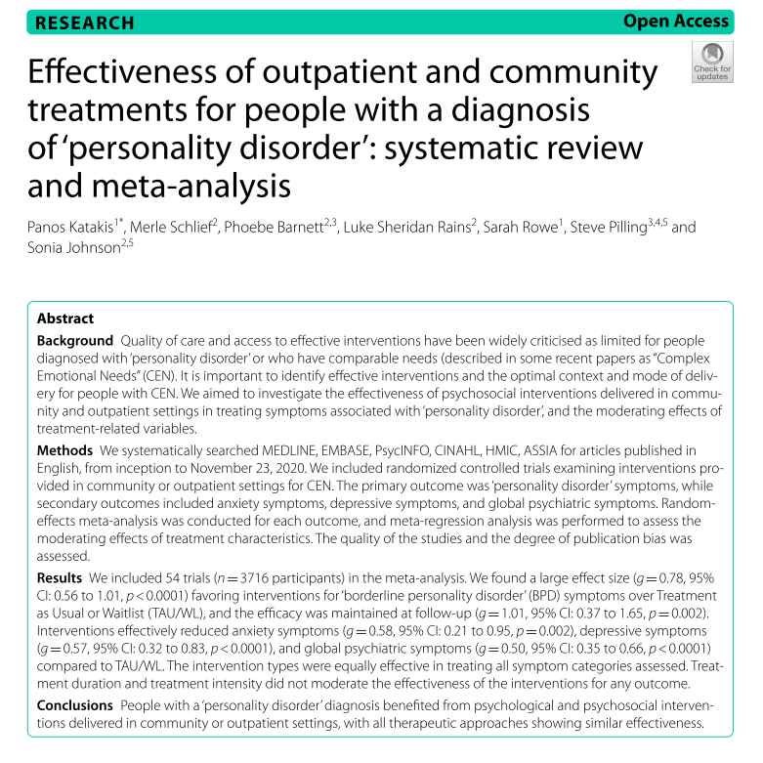
Treatment
Summary of outpatient treatments¹
Most were delivered by specialized teams or within specialist psychiatric outpatient care
Many different interventions: CBT, DBT, MBT, psychodynamic therapy, and less common therapy formats
Most often compared with waiting list or “treatment as usual”
All showed good and comparable effects
Katakis et al. BMC Psychiatry 2023; 23(1): 5
© Mats Adler, 2023

Slide 6
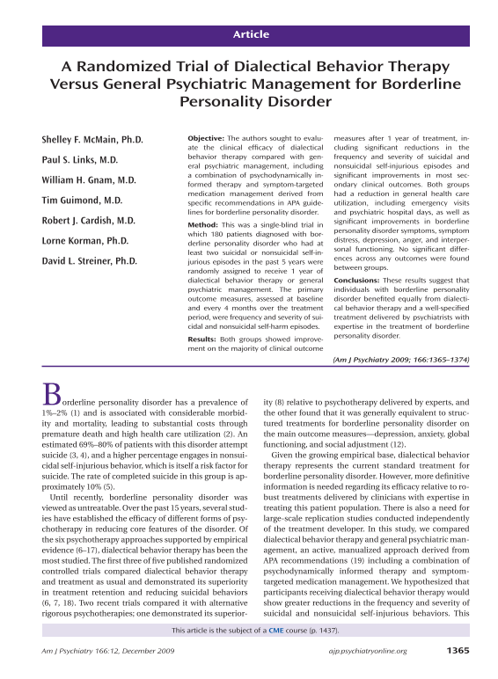
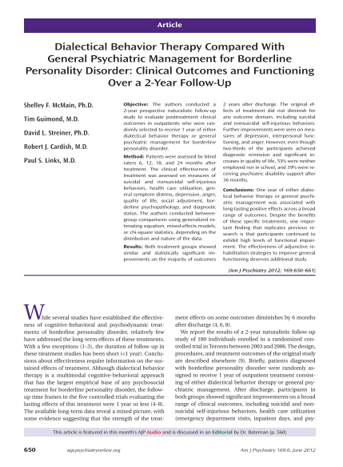
Good Psychiatric Management (GPM)
Shows that GPM ≈ DBT in effectiveness on key outcomes for bordeline personlaity disorder (e.g., self-harm)^{1,2}
Why is GPM of interest for primary care?
  Aligns with the tradition of generalist models that have shown comparable effectiveness in other studies
  Does not require specialized expertise
  Can be taught in a shorter training
  Builds on knowledge that healthcare staff already have
McMain SF et al. The American journal of psychiatry 2009; 166(12): 1365-74.
McMain SF et al. The American journal of psychiatry 2012; 169(6): 650-61.
© Mats Adler, 2026

Slide 7
Problems related to personality disorder in primary care in Sweden
Lack of time | Meet the general practice requirement of 1,100 patients
Lack of knowledge | More research specifically on diagnosis and treatment of personality disorder in primary care
Rarely diagnosed – methods are lacking | Use new diagnostic methods based on the updated definition of personality disorder in ICD-11
The term “personality disorder” is theory-laden and carries a risk of reification and pejorative connotations, which may contribute to clinicians’ reluctance to diagnose these conditions. | Training in how to communicate “unpopular” diagnoses effectively. Replacing the term with a descriptive one, for example “self- and interpersonal disorder.”
Treatment is lacking | Pending further research findings, teach and use GPM—and evaluate clinical outcomes.**
© Mats Adler, 2023
© Mats Adler, 2026

Slide 8
Problems related to personality disorder in primary care in Sweden
Lack of time | Meet the general practice requirement of 1,100 patients
Lack of knowledge | More research specifically on diagnosis and treatment of personality disorder in primary care
Rarely diagnosed – methods are lacking | Use new diagnostic methods based on the updated definition of personality disorder in ICD-11
The term “personality disorder” is theory-laden and carries a risk of reification and pejorative connotations, which may contribute to clinicians’ reluctance to diagnose these conditions. | Training in how to communicate “unpopular” diagnoses effectively. Replacing the term with a descriptive one, for example “self- and interpersonal disorder.”
Treatment is lacking | Pending further research findings, teach and use GPM—and evaluate clinical outcomes.**
© Mats Adler, 2023
© Mats Adler, 2026

Slide 9
Stepped care approach
GPM, DBT
or MBT in
psychiatry
Basic GPM in primary care
Diagnosis
Joint descriptive case formulation
The patient’s condition in descriptive terms
Diagnostic assessment
Comprehensive psychiatric assessment
Focused personality assessment based on ICD-11
© Mats Adler, 2023
© Mats Adler, 2026

