Slide 1


2nd International Conference on GPM for Personality Disorders
Karolinska Institutet • 5 May 2026
General Psychiatric Management for
Adolescent With BPD and
Eating Disorders
GPM-AED
Marcelo Brañas, MD, PhD | Marcos S. Croci, MD
Co-directors, ADRE-USP
Collaborators, GPDI, McLean Hospital
Notes:
[Brañas] Good morning, everyone! Thank you very much for the invitation. Drs. Kim Siscoe, Marcos Croci and I will present the GPM-A adaptation for co-occurring eating disorders — GPM-AED. I'll cover epidemiology, developmental overlap, and a bit of the clinical framework, which Marcos will walk you through. And Kim will present the clinical cases on young adults.

Slide 2
Disclosures
Marcelo Brañas, MD, PhD
No personal financial conflicts of interest.
Marcos S. Croci, MD
No personal financial conflicts of interest.
Both authors receive royalties from Manole Publisher (unrelated; section editors of clinical psychiatry books).
GPM-AED • 2 / 21
Notes:
[Brañas] Neither of us has personal financial conflicts to declare. We both receive unrelated royalties from Manole Publishers.

Slide 3
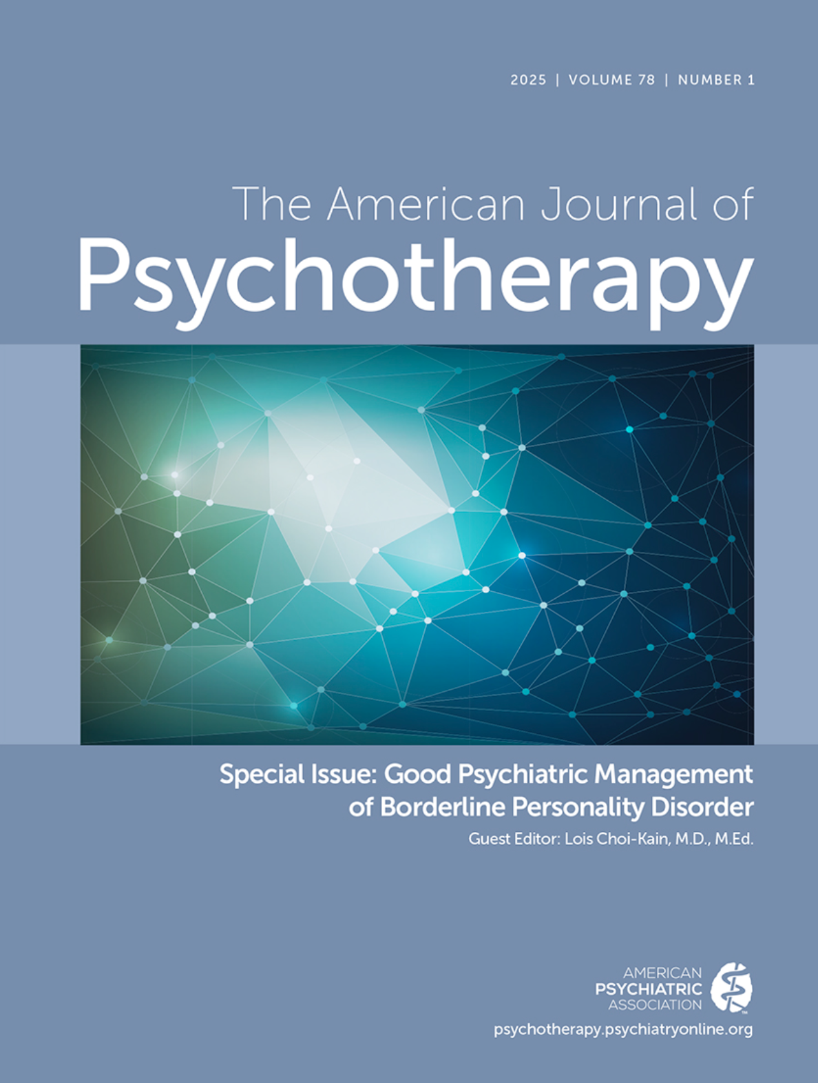
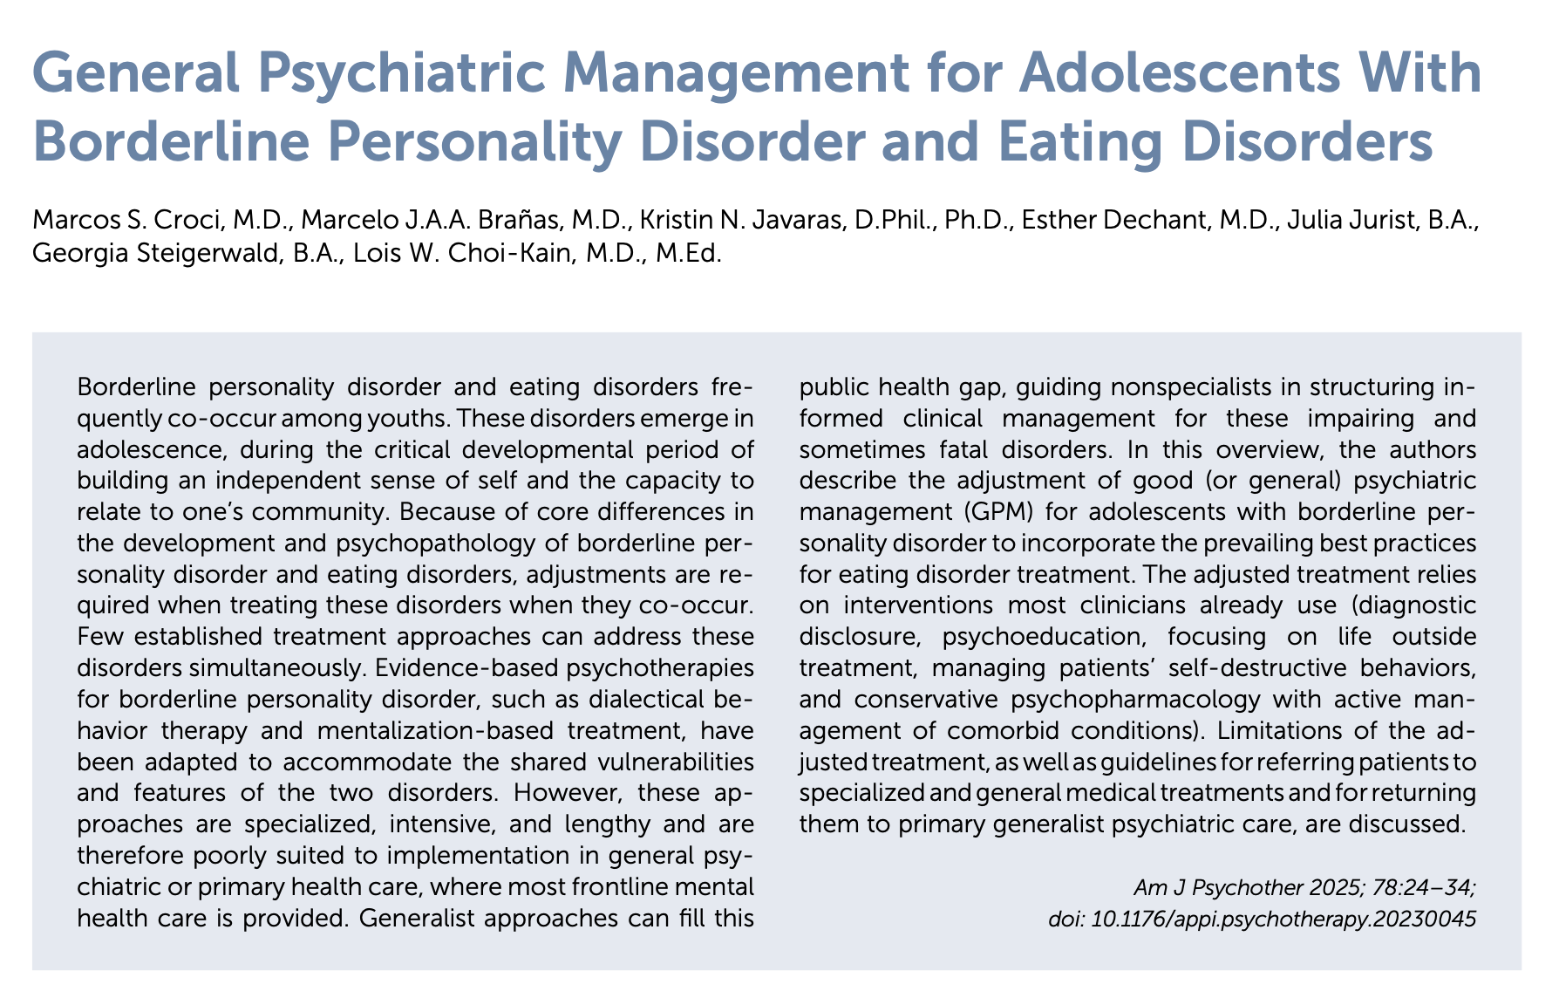
GPM-AED • 3 / 21
Notes:
[Brañas] The GPM-AED paper was published in 2025 in the American Journal of Psychotherapy. There’s will be a QR code at the end of the presentation if you'd like to read the full manuscript.

Slide 4
BPD and eating disorders emerge in adolescence
95%
The same developmental window:
■ Peak age of onset for most mental disorder is mid-adolescence (Solmi, 2022)
■ BPD symptoms peak in mid-adolescence (Cohen, 2005)
■ Adolescence = acquisition of self-regulation + identity formation
■ Strategic window for early detection and intervention
of ED cases onset in
YOUTH
Ward, 2019
Solmi, 2022 · Ward, 2019 · Cohen, 2005 · Dahl, 2018
GPM-AED • 4 / 21
Notes:
[Brañas] BPD emerges during adolescence and 95% of ED emerge in youth. Adolescence is the developmental period when teens are building their identity and acquiring more self-regulation capacity. So, this a strategic window for early intervention.

Slide 5
Prevalence in adolescents
Co-occurrence is common, not the exception
BPD in adolescents
EDs in BPD
Prevalence across settings
Comorbidity rates
Community samples
1.4–3%
Adults
17%
Outpatient clinics
11%
Adolescents
31–52%
Inpatient
50–53%
BPD in ED subtypes
EDs in community (adolescents)
AN (restricting)
5.5–7.9%
AN
0.3–0.4%
BN / AN binge-purge
borderline features
BN
0.3–0.9%
Restricting type → perfectionistic, avoidant traits
Binge/purge presentations → more BPD features
BED
0.62–3.6%
Subthreshold ED
5–11%
Clinicians must actively screen teens with BPD for ED.
Zanarini 2021 · Kaess 2013 · Jaite 2013 · Cassin 2005 · Lindvall Dahlgren 2017 · Laczkovics 2023 · Lekgabe 2021 · Gaudio 2011
GPM-AED • 5 / 21
Notes:
[Brañas] As you can see, the prevalence of EDs in BPD is much higher than the prevalence in the community. Around 30–50% of adolescents with BPD have an eating disorder which is two to three times the adult rate. Regarding the prevalence of BPD in ED subtypes, we have much less data. The restricting type of anorexia nervosa has a much smaller BPD co-occurrence. They have more perfectionistic and avoidant traits. And borderline features are common in binge/purge presentations. So for teens with BPD, we must actively screen for ED.

Slide 6
Shared developmental pathways
Not just co-occurrence — bidirectional longitudinal prediction
BPD symptoms at age 11
(late childhood)
predicts
Binge eating and purging by adolescence at age 16
Brown et al., 2019 · 'high-risk' BPD: 2–4× more likely to engage in binge/purge by 16
High disordered eating in early adolescence
predicts
Later BPD features later in adolescence
Lee & Vaillancourt, 2024
Shared risk factors: insecure attachment, adverse childhood experiences, emotional instability, impulsivity, rejection sensitivity.
Brown, 2020 · Lee & Vaillancourt, 2024 · De Poli, 2020
GPM-AED • 6 / 21
Notes:
[Brañas] And these aren't just two disorders that happen to co-occur. There is a bidirectional longitudinal association. BPD symptoms at age 11 predict binging and purging in adolescents at age 16. And high disordered eating in early adolescence predicts later BPD features lates in adolescence. They share risk factors too — insecure attachment, adverse childhood experiences, emotional instability, impulsivity, rejection sensitivity.

Slide 7
Similar presentations — one main critical difference
Why BPD treatment can be suboptimal
SHARED FEATURES
KEY DIFFERENCES IN CORE PSYCHOPATHOLOGY
■ Emerge in adolescence; disrupted identity formation
■ Emotional instability, rejection sensitivity
■ Impulsivity and self-destructive behaviors
■ Insecure attachment and ACEs as shared risk factors
■ Suicidality and elevated premature mortality
■ Recurrent, chronic course if untreated
BPD
Interpersonal hypersensitivity
→ symptoms activate in stressed relational contexts
EDs
Overvaluation of weight, body shape, eating behavior
→ self-worth organized around bodily control
→ Effective generalist treatment must target BOTH.
Treasure, 2020 · De Poli, 2020 · Fairburn, 2008
GPM-AED • 7 / 21
Notes:
[Brañas] Both disorders shared many aspects in their presentation, such as emergence in adolescence, disrupted identity formation….
But there is one main critical difference that makes the treatment for BPD only suboptimal for this teens. On top of the interpersonal hypersensitivity characteristic they have their self-worth tied to their weight, body shape and control over their eating. So, effective generalist treatment need to address both both.

Slide 8
Good Psychiatric Management — a 30-second recap
1
2
3
4
5
Diagnostic
Disclosure
Psycho-
education
Interpersonal
Hypersensitivity
Getting a Life
Conservative
Pharmacology
Name the diagnosis; frame it as treatable
Destigmatize, explain etiology, course and treatment
Case formulation anchor
Life outside treatment > treatment itself
Adjunctive; active comorbidity management
Today's question: what do we ADD/MODIFY when eating disorders are in the picture?
Notes:
[Brañas] Quick recap since this room knows GPM cold. It's anchored in five things: diagnostic disclosure, psychoeducation, the interpersonal hypersensitivity case formulation, 'getting a life' as the primary goal, and conservative pharmacotherapy with active comorbidity management. GPM-A is the adolescent version. The question for the rest of my time: what do we ADD when eating disorders are in the picture?Verbal cue: diagnostic disclosure is the entry point, but GPM principles work even when the patient declines the label. Kim's first case (Katie, AN-restricting type) will demonstrate this directly — Katie rejected the BPD diagnosis throughout admission, and the team applied GPM principles successfully anyway.

Slide 9
Why adapt GPM-A for BPD + eating disorders?
A generalist approach when specialists are scarce
ACCESS
EARLY INTERVENTION
Specialists for both disorders are scarce
Adolescence = best window to start the treatment
Comorbidity is common; generalist care must reach both.
Outcomes are better when we treat before chronicity sets in.
SPECIFICITY
STEPPED-CARE
BPD treatment alone misses ED psychopathology
Specialized care for non-responders
We add ED-specific interventions to existing GPM-A.
Step up for severe or treatment-resistant cases.
Generalist-first, specialist-when-needed — same logic as GPM-A.
GPM-AED • 8 / 21
Notes:
[Brañas] So here we listed four of the main reason to adapt GPM-A for comorbid ED. Access: specialists for both disorder are scarce and comorbidity as you saw is common. So, generalists treatment have to reach both. Early Intervention: adolescence is the best window to start treatment before chronicity sets in. Specificity: BPD treatment alone misses ED psychopathology, that is why we have to add ED-specific interventions. Stepped-care: for cases which do not respond or are more severe, we refer to specialist care.

Slide 10
Core psychopathology — fundamentally different
One slide on why generalist treatment must target BOTH
BPD — INTERPERSONAL HYPERSENSITIVITY
EDs — WEIGHT & SHAPE OVER-EVALUATION
Self-evaluation, untreated:
Other
3%
Interpersonal
stress
Intense
emotional reaction
Family
6%
Friends
6%
School
15%
Return to baseline
with support
Self-worth anchored on shape, weight, control of eating
Symptoms activate in stressed
relational contexts: self-harm, anger
impulsivity, suicidality
→ Target: interpersonal hypersensitivity
→ Target: rebalance self-evaluation beyond bodily control
Treating BPD alone leaves the some of the ED process aside. Generalist treatment can target BOTH.
Fairburn, 2008 · Stanley et al., 2018
Notes:
[Brañas] The fundamental difference in one slide. On the left, BPD: a stressor-reaction-support cycle. Interpersonal stress triggers intense emotional reaction — self-harm, anger, impulsivity, suicidality — and support or holding brings the patient back toward baseline. The target is interpersonal hypersensitivity. On the right, EDs: the self-evaluation pie is 70% weight, shape, and control of eating. Everything else — family, school, hobbies — gets crushed. The target is rebalancing self-evaluation. If we treat BPD alone, we leave the ED process untouched. That's why GPM-AED has to target both.

Slide 11
Interpersonal Hypersensitivity Model — with ED symptoms
Connectedness
idealizing, dependent, rejection-sensitive
Interpersonal stress
Feeling Threatened
devaluative, self-injurious, angry, anxious, help-seeking, binge eating, purging, weight-loss drug use
Support by the other
(↑ involvement, rescue)
Withdrawal by other (physical or emotional)
Aloneness
dissociation, paranoia, impulsive, help-rejecting, greater severity of eating disorder symptoms
Holding
(hospital, jail, rescue)
Despair
suicidal, anhedonic
Adapted from Gunderson & Links, 2014
GPM-AED • 9 / 21
Notes:
[Brañas] Here we have the classical interpersonal hypersensitivity model as we all know but adapted for comorbid ED symptoms. In the connected state, patients are relatively stable — prone to rejection sensitivity. Interpersonal stress pushes them into feeling threatened, where binge eating, purging, and weight-loss drug use appear alongside self-harm. Without support, they fell alone— dissociation, greater ED severity appears alongside help-rejecting attitude. Later Marcos will show this model applied to a case example.

Slide 12
Intrapersonal Hypersensitivity — the ED-specific process
Triggers: interpersonal (social evaluation) • intrapersonal (internal cues, perfectionism) • guilt/shame from eating behaviors
Interpersonal (social evaluation) or intrapersonal (internal cues, perfectionism) stressors or guilt or shame caused by eating disorders
VULNERABLE SELF
Sensitive to social evaluation specific to eating, body shape, or weight; vague discomfort
SELF-DISTURBANCE
Feeling fat and other negative self-evaluations; poor self-regulation; impulsivity
Compensatory behaviors in eating disorders (e.g., restricting, purging)
Self-standards;
perfectionism
Habits
WITHDRAWAL
Dissociation; social isolation; self-absorption; severe eating control strategies
This loop can be triggered WITHOUT an interpersonal stressor — by hunger, a broken food rule, or emotional distress.
DESPAIR
Suicidality; extreme control strategies; malnutrition
GPM-AED • 10 / 21
Notes:
[Brañas] However, for cases where the ED psychopathology is more central to the self, we have to adapt the model even further. So we have the intrapersonal hypersensitive model, where the vulnerable self is sensitive to social evaluation specific to eating, body shape or vague body discomfort. When the teen feel they lost control over eating, self-disturbance increases, with feeling of being fat, alongside poor self regulation and impulsive behaviors. They can withdrawal from social interactions, being self-absorbed, dissociated and using severe eating control strategies, which can lead to malnutrition and other complications. They use compensatory behaviors such as restricting and purging to get back to a sense of control and self worth. And since they do not engage in healthier eating habits, they are lost in this loop.

Slide 13
GPM-A principles and structure — adapted for eating disorders
GPM-A principle
ED adaptation
Interpersonal hypersensitivity model
Integrate with eating-disorder model
Psychoeducation
Add ED knowledge — for patient AND family
Active, non-reactive stance
Actively search for ED behaviors and triggers
Pragmatic and flexible formulation
Include ED symptoms in the case formulation
Getting a life
Life > body over-evaluation
Safety management
Add evaluation of ED physical-health risks
Eclectic interventions
Include ED-specific adaptations
Coordinated split-treatment
Dietitian, FBT, ED specialist when needed
Croci et al., 2025
GPM-AED • 11 / 21
Notes:
[Croci] As Marcelo mentioned, these patients with this particular comorbidity have different mechanisms leading to their symptoms. So, we needed to make some adaptations of GPM-A to accommodate for these differences, as you can see in this slide. For example, we are active in searching for ED behaviors. Getting a life is still important and we convey this idea that life is larger than body over-evaluation; Safety management includes physical health risks. We also added some interventions that were not initially designed for a standard GPM-A.

Slide 14
Eight add-on interventions
INTERVENTION
DESCRIPTION
Eating regularly
Sit down for meals and snacks at regular intervals (e.g., 3 meals + 2–3 snacks/day)
Psychoeducation on EDs
Weight fluctuation, limited control overweight (strong genetic influence), medical complications
Eating styles
Reduce anxiety around weighing oneself too frequently or avoiding the body; optional when patient is not underweight
“Feeling fat” / “Feeling full”
Work with the patient toward accepting emotions, the body, and physical sensations
Family interventions
Psychoeducation on the ED, structured regular eating, avoiding unhelpful comments
Collaborative weighing
Reduce anxiety around weighing; optional when patient is not underweight
Body checking & avoidance
Identify and monitor ED behaviors; engage patient in critical appraisal to promote change
Safety management
Evaluate suicidality and physical complications of EDs
Table 1, Croci, Brañas et al., Am J Psychother 2025
GPM-AED • 12 / 21
Notes:
[Croci] These are eight add-on interventions. I won't read them all. But as you can see, these are not things we usually do with every adolescent with BPD. However, they are not interventions that only an expert in ED should do. For example, guiding the patient towards eating regularly and psychoeducation on ED is something we learn how to do.

Slide 15
Dual Focus: Assessment and Safety Management
Two parallel tracks: psychiatric and physical
INITIAL ASSESSMENT · OUTCOMES
SAFETY MANAGEMENT
Actively investigate eating behaviors
weight cycles, excessive exercising, compensatory behaviors, dietary rules, body checking — ask early and routinely.
SCOFF — quick 5-question screen (≥2 “yes” = suspect ED)
Sick · Control · One stone · Fat · Food
EDE-Q
Eating Disorder Examination Questionnaire — use at baseline and follow-up as a shared outcome measure.
When
at initial evaluation · signs of malnourishment/weight loss · binge / purge behaviors
What
physical exam · weight & height · vitals · labs · EKG
Red flags
underweight or rapid weight loss · purging with medication misuse · vital signs· delayed pubertal development · obesity or rapid weight gain
Severe cases → refer to specialist
GPM-AED • 13 / 21
Notes:
[Croci] So, getting into some specifics. Two parallel tracks: psychiatric and somatic — and it may sound obvious, but evaluation has to come first. Worth remembering: some BPD interviews do touch on ED symptoms, but these often get lost in the middle of broader evaluations. And although some ED patients are underweight, you cannot tell whether someone has an eating disorder just by looking — so active inquiry matters. Tools help: SCOFF is a well-known rapid screening tool, and the EDE-Q gives us a shared baseline-and-follow-up measure. But what really matters is asking actively. Beyond assessment, on safety management — go past self-harm and suicidality to assess ED-specific risk signals as well; eating disorders are among the deadliest psychiatric conditions. Pay particular attention to signs of malnourishment, rapid weight loss, and the binge–purge cycle.

Slide 16
Engagement and Interventions for Initial Sessions
Four components of the opening phase — motivation is where the work is
1
2
3
4
Rapport Building
Building Motivation
Psychoeducation
Case Formulation
Support and validation. A non-judgmental stance toward eating and bodily shame.
Motivational-interview style questions that elicit the patient’s own reasons to change.
Explain ED + BPD in plain language. Use a ‘no blame’ etiology frame — for patient and family.
Preliminary, collaborative map of triggers, emotions, and behaviors — built in session with the patient.
Motivational questions · examples
03 What role do emotions play around binging?
Frame eating as a way of not-feeling — opens space for affective work.
04 What kind of life do you want — and how does binging fit into that?
Bridges to ‘getting a life’ — the GPM core that anchors long-term change.
01 What does binging do for you?
Open the patient’s own account of function — regulation, escape, comfort.
02 How does it affect your relationships?
Link eating behavior to interpersonal life — the shared terrain of BPD + ED.
GPM-AED • 17 / 25
Notes:
[Croci] This matters for every adolescent with BPD, but it is especially important in this population — how do we engage these patients into treatment. The four components on screen do not need to happen in this order; they are interventions to build insight, participation, and therapeutic alliance. First, support: validation, equally important and often more challenging here, especially when you are worried about the patient's health or you suspect the patient is not disclosing all ED symptoms. Building motivation can also help — raising awareness of what the eating behaviors do for them and how they get in the way of the life they want. Sharing data about ED in a tactful, digestible way helps reframe these as signs of a disorder rather than habits. And then a preliminary case formulation, drawn collaboratively with the patient — showing how interpersonal hypersensitivity and intrapersonal sensitivity feed into, for example, the binge–restrict cycle. The next slide shows what that formulation looks like for a real case.

Slide 17
Preliminary Collaborative Formulation
Maria, 13 years old
ED LOOP
Feeling OK (baseline)
Purging and Restricting
Stressor — Intra or interpersonal
(e.g., friend didn’t reply a message)
ED behaviors: restricting, exercise, purging
ED self-process
1
Angry, sad, self-harming thoughts
Binge Eating
ED self-process (e.g., negative
self evaluations)
If rejection persists; if high on perfectionism
Lack of
structure
(irregular habits)
Withdrawal
Despair
GPM-AED
Notes:
[Croci] This is the case formulation we'd build collaboratively with Maria — 13 years old. The diagram is the interpersonal hypersensitivity model from earlier, now with ED behaviors layered in. Walk it left to right. Baseline 'feeling OK,' then a stressor — interpersonal here, friend didn't reply a message. That triggers angry, sad, self-harming thoughts. From there, two parallel processes: the BPD self-process pulls toward withdrawal and despair; the ED self-process pulls toward negative self-evaluations. If rejection persists, especially with high perfectionism, both intensify. The ED loop kicks in: lack of structure, irregular eating habits, restricting, exercise, purging — that's where the eating behaviors live as regulation strategies. Building this in session does two things. One: it externalizes the pattern, so Maria can see it instead of being inside it. Two: it gives you and her a shared map for what to target — the interpersonal trigger, the affective storm, OR the ED behaviors. You can intervene at any point in the loop, and the formulation tells you where she's most ready to start.

Slide 18
In session: regular eating and coping with binge/purge
The most impactful intervention + what to do when it breaks down
REGULAR EATING — most impactful
COPING WITH BINGE / PURGE
3 meals + 2–3 snacks / day
Binge analysis (chain analysis)
Map triggers: what happened before? feelings? thoughts? relational context?
planned intervals · seated at a table
■ Patient owns their eating habits when possible
■ Parental support when severity requires it
■ Avoid grazing, multitasking, fast eating, between-meal eating
■ Expose to varied foods and settings
■ Dietitian support when available
Skills for mood lability
Counting breaths, grounding, calling a friend, short walk — emotions are temporary.
Environmental structure
Post-meal plans, avoid the bathroom after meals, eat with family when possible.
Dalle Grave & Calugi, 2020
Safer et al., 2017 · Robinson et al., 2019
GPM-AED • 16 / 21
Notes:
[Croci] Eating regularly means structuring meals to cut down long fasting windows, which raise the likelihood of binge eating. This is consistent with GPM because it relates to case management; the same way you know where the patient goes to school and where they live, you need to assess the structure of their eating habits.
It also lowers patient anxiety over the long run and promotes healthier patterns — including eating with the family, so meals shift from pure calorie intake to a social behavior; eating is not only calories. Sometimes that is not possible: there is no structure at home, parents are away, the adolescent cannot structure meals on their own. Family involvement usually helps, though some teenagers will not collaborate. The other intervention is the analysis of binging and purging — looking at the situations in which the behavior happened. It is the same chain analysis you would do for self-harm, applied to an ED behavior.

Slide 19
Getting a Life: Addressing Weight Over-Evaluation
Other
3%
Shape, weight and eating
20%
Family
6%
Other
15%
Friends
6%
Music
10%
School
15%
Family
10%
Sports
10%
Shape, weight and eating
70%
Friends
15%
School
20%
Patient with eating disorder
Patient after treatment
Short-term goals
Case management
Foster identity separate from ED
Adapted from Fairburn, 2008 · Dalle Grave & Calugi, 2020
GPM-AED • 17 / 21
Notes:
[Croci] This is a core goal of GPM — getting a life larger than weight preoccupation, and fostering an identity separate from the eating disorder. You can have a conversation about goals and draw a diagram like this one — it is adapted from Fairburn's work — so the adolescent can visualize concretely what their life can look like when shape, weight, and eating concerns shrink and other domains carry real weight again. Drawn collaboratively in session, it is also a powerful motivational tool: it makes the goal tangible, it anchors the short-term work in concrete activities outside treatment, and it gives us the therapeutic questions — what did you enjoy before the ED took over? What do you want to be doing? Who do you want to be?

Slide 20
Involving the family
Allies — not therapists, not adversaries
PSYCHOEDUCATION
SUPPORT STRUCTURED EATING
ADDRESS BARRIERS
Etiology is complex — 'no blame'
Help, don't battle
Evaluate what's blocking recovery
Family response influences improvement. The ED causes the symptoms — not bad parenting.
Structure meal times, focus on problems pragmatically, avoid power struggles around food.
Comments on eating/body ('fat talk'), parents' own eating habits, expressed emotion/criticism.
The clinician guides the structure. Families carry out day-to-day support.
GPM-AED • 18 / 21
Notes:
[Croci] As in regular GPM-A, family involvement matters in most cases. The first thing — for us as clinicians and then for the family themselves — is no blame. Just like BPD, ED has biological and genetic components; and a parent who feels blamed by the clinician will not collaborate with the treatment. Second, support structured eating. We coach the family to build this routine: schedule mealtimes, avoid difficult topics at the table, lower anxiety around eating, so the meal becomes more than calorie intake — a moment to spend time together, without criticism. Third, address parental behaviors that can feed the ED — particularly comments on eating and bodies. This is common, and it has to stop. Sometimes a parent will say "it was just a joke" — and we need to be firm: those comments can trigger ED symptoms.

Slide 21
Comorbidity and conservative psychopharmacology
Medication is adjunctive, not primary
PRIORITY ASSESSMENT
BE CAREFUL WITH
Does the comorbidity block engagement in GPM?
Stimulants
Appetite suppression → worsens restriction
If yes: severe SUD, mania, complex PTSD, severe ADHD — manage first.
If no: proceed with GPM-AED; many depression/anxiety symptoms improve after ED treatment.
Bupropion
Seizure risk in EDs → avoid
Atypical APs
Weight gain → discuss openly if needed
RULE OF THUMB
Borderline symptoms predict persistence of depression, but the converse is not true — treat BPD to help depression.
SSRIs
Ineffective in malnourished patients;
helpful for persistent depression/anxiety/OCD
GPM-AED • 19 / 21
Notes:
[Croci] Comorbidity and psychopharmacology are handled much as in regular GPM-A, with a few things to keep in mind for this population. ADHD is common in these patients, so be careful with psychostimulants — they suppress appetite and can drive further weight loss. Atypical antipsychotics can also be problematic; there is some evidence of improvement, and they can be useful in AN where weight gain is therapeutic, but pushed without an honest conversation they tend to destroy the therapeutic relationship — the cost is rarely worth it. And most importantly: antidepressants do not work in malnourished patients. The "depression" you are seeing will often improve once the patient is eating properly and nutrition is restored — treat the ED first, and reassess depression and anxiety after.

Slide 22
Take-home
01
Adolescent window
BPD and EDs both emerge in adolescence — the critical period for self and identity.
02
Different cores
Interpersonal hypersensitivity (BPD) vs. weight/shape over-evaluation (ED). Treat BOTH.
03
GPM-AED
A generalist framework for mild–moderate ED + BPD — usable when specialists aren't.
04
Safety first
Low BMI, rapid weight loss, purging + medication misuse, delayed puberty, severe malnutrition → refer early.
05
Stepped care
Specialized treatment reserved for non-responders and severe cases — clear referral pathways.
GPM-AED • 20 / 21
Notes:
[Croci] Five take-homes. One — adolescence is the window: BPD and ED both emerge here, the critical period for self and identity. Two — different cores: interpersonal hypersensitivity for BPD versus weight and shape over-evaluation for ED. Generalist treatment has to target both. Three — GPM-AED is a generalist framework for mild-to-moderate ED with BPD, usable when specialists aren't available. Four — safety first: low BMI, rapid weight loss, purging with medication misuse, delayed puberty, severe malnutrition all trigger early referral. Five — keep the stepped-care logic: specialist treatment is reserved for non-responders and severe cases, with clear referral pathways back to generalist care once stable.

Slide 23
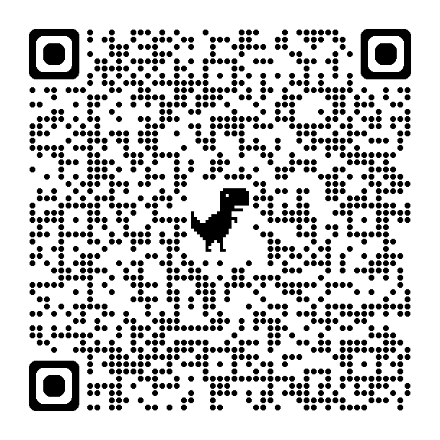
Tack!
Thank you!
Acknowledgments
SENIOR AUTHOR
Lois W. Choi-Kain, MD, Med, DFAPA
CO-AUTHORS
Kristin N. Javaras, DPhil, PhD
Esther Dechant, MD
Julia Jurist, BA
CONTACT
Georgia Steigerwald, BA
marcelo.branas@usp.br
marcos.croci@fm.usp.br
ACKNOWLEDGMENTS
Aline Cho, MD
Fellipe Augusto, PsyD
Sofia Senço, MD
SCAN FOR THE FULL PAPER
doi:10.1176/appi.psychotherapy.20230045
Karolinska Institutet · 5 May 2026
Notes:
[Croci] Thanks to Lois Choi-Kain and the McLean collaborators, and to the ADRE team at University of São Paulo — this is genuinely collaborative work. Our emails are on screen. Happy to take questions.Closing verbal transition before the Tack slide: "That is the framework. Kim Siscoe is going to bring it to life with two patients from her inpatient/residential ED unit. The first is a young woman with AN-restricting type who rejected the BPD diagnosis throughout her entire admission — and the team still applied GPM principles successfully. The second has OSFED, with interpersonal hypersensitivity playing out across the whole milieu, including a wheelchair dependence with no medical justification. Her cases illustrate almost every principle we have just walked through — chain analysis, validation without reinforcement, working with staff and peer dynamics, and getting a life beyond the eating disorder."

